Slide 1
GTAC Workshop – 17th November
17 November 2017

Slide 2
Workshop Agenda
GTAC deferred items
Peaking / hourly overruns
Interconnected parties
ERM and D+1 arrangements
Tolerances
Priority rights
Mechanics of extra nominations cycle
Worked examples (trading and incentive charge rebates)
Transitional arrangements for 1 October 2018
Next steps

Slide 3
GTAC Deferred Items

Slide 4
Peaking / hourly overruns

Slide 5
Maximum Hourly Quantities (standard)
DNC provides both MDQ and MHQ
MHQ is 1/16th of MDQ
i.e. MHQ/MDQ = 0.0625
i.e. MHQ = 1.5 × average HQ
Compare this with the MPOC:
at Delivery Points MHQ = 1.25 × HSQ
at Receipt Points MHQ = 1.5 × HSQ
HSQ is 1/24th of the SQ

Slide 6
Importance of MHQ
HQ is important: the higher the HQ/DQ ratio the “peakier” the load
Peakier loads use (physical) capacity less efficiently:
Deplete line pack disproportionately per GJ of DQ
Minimum line pack (pressure) may reduce capacity available to others
→ Decreased total throughput, higher prices
Pipelines and other equipment need to be sized for peaks
→ Lower average asset utilisation, higher prices
Higher pressure differentials may increase compression costs
→ Higher prices

Slide 7
Specific HQ/DQ
Shippers’ HQs are only available at Dedicated Delivery Points
→ Hourly Overrun Charges (HOCs) are only calculable at Dedicated DPs
There is a materiality threshold: we have set it at an HQ of 200 GJ
Some large loads may use more capacity each hour than 1/16th of MDQ
A Shipper can increase DNC, and therefore MHQ, via Intra-Day NQs
The Specific HQ/DQ effectively provides a higher MHQ
To be set case by case
Annually, ahead of a Year
Not applicable to Supplementary or Interruptible Agreements

Slide 8
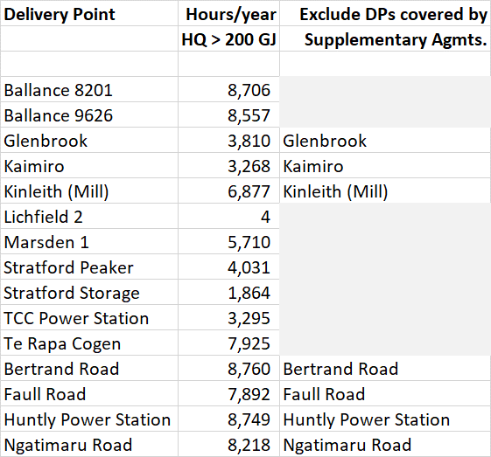
Delivery Points With HQ > 200 GJ

Slide 9
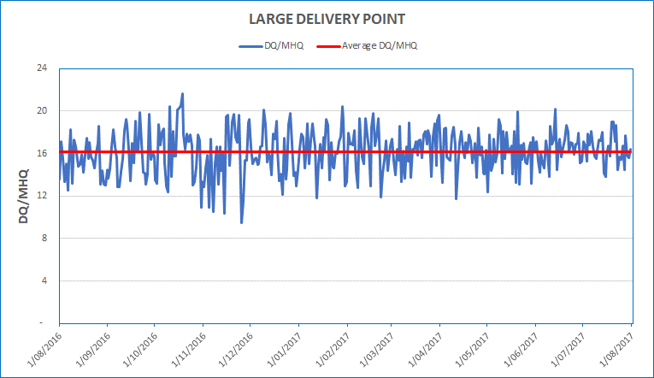
Example: A Site From That List

Slide 10
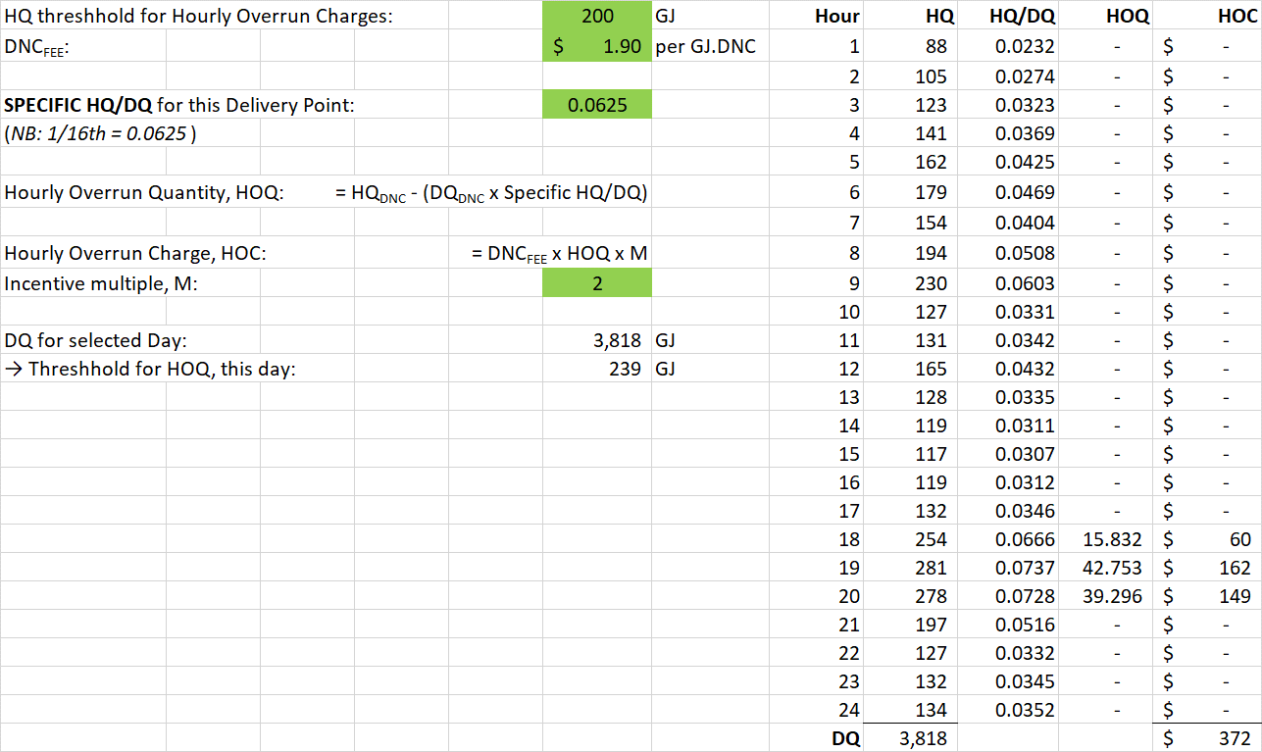
Example: HOC Calculation for One Day

Slide 11
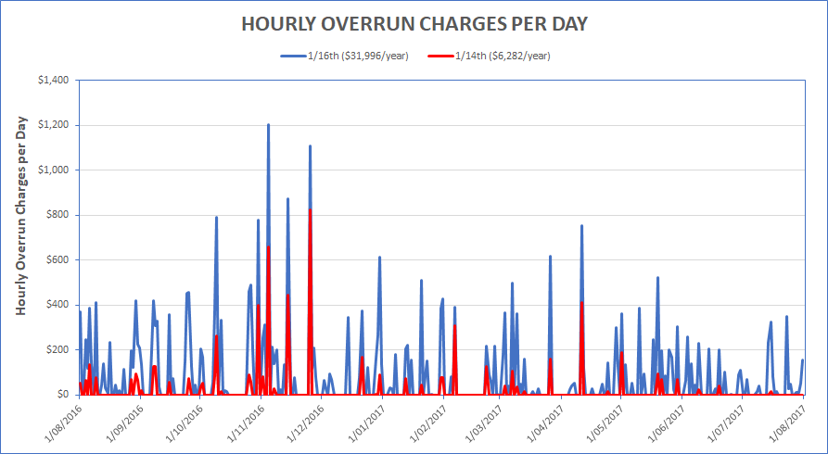
Example: HOCs For Whole Year

Slide 12
Agreed Hourly Profile
Specific HQ/DQ and MHQ of MDQ/16 are not intended to be dynamic.
Some shippers may value greater ability to peak
Increasing MHQ via an Intra-Day NQ may be too expensive due to
DNC Charges are for the Day
Peaking may be just for a few hours
An alternative may be an Agreed Hourly Profile (AHP):
A schedule of Hourly transmission capacity, for a full or part Day
Applied for in advance via normal nominations cycles
First Gas is considering options on how the AHP functions:
An AHP effectively substitutes for, or replaces DNC
An AHP is supplementary to the DNC and defines a higher peak

Slide 13
Option 1: AHP as a Replacement to DNC - Example
Say a Shipper has DNC of 20,000 GJ
MHQ is 1,250 GJ (i.e. 1/16th)
Before (say) ID3 the Shipper decides it needs greater transmission capacity between 18:00 and 20:00
At ID3 the Shipper applies for an AHP, i.e.:
18:00 to 19:00: 2,000 GJ
19:00 to 20:00: 3,000 GJ
20:00 to 21:00: 2,000 GJ
21:00 to 22:00: 1,000 GJ
22:00 to 23:00: 1,000 GJ
23:00 to 24:00: 1,000 GJ

Slide 14
Option 1: AHP as a Replacement to DNC - Outcomes
Deemed capacity use, 00:00 to 18:00 = 20,000/24 × 18, i.e. 15,000 GJ
The AHP equates to 10,000 GJ of capacity, i.e. sum of HQs
The DNC_{FEE} applies to GJ of both DNC and AHP:
i.e. Capacity charge for the Day = DNC_{FEE} × (15,000 + 10,000) GJ
Liable for Daily overrun charges if DQ > (15,000 + 10,000) GJ
Liable for Daily underrun charges if DQ < (15,000 + 10,000) GJ
Liable for HOCs if:
00:00 - 18:00, Hourly offtake > 1,250 GJ (i.e. while DNC applies)
18:00 – 24:00, Hourly offtake > relevant HQ under the AHP

Slide 15
Option 2: AHP supplementary to DNC - Example
Say a Shipper has DNC of 20,000 GJ
MHQ is 1,250 GJ (i.e. 1/16th)
Before (say) ID3 the Shipper decides it needs greater transmission capacity between 18:00 and 20:00
At ID3 the Shipper applies for an AHP, i.e.:
18:00 to 19:00: 1,000 GJ
19:00 to 20:00: 2,500 GJ
20:00 to 21:00: 2,000 GJ
21:00 to 22:00: 1,000 GJ
22:00 to 23:00: 1,000 GJ
23:00 to 24:00: 1,000 GJ

Slide 16
Option 2: AHP Supplementary to DNC - Outcomes
The DNC_{FEE} applies to GJ of the revised DNC:
i.e. Capacity charge for the Day = DNC_{FEE} × 30,000 GJ
Liable for Daily overrun charges if DQ > 30,000 GJ
Liable for Daily underrun charges if DQ < 30,000 GJ
Liable for HOCs if:
00:00 - 18:00, Hourly offtake > 1,250 GJ
18:00 – 24:00, Hourly offtake > 1,250 + HQ under the AHP
To obtain an MHQ of e.g. 3,750 GJ, DNC of 60,000 GJ would be required and avoid HOCs

Slide 17
Interconnected parties

Slide 18
ERM and D+1 arrangements

Slide 19
Tolerances

Slide 20
Line Pack Flexibility
First Gas will make available portions of the line pack for parties to accommodate variances between nominations and metered quantities.
When conditions allow, First Gas will also make available portions of the line pack for park and/or loan services
Shippers Flexibility | OBA Parties Flexibility
T_{SHIPPERS} is the quantity of Line Pack periodically determined by First Gas and published on OATIS | T_{OBAPS} is the quantity of Line Pack periodically determined by First Gas and published on OATIS
Park and Loan Availability

Slide 21
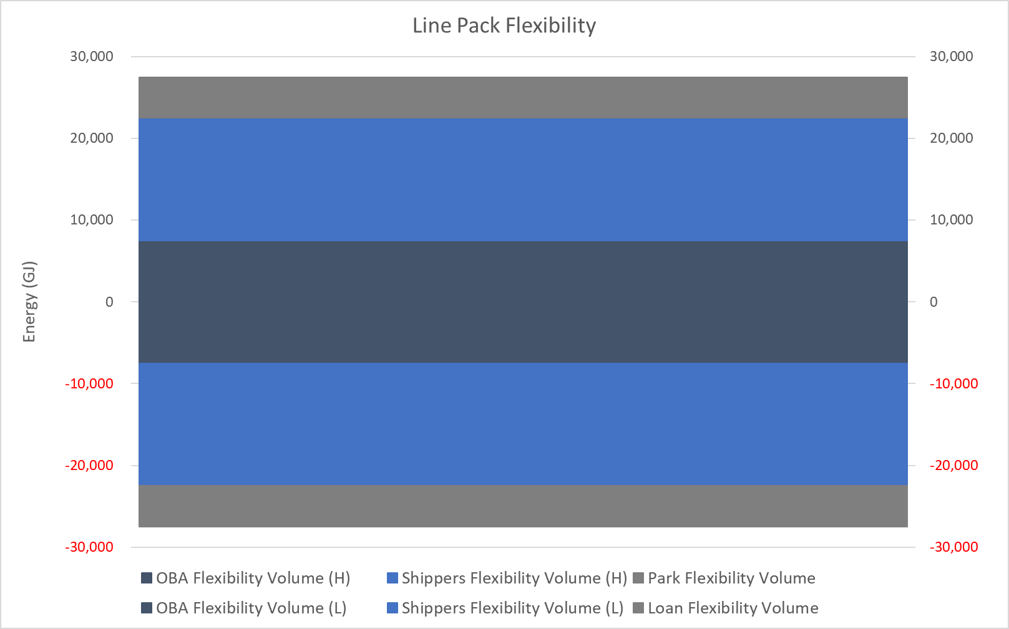
Line Pack Flexibility
Below is an example of how the Line Pack Flexibility may be allocated

Slide 22
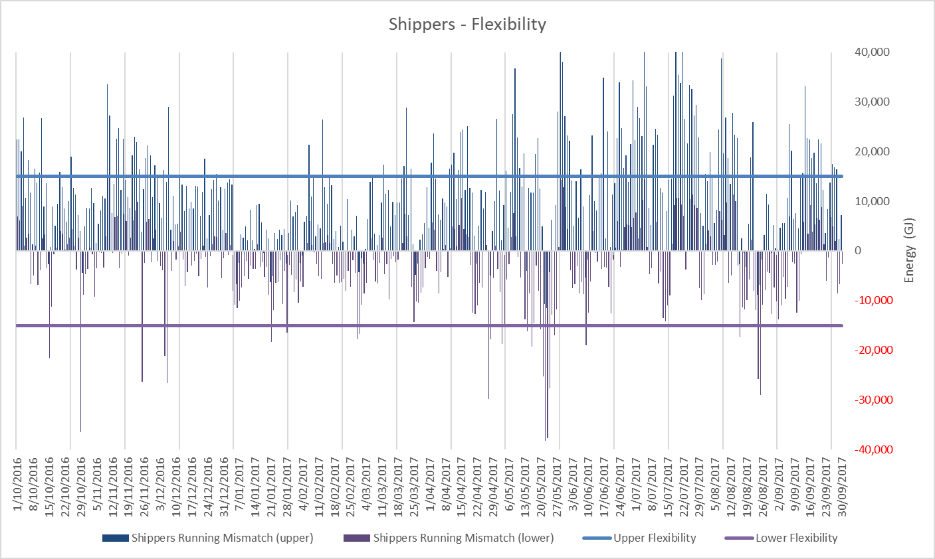
Line Pack Flexibility
Below is an example of how the Line Pack Flexibility may be allocated to Shippers

Slide 23
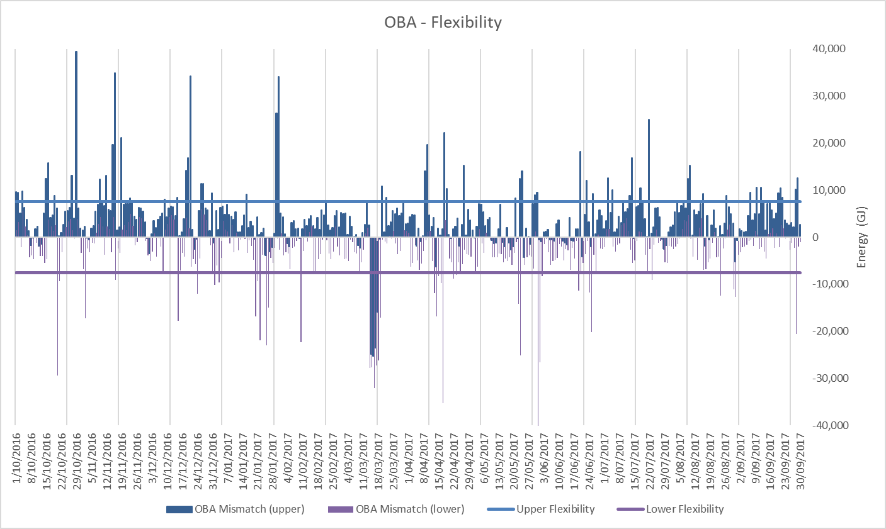
Line Pack Flexibility
Below is an example of how the Line Pack Flexibility may be allocated to OBA Parties

Slide 24
Priority Rights

Slide 25
Nomination Cycle Mechanics

Slide 26
Prior to Day Nomination Cycles
Provisional NQ may be submitted at any time prior to the Provisional Nomination Deadline for the week
The NQ may exceed the shippers DNC under their TSA with First Gas with actual flows not in line with DNC subject to overrun/underrun charges
Provisional Nomination Deadline
XX:00 Last business day of the week
Provisional NQ for each day
OBA Party Confirmation
XX:00+00:30
First Gas Response
XX:00+01:00
Monday
Tuesday
Wednesday
Thursday
Friday
Saturday
Sunday
Changes to any Provisional NQ may be submitted at any time prior to the Changed Provisional Nomination Deadline
If there are no changes, the Provisional NQ becomes the Changed Provisional NQ and is considered by First Gas for acceptance
Changed Provisional Nomination Deadline
XX:00 D-1
Changed Provisional NQ for D+1
OBA Party Confirmation
XX:00+00:30
First Gas Response
XX:00+01:00
D+1

Slide 27
Intra-Day Nomination Cycles
Four Intra-Day Nomination cycles will be held at 22:00, 10:00, 14:00 and 18:00
Shippers may submit changes to any NQ prior to the Intra-Day Nomination Deadline
Intra-Day Nominations Deadline
XX:00 D
Intra-Day NQ for D
OBA Party Confirmation
XX:00+00:30
First Gas Response
XX:00+01:00
D
First Gas approves NQs based on:
Available Operational Capacity
Interruptible Capacity
Priority Rights
For Intra-Day nominations:
Decreases in NQ cannot be less than the proportion of the last approved DQ deemed to have flowed up to that point in the day
Changes to agreed hourly profiles cannot be less than the sum of agreed hourly profile hourly quantities up to that point in the day
Hour | Flow | NQ/24
0:00 | 0 | 1
1:00 | 0.5 | 1
2:00 | 1 | 1
3:00 | 0.5 | 1
4:00 | 2 | 1
 | 4 | 5
Shipper 1 can’t nominate less than 5 for the day
Hour | Flow | AHP
0:00 | 0 | 1
1:00 | 0.5 | 2
2:00 | 1 | 0
3:00 | 0.5 | 0
4:00 | 2 | 3
 | 4 | 6
Shipper 2 can’t nominate less than 6 for the day

Slide 28
Extra Nomination Cycles
ONE additional Intra-Day Cycle can be requested by a Shipper
Request must be based on an unforeseen material change in either:
Its receipt of gas due to an Interconnected Party’s unplanned loss of production
Its customers’ (or its own) demand for Gas
Shipper needs to give reasons for Extra ID in its notice to First Gas
All ID Cycle rules apply for timing and change in quantities
First Gas response deadlines and decisions on timing of Extra ID cycle to be defined
Request for Extra ID Cycle
Shippers submit Extra ID Nominations
XX:00
D
First Gas Response to Extra ID Request
First Gas Notifies Shippers of Extra ID
XX:00 - 1
First Gas Response
XX:00 + 1

Slide 29
Worked examples

Slide 30
Incentive Charge Rebates
First Gas will credit each month a proportion of the following charges for the previous month:
Transmission-related incentive charges
Daily overrun charges,
Underrun charges
Hourly overrun charges
Over-flow charges
Excess running mismatch charges
The credit will be deducted from the charges for the following month

Slide 31
Rebate of Incentive Charges
Transmission Charges and Priority Rights Charges
Rebate will be prorated according to the Shipper’s proportion of total DNC Charges for the month:
Allocation according to bookings links the rebate to the scale of capacity booked
(TIC_{TOTAL} + PRC_{TOTAL}) × DNCC_{SHIPPER} ÷ DNCC_{TOTAL}
where:
TIC_{TOTAL} is the total of Daily Overrun Charges, Underrun Charges, Hourly Overrun Charges and Over-Flow Charges payable by all Shippers;
PRC_{TOTAL} is the total of Priority Rights Charges payable by all Shippers;
DNCC_{SHIPPER} is the total of DNC Charges paid by the Shipper; and
DNCC_{TOTAL} is the total of DNC Charges paid by all Shippers.

Slide 32
Rebate of Incentive Charges
Excess Running Mismatch Charges
Rebate will be prorated according to the delivered quantities
Rebate related to flows through the pipe links balancing to flows
(ERM_{N} + ERM_{P}) × TP_{SHIPPER} ÷ TP_{TOTAL}
where:
ERM_{N} is the total charges for Negative ERM payable by all Shippers;
ERM_{P} is the total charges for Positive ERM payable by all Shippers;
TP_{SHIPPER} is the aggregate of a Shipper’s Delivery Quantities (including under all that Shipper’s Supplementary Agreements, Existing Supplementary Agreements and Interruptible Agreements, if any) excluding all that Shipper’s Delivery Quantities at Delivery Points where an OBA applies; and
TP_{TOTAL} is the aggregate of all Shippers’ Delivery Quantities (including under all Supplementary Agreements, Existing Supplementary Agreements and Interruptible Agreements) excluding all Shippers’ Delivery Quantities at Delivery Points where an OBA applies.

Slide 33
Transitional arrangements for 1 October 2018
Transitional arrangements are largely operational:
Opening balance positions
Closing out invoicing
Completing washups from previous codes
Anything else?
Do not affect the contents of the code or the approval of the code by GIC
First Gas see this as a matter that can be resolved during the coming year by agreement after approval of the GTAC
First Gas welcomes shipper input on this point to ensure successful implementation of the GTAC

Slide 34
Next steps

Slide 35
Approach for final round of GTAC negotiation
We are here
Complete GTAC draft released for consultation and negotiation (10 August)
Release of revised draft GTAC (11 September)
Focused sessions on selected topics (21 & 28 September)
Submission of GTAC to GIC for review (8 December)
GIC complete review (by 23 March)
Workshop on revised draft GTAC (15 September)
Release of second revised draft GTAC (3 November)
GIC releases Preliminary Assessment (22 December)
2-day workshop (24-25 August)
Submissions on GIC Preliminary Assessment due (23 February)
Stakeholder mark-ups and submissions on revised draft GTAC due (9 October)
Final mark-ups on second revised draft GTAC due (24 November)
Initial run through session (17 August)
Telecon Q&A session (31 August)
Aug 2017
Sept 2017
Oct 2017
Nov 2017
Dec 2017
Jan 2018
Feb 2018
Mar 2018
Ensure provisions of GTAC are well-understood before inviting mark-ups
Enable further revisions to be made to better achieve intent and eliminate ambiguities
✓
Allow stakeholders further opportunity to address any unresolved issues (including issues raised by other parties prior to submission of final GTAC)
✓
Allow stakeholders to propose improvements and highlight any remaining concerns
Allow time for First Gas to review proposed changes and submissions
Allow stakeholders to review changes made following first round of mark-ups and obtain legal review/mark-ups
Allow time for First Gas to finalise the GTAC before submitting to GIC
✓
✓
* See GIC paper “Proposed approach to GTAC assessment” for further details on this stage
✓

Slide 36
Next Steps
Still work to do before final GTAC is submitted to GIC on 8 December
Parties can submit second (and final) round of contract mark-ups on 24 November. Please let us know if you consider that any points previously raised have not been addressed
First Gas will consider these submissions and mark ups before finalising the GTAC and submitting to GIC for review on 8 December

