Slide 1
Hourly Overruns & Agreed Hourly Profiles

Slide 2
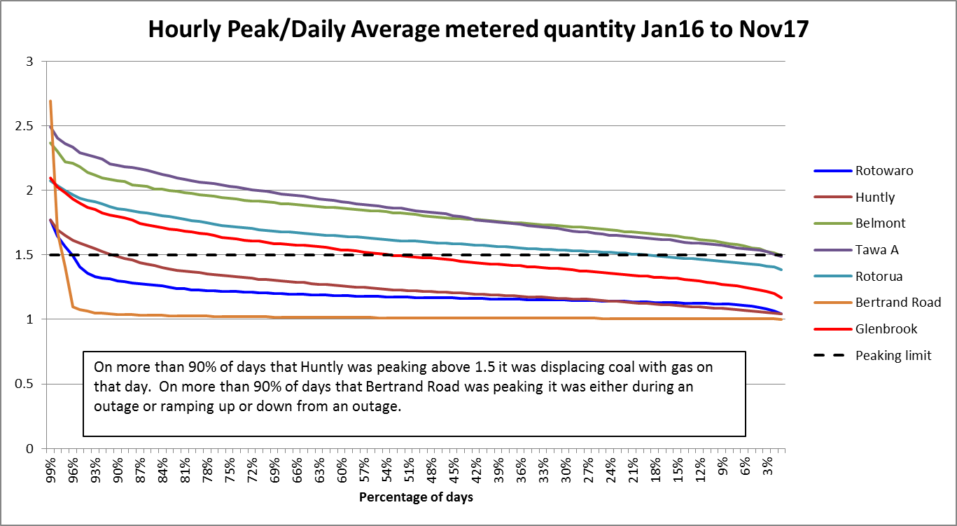
HQ/DQ Graph

Slide 3
The Chart and Observations
The Chart
The chart on the previous slide shows the highest gas hour/average over day.
Data is from January 2016 and ordered from highest to lowest
1.5 is equivalent to DQ/16 as per the GTAC definition of MHQ (and as per VTC, MPOC is 1.25 over 3 hours)
General Observations
Some Dedicated Delivery Points (DDPs) peak considerably less than shared delivery points
Belmont and Tawa exceeds 1.5 on more than 98% of days
Huntly’s highest HQ/DQ ratio is the same as the entire north pipeline.
However, only Dedicated Delivery Points are charged Hourly Overrun Charges
What is First Gas’ justification for this?

Slide 4
Agreed Hourly Profiles
Poor cousin to Specific HQ/DQ
The Agreed Hourly Profile is problematic because it is not part of the normal nomination cycle.
It is separately approved by First Gas (cl. 3.26) and the sum of hours must equal the DNC (or NQ cl. 3.28).
So parties with and AHP can’t change the DNC in a nomination cycle without getting a new AHP approved by First Gas.
Better to have the AHP approved through the standard nomination cycle.
The other issue with AHP that there is no ability to exceed the AHP (on any hour) without paying additional charges of 2 times DNC (cl 11.5).
This will incentivise a Higher DNC
Solution is to have an HOQ = HQDNC * (1+f) - HQAHP

Slide 5
Carbon Emissions – GTAC incentivises coal use
Hourly Overrun Charges are sufficient to incentivise running coal ahead of gas.
Hourly Overrun Charge = HOQ * DNC * 2 = $0.88c/GJ
Emissions Trading Scheme incentivises running gas ahead of coal
Difference in carbon cost = (90.5 – 54.1) * $19 *0.67 /1000 = $0.46/GJ.
90.5 is the tonnes of carbon per TJ of coal
54.1 is the tonnes of carbon per TJ of coal
$19 is the current cost of carbon ($/NZU)
0.67 is the current unit surrender rate.

Slide 6
Summary
Dedicated delivery points
targeted for peaking, but examples of peaking at shared points
should receive generous Specific HQ/DQ if shared delivery points get a free ride
AHPs need to be approved in normal nomination cycles
Hourly Overrun Charges incentivise coal burn
Huntly isn’t a “peaking behemoth”

Slide 7
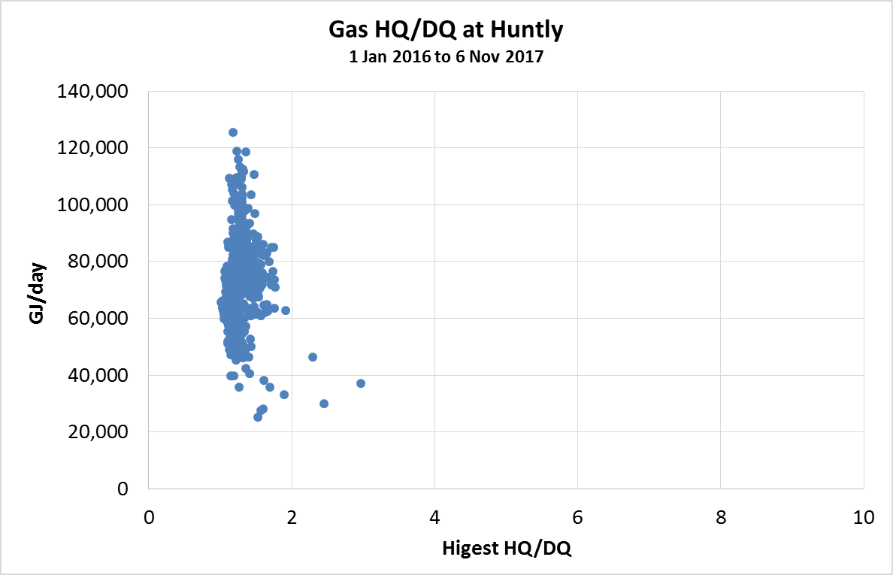
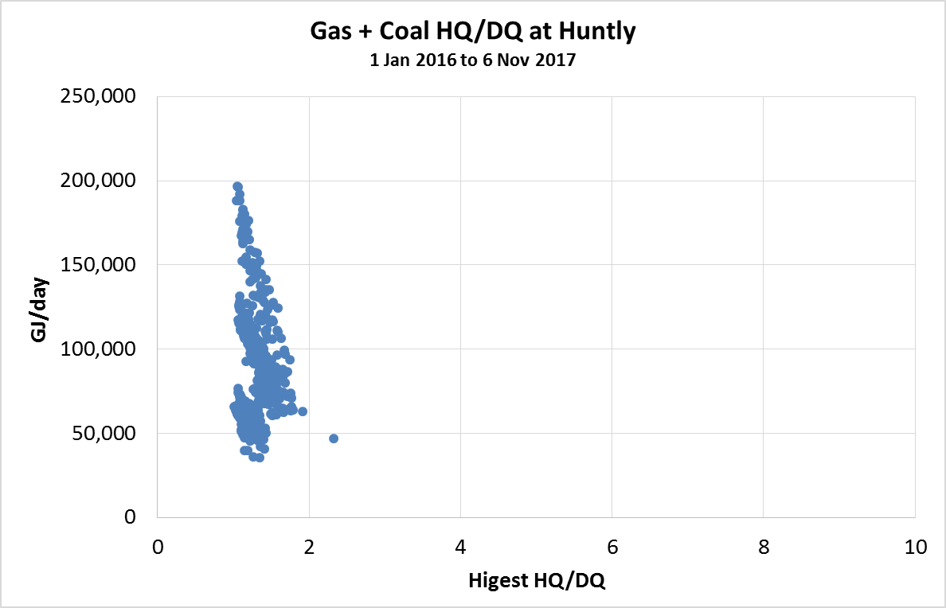
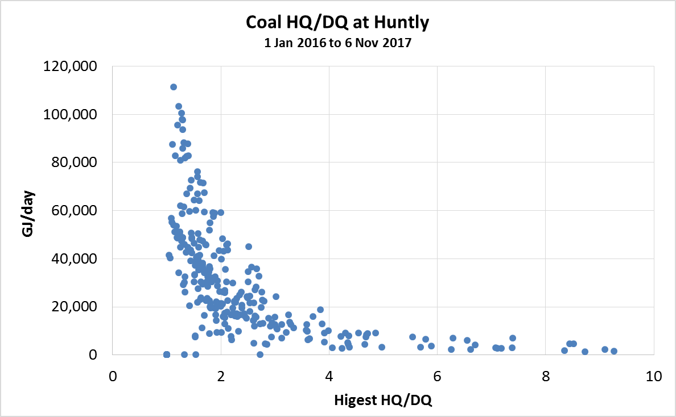
If Huntly converted coal to gas
Huntly Coal is peaky, but Huntly Gas + Coal isn’t
Why?
Coal typically runs when Unit 5 is running hard (Unit 5 has better efficiency)
Sometimes gas runs morning peak and coal in afternoon peak

Slide 8
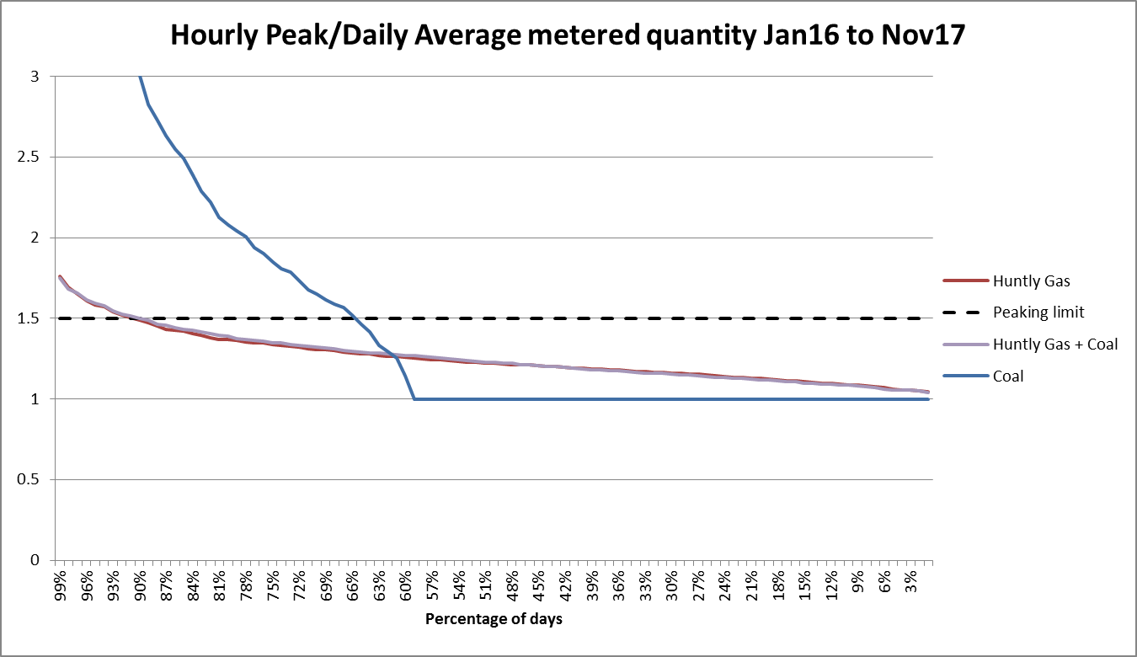
Appendix

