Slide 1
Gas Transmission Access Code: Submission on GIC Preliminary Assessment
27 March 2018

Slide 2
Agenda
Suggested improvements to methodology
The 4 big ticket items
Other issues
Overall assessment

Slide 3
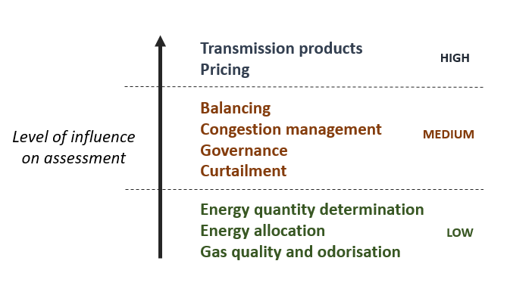
Suggested improvements to methodology
Assessment methodology is fundamentally sound and fit-for-purpose
Link missing between detailed assessment and overall conclusion. Being explicit on level of influence of different code elements could help bridge that gap
Other suggestions:
Counterfactual used in assessment could focus on most relevant existing code
Trade-offs should be explicitly identified
Need to ensure consistency when counting benefits and costs

Slide 4
The 4 big tickets: transmission incentive charges, liabilities, interconnection terms and park & loan

Slide 5
Transmission incentive charges
Preliminary assessment findings:
Transmission incentive charge structure in non-congested situations appears likely to encourage inefficient behaviour by pipeline users – detracting from the efficiency improvement that would otherwise occur

Slide 6
Transmission incentive charges
First Gas response:
Nominations under GTAC (like MPOC) play a dual role – commercial and operational
Therefore need a high degree of integrity so that transmission charges are allocated fairly
GTAC nominations do not create significant additional effort (but need to address cost risks)
Nominations should achieve:
Balance
Fairness
Efficiency

Slide 7
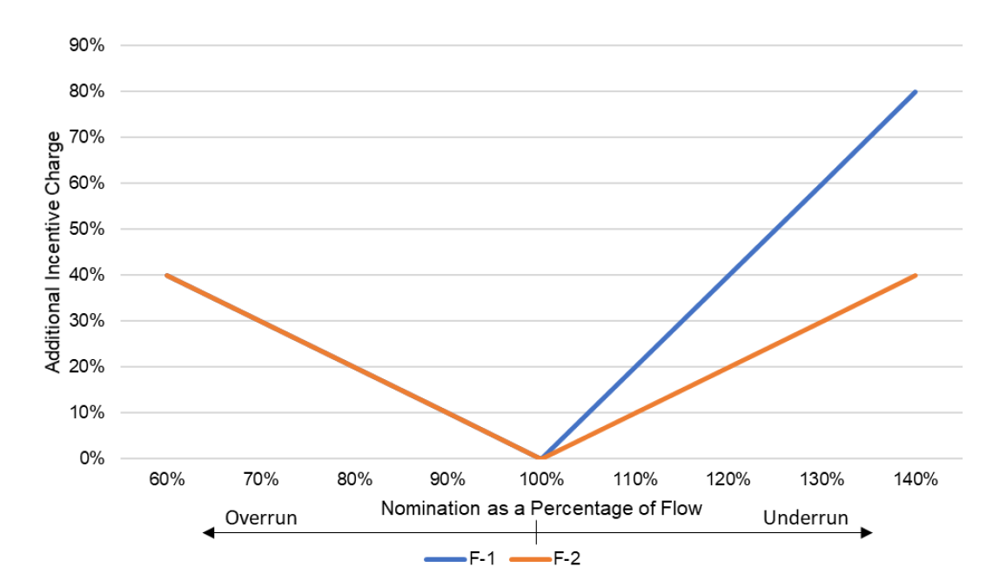
Transmission incentive charges: Balance

Slide 8
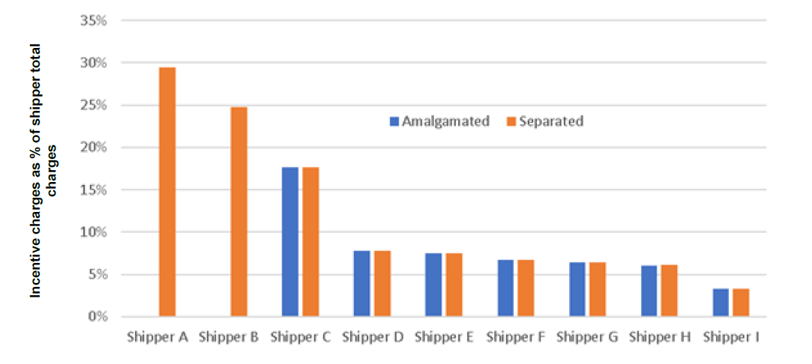
Transmission incentive charges: Fairness
Not actually shippers (gas retailers using another shipper to transport gas)

Slide 9
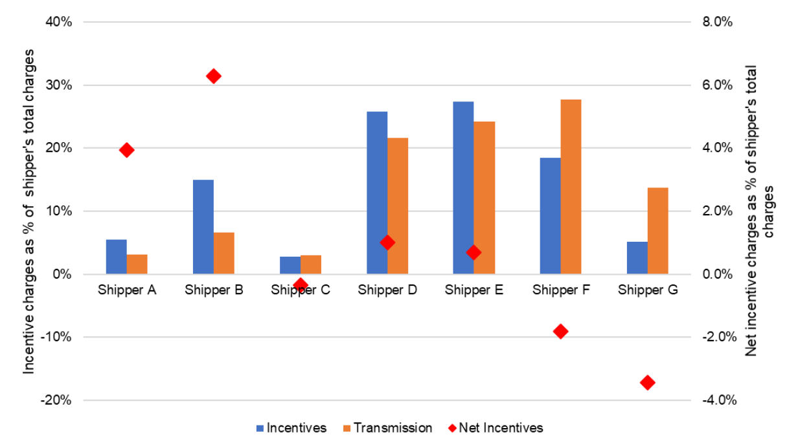
Transmission incentive charges: Efficiency

Slide 10
Transmission incentive charges: What’s left?
Does one simple change (F-2) deliver balanced, fair, efficient incentives?
Should a different process be used for mass market load nominations?
How should incentive charge revenue be rebated? (other issues)

Slide 11
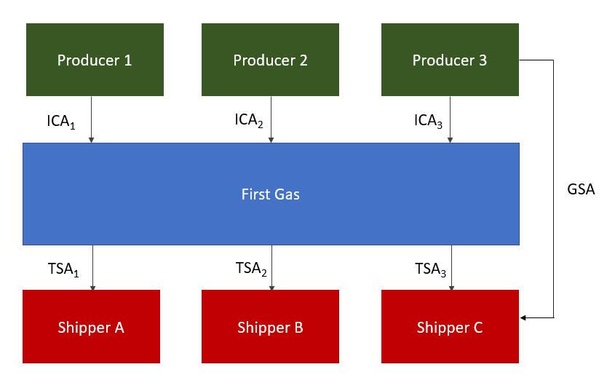
Liabilities
Preliminary assessment findings:
Aspects of the GTAC liability provisions are less certain in their effectiveness, undermining the incentives on pipeline users to act prudently – detracting from the efficiency and reliability benefits of the GTAC
How can Shipper C recover loss caused by Producer 1?

Slide 12
Liabilities
First Gas response:
Option 1. Continue with a step-in type model (e.g. using the Contracts Privity Act or subrogation type provisions). This would need to resolve the issues identified in submissions and the preliminary assessment (which may be difficult)
Option 2. Adopt an incentives pool type model (currently used in the MPOC for non-gas quality related losses). To our knowledge, the MPOC incentives pool has never been used, and therefore may result in an inefficient use of capital. It may also create a barrier to entry for prospective shippers
Option 3. Provide indemnities in the event of recovery (current VTC/MPOC for gas quality related losses). This is a simple way to link parties via the contractual chain through First Gas, but does not expose First Gas to liability if the party causing loss cannot be identified or the loss cannot otherwise be recovered (e.g. in the event of insolvency)

Slide 13
Liabilities: What’s left?
An area that would benefit from further discussion
Some questions we have are:
Is the merit in retaining different approaches for gas quality and non gas quality events?
Should certain events (e.g. injecting non-spec gas) not have the protection of having acted as an RPO?
What are the most efficient insurance arrangements for liabilities?

Slide 14
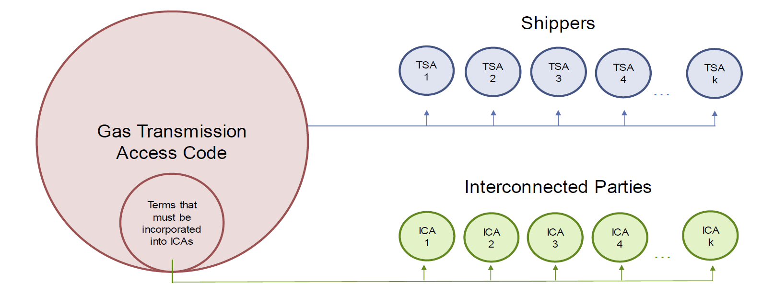
Interconnection terms
Preliminary assessment findings:
GTAC does not give shippers and interconnected parties sufficient certainty on the terms of interconnection agreements. This is considered detrimental to efficiency and fairness

Slide 15
Interconnection terms
First Gas response:
OK
Need to decide:
Which terms of interconnection are common and essential?
How should those terms be incorporated into ICAs?
Should provide further debate and certainty on:
TTP
Receipt point nominations processes
OFOs
Metering requirements
Liabilities
Interconnection and allocation (OBAs)

Slide 16
Park and loan
Preliminary assessment findings:
First Gas could face skewed incentives in allocating total line pack flexibility if park and loan revenues fall outside the transmission services revenue cap
First Gas response:
Park and loan revenue is treated the same way as ERM charges

Slide 17
Park and loan
Commerce Act 1986
http://www.legislation.govt.nz/
Gas Transmission Services Input Methodologies Determination 2012
http://www.comcom.govt.nz/regulated-industries/input-methodologies-2/gas-pipelines-2/

Slide 18
Park and loan
Ahuroa Gas Storage
First Gas cannot drive parties to use Ahuroa since:
The flexibility service provided is not substitutable
There are available substitutes for the flexibility service provided by Ahuroa
A number of safeguards protect system users against such an outcome (see letter of 8 March)

