Slide 1
GIC ASSESSMENT METHODOLOGY
Not clear how assessment in Step 1 and Step 2 informs conclusions in Step 3
Lost the principles from SCOP1 and SCOP2 in final assessment?
Possible that GTAC is materially better vs combined arrangements when weighed against these (but probably not when weighed against MPOC)
Reductionist approach to provision assessment misses synergies within arrangements.
Eg ANQ + OBA seems better than DNC + over/under run

Slide 2
POSSIBLE ALTERNATIVE CONCLUSION (illustrative)
Use Code Objectives vs Provisions for overall assessment.
Clearer view where GTAC outperforms vs existing codes.
Could inform regulatory backstop.

Slide 3
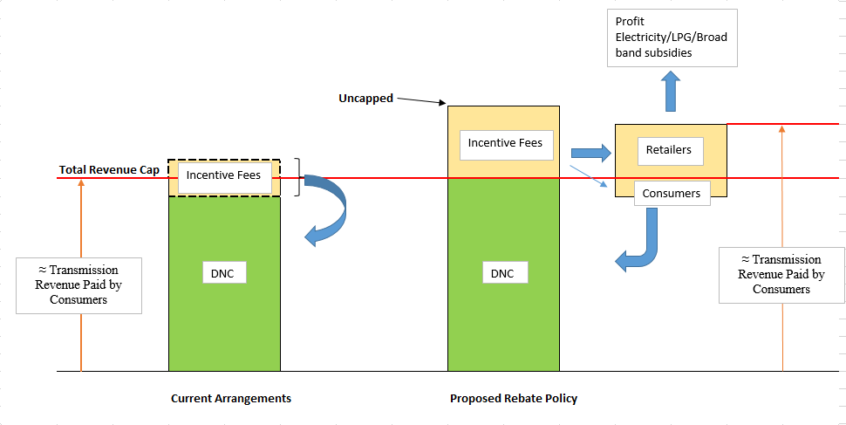
INCENTIVE FEE & REBATE PROBLEM

Slide 4
Materially worse outcome for Consumers
Current Arrangements
Proposed Arrangements
Incentive fees integral to regulated services/product design.
Discipline on TSO to minimize Incentive Fees (harder to predict)
Under/over recovery of total revenue recycled into DNC fee
Transparent
Rebates all consumers
Downward pressure on pricing maintained.
Incentive fees no longer part of providing regulated services (seems wrong in principle)
Weakened incentives on TSO to minimize Incentive Fees.
Rebates back to shippers/retailers – no obligation to pass back to consumers.
Rebate transparency to consumers lost
Transmission revenue paid by consumers no longer capped
No downward pressure on pricing (comcom + Gas Act objectives)

Slide 5
GIC RESPONSE
“Not a problem for stakeholders”
If Incentive fees set at economically efficient level.
If retail markets are efficient (economic rent competed away)
But..
First caveat openly questioned by GIC (fees excessive)
Confuses energy retail markets with gas retail markets (Gas Act focus)
Retailers compete for market share with product bundles – electricity primarily + gas/LPG/ Broadband services.
Mass market + small commercial/ industrial little transparency on product pricing.
Savings in gas costs not automatically passed through to gas customers (as seen in published residential gas prices from 1 October 2017 when lower transmission and distribution revenues set by Commerce Commission came into effect)
i.e. we think it is a problem for stakeholders, particularly consumers

