Slide 1
Summary of Vector’s Views on Preliminary Assessment by GIC
27 March 2018

Slide 2
GTAC - Liability
Vector’s key issues:
=> Less risk for FG
1. GTAC abandons the concept that FG indemnifies users for loss caused by other users
Existing codes provide direct indemnity for loss caused by non-spec gas, recognising that users have no contractual nexus with each other
Instead FG offer subrogation rights – but these create uncertainty and complexity
FG needs to stand behind the principle of operator responsibility and share the risk of non-spec gas by giving a direct indemnity to users
2. Deemed failure of RPO
GTAC widens the scenarios where users lose the benefit of the RPO standard
3. Uneven standard for obligation to mitigate loss

Slide 3
Balancing – Running Mismatch Tolerance
Reminder
Shippers nominating DNC get a share (delivery point only, our view is that Shippers do not nominate DNC for Supplementary/Interruptible Agreements)
OBA parties get a share (receipt point and delivery point)
Examples
Shipper supplying gas to End-User under a Supplementary/Interruptible Agreement where the End-User does not have an OBA in place.
Shipper has mismatch risk but is unable to get any tolerance for it.
2. Shipper purchases gas at Receipt Point on OBA and ships that gas to End-User on OBA.
Shipper has no mismatch risk but is able to get tolerance as it nominates DNC for End-User. The End-User also gets tolerance (as it should because it takes on the mismatch risk). So tolerance has been given out to both the Shipper and the End-User for the same gas.
3. Shipper A purchases gas at Receipt Point not on an OBA and trades that gas with Shipper B.
Shipper A takes on the mismatch risk at the Receipt Point but is unable to get any tolerance for it.

Slide 4
Balancing – Running Mismatch Tolerance
First Gas hold discretion on how to divvy up tolerance. How will they use that discretion?
Concerned that tolerance is not going to be allocated to those parties that need it and those that value it

Slide 5
Balancing – Setting of F_{nerm} and F_{PERM}
A fixed fee gives Shippers and OBA parties a free option. It may encourage parties to take the F_{NERM} and F_{PERM} charges rather than correct their position.
Increased transparency along with asymmetry of fees may result in parties operating to a positive running mismatch position
Current F_{PERM} fee may encourage weekend storage and releasing during the week.
We favour a market based approach that creates price uncertainty for parties so that it provides a strong incentive to balance

Slide 6
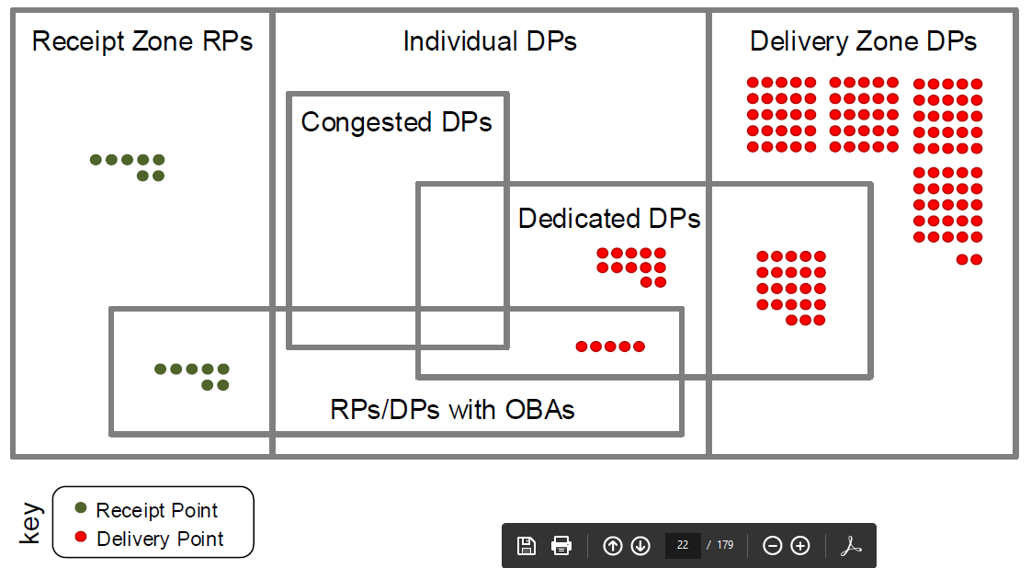
GTAC Products and pricing
Hourly Overrun Charge (and administration costs to mitigate) may fall onto just two or three End-Users
Who affected by this?
Dedicated Delivery Points only
Hourly quantity >200 GJ/hr
Gas shipped using DNC
Chart sourced from Preliminary Assessment by GIC

Slide 7
GTAC Products and pricing
Vector does not share in GIC comments such as:
“considerably increases transaction costs” and “increased nomination workload”
Agree with requirement for symmetry on overrun/underrun fees

Slide 8
GTAC – Congested Delivery Points
When is a Congested Delivery Point actually subject to congestion – 365 days a year?
Does First Gas proposed to tailor Priority Rights to when a delivery point is congested.
If Congested Delivery Point is only likely to be congested in the peak winter months then should the 10 times incentives charges apply all year round?

Slide 9
Other Issues
Auditing of First Gas’s Odorisation processes and procedures
Support a discussion on mass market customer issues
Code Change process
When is a Congested Delivery Point actually subject to congestion – 365 days a year?
Does First Gas proposed to tailor Priority Rights to when a delivery point is congested.
If Congested Delivery Point is only likely to be congested in the peak winter months then should the 10 times incentives charges apply all year round?

Slide 10
Regulated Code or Incremental changes or complete the current work shop arrangements?
Regulated Code – No
Incremental MPOC and VTC changes – Only if the current workshop approach fails and this will delay or increase the costs for the implementation of an OATIS replacement
Continue with the current workshop development of the Code but with a less intensive but more focused schedule

