Slide 1
FY2026 Draft Work Programme and Budget
Co-Regulatory Forum
28 November 2024
Gas Industry Co

Slide 2
Agenda
Housekeeping
Objective
Strategy and co-regulatory model
Proposed Work Programme
Funding
Questions & Discussion

Slide 3
Gas Act and GPS objectives
Gas Industry Co seeks to ensure that gas is delivered to consumers in a safe, efficient, reliable, fair, and environmentally sustainable manner.

Slide 4
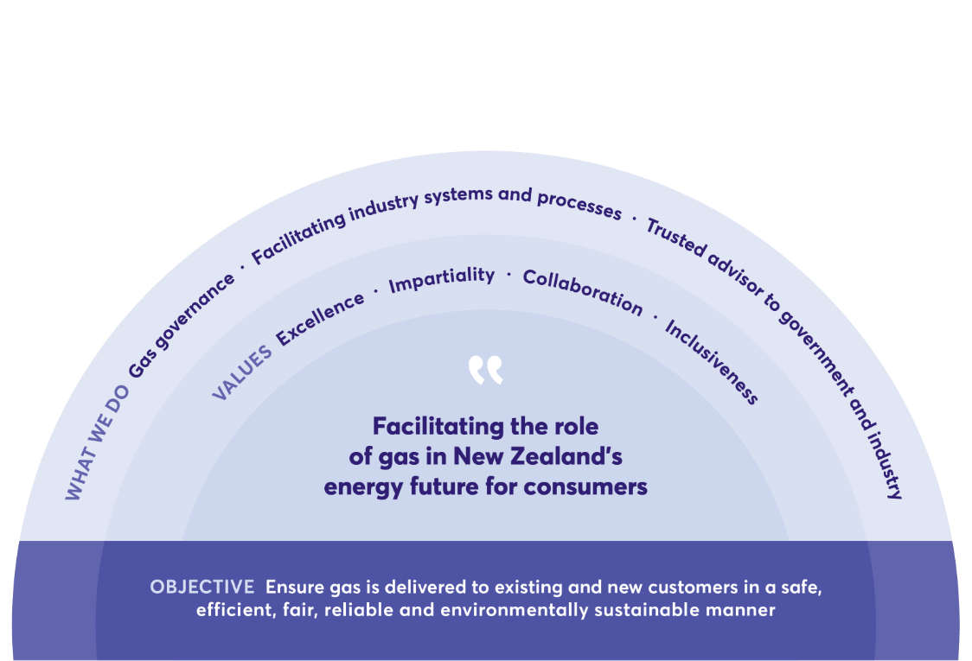
Strategy

Slide 5
FY2026 Planning process starts early
Oct/Nov 2024 | Board notes Indicative Work Programme & Budget
28 November | Initial industry engagement (Co-regulatory Forum)
18 December | Board approves release of Consultation Paper
7 February 2025 | Industry submissions due
27 February | Board approves Levy Recommendation
March | Recommendation to Minister for Levy Regulations
Levy Regulations
take effect
1 July 2025

Slide 6
Gas Industry Co proposed work programme FY2026

Slide 7
Proposed work programme
Security of Supply
emsTradepoint
Gas Governance arrangements: Recommendation to Minister on Gas Governance arrangements; Critical Contingency Management
Levy
Consumer: consumer voice; retail gas contracts oversight scheme; guidelines to enhance consumer outcomes
Gas Distribution Contracts Oversight Scheme
Gas Transmission

Slide 8
Security of Supply​
Work on issues relating to the energy transition will continue to be required in FY2026. This work may include: ​
  Facilitating industry and advising Government to enable imported LNG to be available by winter 2026 if required; ​
  Blending of renewable gases into gas networks and measures to bring renewable gases into the natural gas market, such as tradeable renewable gas certificates and other market measures; ​
  Consideration of whether additional or changed mechanisms are needed to ensure natural gas is available to industrial users in times of unexpectedly tight supply; and ​
  Our regular supply and demand studies. ​

Slide 9
emsTradepoint
We note Transpower’s most recent statement on emsTradepoint has the system continuing until September 2025. ​
Given the importance of a trading platform, we are assuming a role in managing the transition of emsTradepoint after September 2025, including consulting on a range of options.​
This may include Gas Industry Co purchasing the gas trading platform if necessary to ensure security of supply. ​

Slide 10
Gas Governance
Fulfil Gas Industry Co’s statutory roles under each of the existing gas governance arrangements: ​
Gas (Downstream Reconciliation) Rules 2008; ​
Gas Governance (Compliance) Regulations 2008; ​
Gas (Critical Contingency Management) Regulations 2008; ​
Gas (Switching Arrangements) Rules 2008; and ​
Gas (Facility Outage Information Disclosure) Rules 2022.

Slide 11
Gas Governance arrangements
SWITCHING & GAS REGISTRY
DOWNSTREAM RECONCILIATION
CRITICAL CONTINGENCY MANAGEMENT
D+1
INFORMATION DISCLOSURE
RETAIL CONTRACTS
DISTRIBUTION CONTRACTS
Service provider management
Audits
Compliance & enforcement
Market monitoring & investigations
Reporting & market performance
Effectiveness of governance arrangements

Slide 12
Gas Governance arrangements: Recommendation to the Minister
In November 2024 we made a Recommendation to the Minister to amend the Gas (Downstream Reconciliation) Rules 2008 and the Gas (Switching Arrangements) Rules 2008 to make provision for advanced gas meters, injection of renewable gases and D+1 (daily allocations). ​
Forecast activities for FY2026 include: ​
  Engaging with industry on rule drafting and detailed specifications for the implementation of the system changes; ​
  Non-regulatory work, for example consulting on and publishing guidelines and information exchange protocols; and ​
  Go-live of new arrangements and monitoring of new processes (eg UFG allocation and D+1) to ensure they are working effectively. ​ ​

Slide 13
Critical Contingency Management​
We are currently supporting MBIE through the legislative change process to progress amendments to the CCM Regulations. In FY2026 we intend to: ​
  Implement proposed changes to the CCM Regulations including consequential changes to existing industry processes. ​

Slide 14
Levy ​
Gas Industry Co’s levy arrangements have remained unchanged since 2007. With wholesale gas volumes continuing to decline, while the consumption of LPG, LNG and biogas is expected to increase, in FY2026 we intend to: ​
  Consult with industry in relation to the possibility of Gas Industry Co levying LPG, LNG and biogas; and ​
  Consider whether changes would be required to the Gas Act or levy regulations to enable this.

Slide 15
Consumer
Consumer voice​
Based on preliminary work showing fuel switching costs may be much higher than thought, we are interested in better understanding the lifetime cost and emissions outlook for residential and small commercial gas customers. In FY2026 we propose to:​
  Investigate the lifetime cost to residential consumers and the cost of emissions abatement of fuel switching.​
Retail Gas Contracts Oversight Scheme ​
The next full assessment of retailer alignment with the Retail Gas Contracts Oversight Scheme is scheduled for FY2027. In FY2026 we will: ​
  Provide information to new entrant retailers to help them understand their obligations and the governance processes. ​

Slide 16
Consumer (continued) ​
Guidelines to Enhance Consumer Outcomes ​
We are currently awaiting finalisation of the changes to the Electricity Industry Participation Code to mandate the electricity Consumer Care Guidelines, after which we assess what changes should be made the existing gas Consumer Care Guidelines. In FY2026, we expect to: ​
  Complete our review of amendments to the Code together with retailer feedback on the gas Consumer Care Guidelines and make any changes to the gas Consumer Care Guidelines that are appropriate; and ​
  Following an appropriate implementation period, assess alignment with the revised Gas Consumer Care Guidelines. ​

Slide 17
Gas Distribution Contracts Oversight Scheme
During FY2025, Gas Industry Co appointed an independent assessor to undertake a review of Firstgas's standard gas use-of-system agreement. The independent assessor's report, and Gas Industry Co's response to the report, were been published in November 2024. Further work, which may be continuing in FY2026, includes: ​
  Following up with retailers on progress towards putting a signed agreement in place; and ​
  Liaising with distributors regarding any changes to their contracts. ​

Slide 18
Gas Transmission
The suitability of transmission arrangements during the energy transition is a matter that will likely require further consideration. Forecast activities in FY2026 could include: ​
  Working with the Commerce Commission regarding any changes impacting pipeline regulation; ​
  Assessing any proposed changes to the transmission codes; ​
  Transmission pricing changes remain an issue for industrial customers and feedback on increases may require engagement by Gas Industry Co; and ​
  Reviewing transmission pipeline interconnections as required, address any concerns regarding reasonable access, and amend the Guidelines as required. ​

Slide 19
Funding

Slide 20
Two main sources of funding: Market fees and Levy
Market fees:
  Provided for in gas governance rules and regulations;
  Cover costs of most service providers, and other direct costs relating to the monitoring of rules/regulations;
  Formal estimate of market fees published two months before the beginning of the financial year, so placeholder included in FY2026 budget;
  Gas Industry Co required to wash-up at year end - either invoices under-recovery, or credits over-recoveries.
Levy:
  Cover direct cost of workstreams and non-operational expenditure;
  Two components of the levy: wholesale and retail;
  Wholesale levy paid by industry participants on purchases of gas from gas producers;
  Retail levy paid by gas retailers on the number of ACTIVE-CONTRACTED ICPs in the registry;
  Wholesale/retail component of levy reflects the weighting of the work programme, which changes from year to year;
  Gas Industry Co Board practice has been to return any over recovery and/or underspend.

Slide 21
Shortfall in wholesale levy revenue not sustainable
  Over recent years we have managed significant shortfalls in wholesale levy revenue due to actual gas volumes being less than budgeted gas volumes. This is not sustainable if we want to continue to deliver our work programme.
  If we use a more conservative/accurate estimate of wholesale gas volumes in FY2026 we would see a sharp increase in the wholesale levy rate, unless the amount required to be funded by the levy is significantly lower.

Slide 22
Reallocation of salary costs from levy to market fees
  We reviewed our current practice of including all salary costs in the levy, and none in market fees, even though the rules/regulations allow for this.
  We carried out an exercise to determine the portion of time staff spend working on gas governance arrangements vs time spent on other work. This has resulted in $900,000 being reallocated from the levy to market fees in FY2026.
  The impact of this reallocation to levy/market fee payers is small overall.
  Using 2024 numbers, 9 of 13 industry participants will pay less overall than they currently do. Of the 4 who will pay more, the increases range from 2% to 6% for all but one industry participant (a small gas retailer who does not pay the wholesale levy so doesn’t benefit from the offsetting reduction in amounts funded by the levy).
  In our view, this reallocation of salary costs more accurately reflects the allocation of staff time and effort across our various activities.

Slide 23
Projected FY2026 expenditure
The reallocation of salary costs is illustrated in the table below by the reduction in the levy funding requirement, and offsetting increase in market fees:
Levy funding requirement | + | Market fees | = | Total work programme costs
$3,410,198 |  | $2,674,550* |  | $6,084,748
22.89% decrease from FY2025 ($4,422,758) |  | 57.83% increase from FY2025 ($1,694,566) *Placeholder - Market fees estimated in April |  | 0.53% decrease from FY2025 ($6,117,324)

Slide 24
Comparison of FY2025 and FY2026
  The reduction in the levy funding requirement has enabled us to use a more conservative 110PJ estimate of wholesale gas volumes, with the result being a modest 7.56% increase in the wholesale levy rate for FY2026 (11.35% increase in FY2025).
  If no reallocation was done the FY2026 wholesale levy rate would increase by 24.66%.
 | FY2026 (indicative) | FY2025 (published) | Variance
Levy Funding requirement | $3,410,198 | $4,422,758 | 22.89% decrease
Wholesale volume estimate | 110PJ | 150PJ | 26.67% decrease
Wholesale Levy | 1.7158c/GJ | 1.5952c/GJ | 7.56% increase
Retail Levy | $4.90/ICP | $6.53/ICP | 25.02% decrease

Slide 25
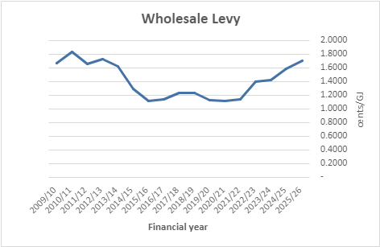
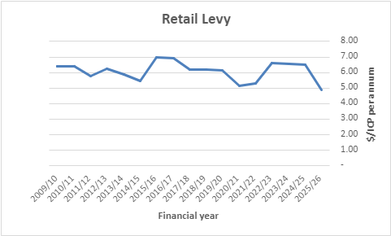
Year-on-year levies

Slide 26
Crucial Questions
Do you agree with suggestions that energy affordability should feature more centrally in market regulation?​
Is the voice of consumers (large and small) adequate in the regulatory process? ​
Is there other work that should be included in the 2026 work programme?​
What issues in the gas sector do you think will need more attention in future?​
Are there gas industry issues that we haven’t identified?​

Slide 27
Next steps
Feedback from today’s Co-regulatory forum will be incorporated into the Consultation Paper on the FY2026 Work Programme and Levy;
The Consultation Paper will be published on our website (and advised via our News Bulletin) on 18 December 2024;
Submissions will be due by 5 pm Friday, 7 February 2025.

Slide 28

Thank you

