Slide 1
FY2027 Draft Work Programme and Budget Co-Regulatory Forum
27 November 2025
Gas Industry Co

Slide 2
Agenda
Welcome
Objective
Strategy and co-regulatory model
Proposed Work Programme
Funding
Questions & Discussion

Slide 3
Gas Act and GPS objectives
Gas Industry Co seeks to ensure that gas is delivered to consumers in a safe, efficient, reliable, fair, and environmentally sustainable manner.

Slide 4
FY2027 Planning process starts early
Oct/Nov 2025 | Board notes Indicative Work Programme & Budget
27 November | Initial industry engagement (Co-regulatory Forum)
16 December | Board approves release of Consultation Paper
9 February 2026 | Industry submissions due
26 February | Board approves Levy Recommendation
March | Recommendation to Minister for Levy Regulations
Levy Regulations
take effect
1 July 2026

Slide 5
Draft FY2027 work programme
The FY2027 draft work programme has been framed by the strategic issues that the industry faces, and the work Gas Industry Co is proposing to undertake to address these issues. This highlights where the majority of our focus and effort will be in FY2027.
In addition, we will continue to meet our statutory requirements, and the objectives and outcomes included in the Gas Act 1992 (Gas Act) and the Government Policy Statement on Gas Governance 2008 (GPS).
It is possible that unplanned work might need to be undertaken in FY2027. If this happens we will reassess our work programme to ensure this is addressed.

Slide 6
DRAFT FY2027 WORK PROGRAMME
Strategic Issues:
Gas Supply | Viability of Networks | Gas Pricing
Gas industry roadmap | Future of infrastructure | Industrial gas consumers
Lack of upstream investment |  | Residential gas consumers
LNG
Biogas
Demand response for dry years
Provision of gas market data
Levy funding arrangements
Other Activities:
Educate and influence
Gas Governance arrangements

Slide 7
Draft FY2027 Work Programme - Strategic Issues: Gas Supply

Slide 8
Gas industry roadmap
Given the rapid decline in gas supply, we believe it is timely to revisit how the industry can move to a lower carbon future in a managed and orderly way, with the least impact on consumers.
Work in FY2027 may include:
Preparing advice to the Minister and industry in relation to how the gas industry can move to a lower carbon future in a way that minimises consumer impacts.

Slide 9
Lack of upstream investment
The lack of upstream investment has led to a rapidly declining gas supply situation.
The Government has announced an action to ‘reduce sovereign policy risk for investors’, with options being considered including indemnities; co-investment (eg $200m set aside for exploration, gas storage); public/private partnerships and other procurement contracts. Further decisions are expected in early 2026.
Work in FY2027 may include:
Advising the Minister on changes to the gas supply and demand balance, and any implications for Government policy;
Assisting with work arising from the Government’s action, as appropriate.

Slide 10
LNG
The Government is exploring supplementing indigenous gas with LNG with a procurement process commenced for development of an LNG import terminal with possible delivery from 1 June 2027. Announcements are expected in mid-December.
Work in FY2027 may include:
Facilitating industry processes, and advising Government (where requested) on matters relating to the importation of LNG; and
Advising on regulatory roadblocks hindering the uptake of LNG.

Slide 11
Biogas
The October 2025 Government Statement on Biogas noted that the Government will take a “market-led approach" to supporting the establishment of a biogas market.
Numerous agencies are involved in biogas (MBIE, MfE, Biogas Association, GasNZ), however we are concerned about the lack of coordination and potential for duplication of effort.
Work in FY2027 may include:
Providing advice to the Minister outlining barriers currently inhibiting the creation of a biogas market in New Zealand, and detailing actions that need to be undertaken (either by Gas Industry Co or others) to enable this;
Liaising with stakeholders to gather information and to identify market-led measures to meet the Minister’s expectations; and
Completing any remaining work in relation to the amendment of the Downstream and Switching Rules to accommodate the injection of renewable gases into downstream networks.

Slide 12
Demand response for dry year cover
Concerns regarding the long-term viability of Methanex has been highlighted in our previous Supply and Demand studies. If Methanex exits New Zealand demand response will be unavailable for power generation in dry years.
The Government is currently consulting on strengthening the regulatory framework for dry years. This includes ensuring Transpower’s security of supply assessments are fit for purpose and adapt to evolving information about declining gas supplies. Recommendations are expected in early 2026.
In FY2027 we will:
Continue to work closely with the Electricity Authority in relation to the extent to which gas is able to provide dry year cover (including as provided for in our MoU);
Publish the codified 2026 Supply and Demand study (with input from Minister/MBIE);
Where relevant, assist on any recommendations arising from the Government’s consultation on strengthening the regulatory framework for dry years.

Slide 13
Levy funding arrangements
With gas supply forecast to reduce further, we are concerned that current levy funding arrangements are no longer fit for purpose to allow us to generate the income required to deliver our work programme.
In FY2027 we intend to:
Review the current levy funding arrangements to determine if they are fit for purpose; and
If necessary, commence steps to introduce an alternative funding arrangement.

Slide 14
Draft FY2027 Work Programme - Strategic Issues: Viability of Networks

Slide 15
Future of infrastructure
As the gas industry contracts, the future of infrastructure and increasing costs to consumers who are unable to transition are becoming key issues.
In FY2027 we intend to:
Investigate the impacts on consumers of the continued decline in gas production, including the future of infrastructure and costs; and
Consider whether consumer costs could be reduced by ‘right sizing’ the network for future loads (eg by allowing networks to be run at lower pressures or with fewer compressors).
Further activities may include:
Supporting MBIE and Commerce Commission regarding any changes impacting pipeline regulation;
Assessing any proposed changes to the transmission codes;
Assessing transmission pricing changes and their impact on industrial customers; and
Reviewing transmission pipeline interconnections as required, address any concerns regarding reasonable access, and amending the Guidelines as required.

Slide 16
Draft FY2027 Work Programme - Strategic Issues: Gas Pricing

Slide 17
Industrial gas consumers
We continue to receive reports that even where volumes are available to meet demand, some industrials are planning to close or exit New Zealand in response to high forward gas prices.
We are assisting industrial gas consumers who want to take responsibility for their own gas procurement and delivery to became shippers under the Gas Transmission Code, and retailers under our gas governance arrangements.
In FY2027, we will:
Continue to provide data and advice to industrial gas consumers to ensure they are making informed decisions;
Monitor reports from industrial gas consumers regarding gas availability and pricing;
Ensure that issues facing industrial gas consumers (and the impacts of these) are socialised and well understood (including through regular communications/ stakeholder engagement);
Advise the Minister/peer regulators regarding issues facing industrial gas consumers;
Continue to support industrial gas consumers who want to take responsibility for their own gas procurement and delivery.

Slide 18
Residential gas consumers
Residential gas prices are continuing to rise, and some retailers are no longer offering gas.
In FY2027 we will:
Continue to provide data to inform residential gas consumers, aiding them in making informed decisions;
Monitor the availability and pricing of gas for residential consumers;
Ensure that issues facing residential gas consumers are socialised and well understood (including through regular communications/ stakeholder engagement);
Advise the Minister/peer regulators/consumer groups about issues facing residential gas consumers;
Engage an independent assessor to carry out the 3-yearly review of retail gas contracts
Assess retailer and distributor alignment with the Consumer Care guidelines, monitor the effectiveness of the guidelines, and propose any necessary amendments to them.

Slide 19
Draft FY2027 Work Programme - Other Activities

Slide 20
Educate and influence
Providing advice to the Minister and industry on matters concerning the gas industry;
Stakeholder engagement, including presenting at conferences and forums; hosting industry workshops; and presenting to industry participant Boards; and
Reporting on the present state and performance of the gas industry.
Gas Governance arrangements
Fulfilling our statutory roles under the following gas governance arrangements, and ensuring that the arrangements remain fit for purpose as the industry transitions:
Gas (Downstream Reconciliation) Rules 2008;
Gas Governance (Compliance) Regulations 2008;
Gas (Critical Contingency Management) Regulations 2008;
Gas (Switching Arrangements) Rules 2008; and
Gas (Facility Outage Information Disclosure) Rules 2022.

Slide 21
Funding

Slide 22
Two main sources of funding: Market fees and Levy
Market fees:
Provided for in gas governance rules and regulations;
Cover costs of most service providers and any direct external costs or Gas Industry Co internal costs that relate to the rules/regulations;
Formal estimate of market fees published two months before the beginning of the financial year, so placeholder included in FY2027 budget;
Gas Industry Co required to wash-up at year end - either invoices under-recovery, or credits over-recoveries.
Levy:
Cover direct cost of workstreams and non-operational expenditure;
Two components of the levy: wholesale and retail;
Wholesale levy paid by industry participants on purchases of gas from gas producers;
Retail levy paid by gas retailers on the number of ACTIVE-CONTRACTED ICPs in the registry;
Wholesale/retail component of levy reflects the weighting of the work programme, which changes from year to year;
Gas Industry Co Board practice has been to return any over recovery and/or underspend.

Slide 23
Projected FY2027 expenditure
Levy funding requirement | + | Market fees | = | Total work programme costs
$2,964,139 |  | $3,074,700* |  | $6,038,839
13.08% decrease from FY2026 ($3,410,198) |  | 14.96% increase from FY2026 ($2,674,550) *Placeholder - Market fees estimated in April |  | 0.75% decrease from FY2026 ($6,084,748)

Slide 24
Comparison of FY2026 and FY2027
 | FY2027 (indicative) | FY2026 (published) | Variance
Levy Funding requirement | 2,964,139 | $3,410,198 | 13.08% decrease
Wholesale volume estimate | 85PJ | 110PJ | 22.73% decrease
Wholesale Levy | 1.7058/GJ | 1.7158c/GJ | 0.58% decrease
Retail Levy | $4.98/ICP | $4.90/ICP | 1.63% increase

Slide 25
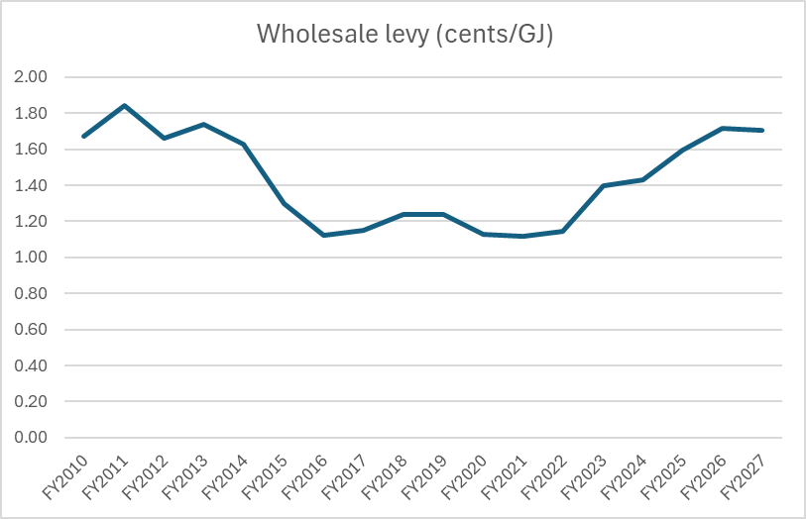
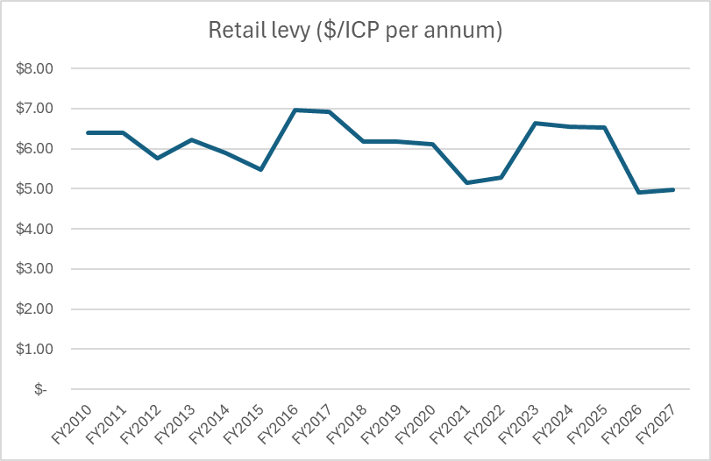
Year-on-year levies

Slide 26
Crucial Questions
Do you agree with the 85 PJ wholesale volume estimate?
Is there other work that should be included in the 2027 work programme?​
What issues in the gas sector do you think will need more attention in future?​
Are there gas industry issues that we haven’t identified?​

Slide 27
Next steps
Feedback from today’s Co-regulatory forum will be incorporated into the Consultation Paper on the FY2027 Work Programme and Levy;
The Consultation Paper will be published on our website on 18 December 2025;
Submissions will be due by 5 pm Monday, 9 February 2026.

Slide 28

Thank you

