Slide 1
Determination of Critical Contingency Price in respect of the critical contingency of 23rd May 2017
Notification of proposed critical contingency price by industry expert
Tim Denne

Slide 2
The event
Critical Contingency of 23rd May
  declared at 10:50
  Terminated at 18:15
  Duration of 7 hours 25 minutes
There was no curtailment and no real market scarcity

Slide 3
How the price must be set
Gas Governance (Critical Contingency Management) Regulations 2008, Section 71. Relevant matters =
The industry expert must:
  determine the critical contingency price in $/GJ
  seek to set the critical contingency price at a level that reflects the price that would be established by an efficient short-term market that allocated scarce gas resources to the highest value uses during the critical contingency
  [if no curtailment] must take into account the following matters:
    the prices in the wholesale market for electricity during the critical contingency; and
    the economic cost of the loss of gas supply to those consumers who had their gas supply curtailed; and
    any other matters that the industry expert considers relevant to achieving subclause (2).

Slide 4
Purpose
Section 71 describes how to set the critical contingency price, but this needs to be interpreted in the light of the overall purpose of the price (Section 67). The price needs to:
  encourage available supply;
  signal scarcity; and
  provide incentives to retailers to make arrangements to minimise the financial consequences of a critical contingency if one was to occur.

Slide 5
Previous events

Slide 6
Market information
Gas generation on 23rd May cf weeks either side
It was a high use day
Stratford peakers reduced generation, but not in response to price
Critical
contingency

Slide 7
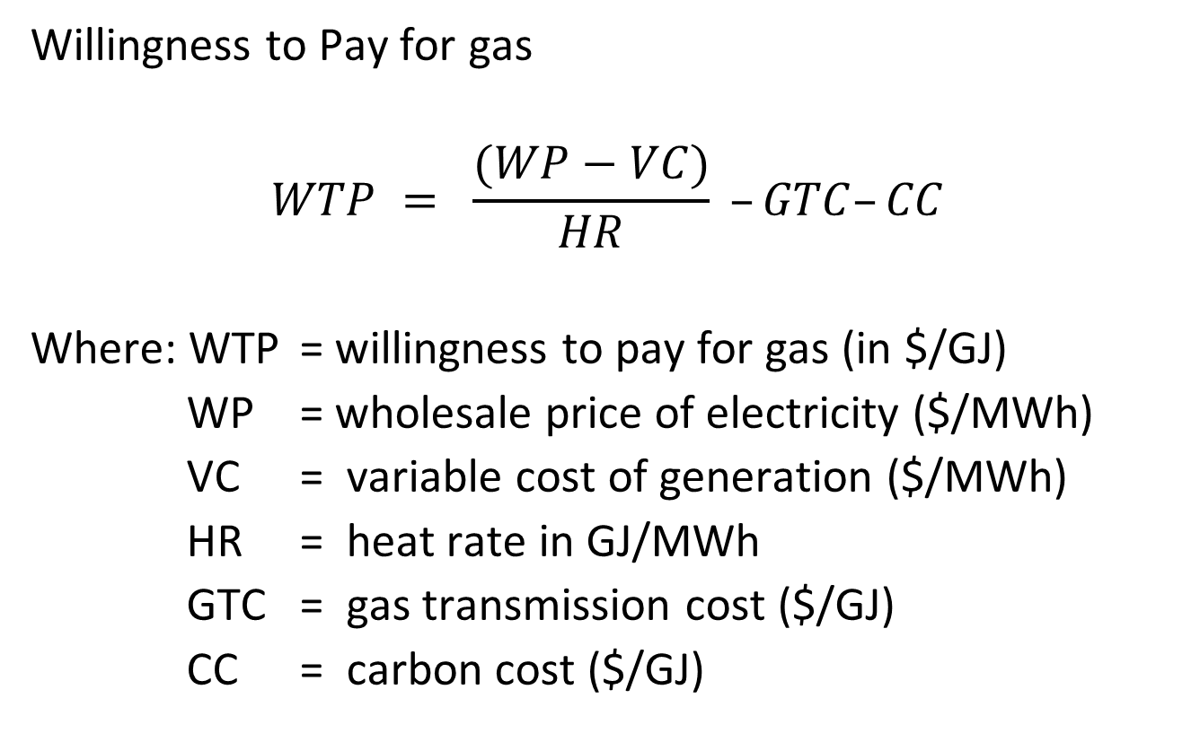
Price estimate (maximum)
Willingness to Pay for gas
$$WTP = \frac{(WP−VC)}{HR} –GTC–CC$$
Where: WTP = willingness to pay for gas (in $/GJ)
WP = wholesale price of electricity ($/MWh)
VC = variable cost of generation ($/MWh)
HR = heat rate in GJ/MWh
GTC = gas transmission cost ($/GJ)
CC = carbon cost ($/GJ)

Slide 8
Plant-specific data

Slide 9
Willingness to Pay

Slide 10
Gas Prices for May 2017
On 23rd May: AMP = $5.60/GJ; MBP = $6.16/GJ
These prices are not unusual and do not signal scarcity

Slide 11
Proposed critical contingency price
I am steered by Section 71 to take account of prices in the wholesale electricity market for price that would allocate gas efficiently.
CCGT’s WTP is higher than market prices of gas
The price must signal scarcity which drives me towards the higher value (e3P rather than TCC)
My draft determination is that the critical contingency price for the 23rd May 2017 is $10.62/GJ.

