Slide 1
Gas Transmission Access: Draft GTAC Release
17 August 2017
First Gas / Presentation

Slide 2
Agenda
Introduction
Housekeeping
Facilitator’s role
Context for GTAC release
Process followed to date
Collaboration on draft GTAC
Overview of GTAC contents and construction
Objectives
Fit with other documents
Structure
Discretion and transparency
Walk through of draft GTAC by section (break for lunch)
Next steps and proposed process

Slide 3
Context for GTAC release

Slide 4
Context for draft GTAC release – Recap of process
The release of the draft GTAC is an important milestone - another step in the process of ongoing consultation and negotiation on new access code arrangements.
Elements of process to date (summarised on next slide) include:
Started around 12 months ago by agreeing respective roles of GIC and First Gas (SCOP1)
Proposed a general framework for developing the code, as well as some philosophies/directions that the new code could adopt (SCOP2), November 2016
Announced decisions following that round of engagement to help focus further efforts in the areas where consensus did not already exist and detailed design work was required, February 2017
Released emerging views on the detailed design of core code elements, and preliminary drafts of those sections of the code, May 2017
Released full draft of code, alongside template interconnection agreements, August 2017
Process has helped to test and refine concepts, and highlight different perspectives. Has seen considerable evolution of proposals in response to submissions and suggestions on how best to design particular code elements
Throughout the process, parties have continued to support the view that having a single access code that provides end-to-end transmission service is a good idea. Divergence in views has come on the specific arrangements used to achieve that outcome
We thank the GIC, shippers, interconnected parties and other stakeholders for the time and effort they have dedicated to the process so far, and their ongoing constructive engagement

Slide 5
Context for draft GTAC release – Recap of process
SCOP1 (September 2016): Process / roles
SCOP2 (November 2016): Options for high-level direction
SCOP2 Decisions (February 2017):
Detailed design work needed on access products, nominations processes
Other areas could move to code drafting (e.g. non-standard agreements, gas quality)
Emerging Views (May 2017):
Access products
Balancing and allocation
Pricing
Draft GTAC release (August 2017)
Revised draft GTAC release (September 2017)
GTAC submitted to GIC (October 2017)
High-level direction options
Detailed design options
Code proposals

Slide 6
Collaboration via Trello
We are keen to refine and improve the code prior to releasing the GTAC for mark-ups in September
We have set up a Trello site to receive and respond to questions on the draft GTAC
Invitations to join the site will be sent to all parties registered with First Gas / GIC
Provides a streamlined way of communicating and collaborating on the GTAC over the next few months

Slide 7
Context for draft GTAC release – Code transition
VTC and MPOC change requests progressing through both processes
Proposed MPOC termination clause used as a process to govern minimum requirements for adopting the GTAC (“materially better” than the status quo, procedural arrangements in place)
GIC due to issue draft recommendation on MPOC change request on Friday, 25 August 2017
In submissions on proposed MPOC change, shippers expressed concern about the period allowed for implementation of the new IT software
The 40 business day period mentioned in the MPOC change request is a final check point to confirm that the software and other systems required to implement the GTAC will be ready when the GTAC starts operation. This reflects its status as a condition precedent in the MPOC
We will be engaging with shippers well before this point
We intend to issue the Requirements and RFP documents over the coming month and complete the software selection process by the end of 2017. The implementation process will commence in January 2018
As the implementation proceeds, shippers and other interested parties will be provided with information on the operation of the software selected, and its data interfaces. We will need shipper participation to develop the reporting functions. Training will also be scheduled. Most of this will happen before the 40 business day period commences
We will advise of any delays in the IT implementation process. We acknowledge that the process involves the risk of delays and will be actively managing these risks

Slide 8
Context for draft GTAC release – IT procurement process
Finalise Requirements Document and RFP
Commence bid
evaluation
Commence implementation
Software Go Live
Implementation and Training Period
August 2017
December 2017
March 2018
June 2018
September 2018
Appoint Bid Evaluation Panel
Select vendor and negotiate contract
Software conditions met to proceed

Slide 9
Context for draft GTAC release – Negotiation process
We have been asked to clarify the status of negotiating the GTAC
Negotiation is defined as discussion aimed at reaching an agreement
In this case, negotiation involves multiple stakeholders, interests, options – but one standard set of terms
Negotiation on the GTAC has been ongoing for several months
Have used a process of sharing ideas and testing concepts through consultation papers, workshops, one-on-one meetings
Have tried to reflect different views in evolving thinking on the best set of access arrangements, as illustrated by proposals on:
Zones v Delivery Point nominations
Initial allocations, OBAs
Extent of PRs made available

Slide 10
Overview of GTAC contents and construction

Slide 11
Context for draft GTAC release – Reminder of objectives
We established and refined 5 objectives for the GTAC as part of SCOP2, which we have applied throughout the process:
Enable the use of gas (primary objective)
Minimise the cost of transporting gas
Keep it simple
Promote flexibility
Promote transparency
The overall aim is for the GTAC to take this opportunity to significantly improve on the access arrangements currently provided under the VTC/MPOC – “materially better”

Slide 12
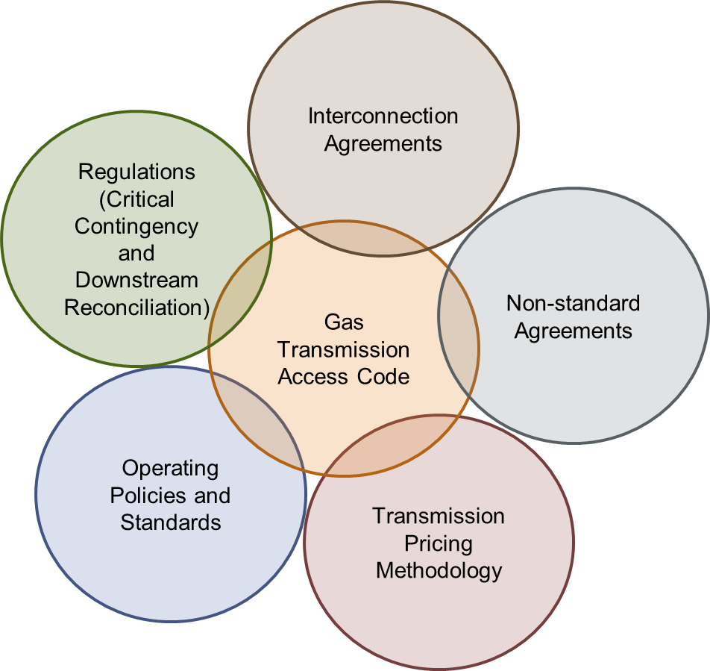
Context for draft GTAC release – Fit with other documents
SCOP2 illustration (right) shows how the code works alongside other documents in defining roles and responsibilities in gas transmission
We have continued to adopt an approach to the code that seeks to appropriately confine the matters that the code determines, which adds simplicity and flexibility to the code arrangements
This has resulted in a significantly shorter code
VTC is around 150 pages, MPOC is 130 pages (so a total of 230 pages across the existing codes)
GTAC is currently less than 90 pages
It also means a complete understanding of transmission arrangements inevitably requires reference to other documents
To enable parties to consider how the code works in concert with other documents, we have released template ICAs (receipt and delivery), which incorporate a mechanism for Operational Balancing Agreement (OBAs) as an option for allocating receipt and delivery quantities. This presentation also provides further information on how the proposed pricing methodology and pricing zones for the GTAC will operate (although TPM will not be finalised until 2018)

Slide 13
Overview of GTAC contents and construction
Section 1
Definitions
Section 2
Transmission Services
Section 3
Transmission Products and Zones
Section 4
Nominations
Section 5
Energy Quantity Determination
Section 6
Energy Allocation
Standard terms for accessing and managing transmission capacity
Process for determining and allocating gas quantities on transmission system
Foundational terms and concepts
Section 7
Additional Agreements
Section 8
Balancing
Section 9
Curtailment
Section 10
Congestion Management
Section 11
Fees and Charges
Short term system operations / line pack management
Charges for access products and balancing
Governs non-standard transmission and interconnection terms
Processes for managing emergencies and scarcity when it arises
Section 12
Gas Quality
Section 13
Odorisation
Section 14
Prudential Requirements
Section 15
Force Majeure
Section 16
Liabilities
Responsibilities for gas composition and safety
Provisions to manage credit risk, or suspend or limit impact of code
Section 17
Code Changes
Section 18
Dispute Resolution
Section 19
Term and Termination
Section 20
General and Legal
* Note: colours matched to Trello question categories
Code governance
General legal provisions

Slide 14
Overview of GTAC contents and construction - TSO Discretion
In seeking to draft a code that is principles-based (rather than determining specific parameters), we have left more areas to the discretion of the Transmission System Operator and created more flexibility for users (certainly when compared to the MPOC)
We consider that discretion is valuable to ensure that First Gas can respond in the most appropriate ways to operational issues as they arise. No two sets of circumstances are identical, so it is important not to tie the TSO into a strict set of requirements that do not adequately resolve issues in the best interests of our customers and the industry as a whole
We acknowledge that discretion needs to be used appropriately, and that First Gas should be accountable for the decisions that it makes. Accordingly, we have sought to ensure that:
Areas for discretion have clear principles or outcomes that serve to guide TSO decisions, with reasons for decisions being transparent
Stakeholders have the ability to seek information on the factors that led to particular decisions being taken, and to have legitimate disputes about the exercise of discretion resolved efficiently
We have also sought to increase transparency:
In how parties intend to use the system (e.g. extending nominations and providing park and loan service) and actually use the system (e.g. publishing contracts and running mismatch positions)
The code also provides for information that must be made available by First Gas, which will be summarised in Appendix 2 of the GTAC

Slide 15
Walk through of draft GTAC by section

Slide 16
Sections 1 & 2: Foundational Terms and Concepts
Purpose: Define commonly used terms and set out the overarching principles that apply to the provision and use of gas transmission capacity
Defined terms (section 1):
Tried to ensure most intuitive terms used for various situations arising under the code
Foundation concepts (section 2), include:
TSO to reasonably maximise capacity provided (s 2.3)
Principle of non-discrimination (s 2.7)
Mutual RPO (reasonable and prudent operator) obligations (s 2.13 & 2.14)
Also deals with Taranaki Target Pressure and uneconomic transmission services

Slide 17
Section 3: Transmission Products and Zones
Purpose: Define the products that shippers can purchase to transport gas (including the geography associated with those products), and how those products can be acquired
Daily nominated capacity:
Primary product for accessing transmission capacity
Obtainable via nominations
Cannot be transferred or traded
May be curtailed in the circumstances set out in sections 9 and section 10 (subject to Priority Rights, if any)
Cannot be used in conjunction with Supplementary or Interruptible Capacity.
Geography for DNC:
Receipt zones: Propose to have a single receipt zone to start, but discretion to add more if required (including for reasons set out in s 3.3(a)-(c))
Delivery zones: Propose 17 delivery zones, plus nominations to all dedicated Delivery Points. Criteria guiding definition of zones are set out in s 3.4(a)-(e).
Delivery Points with prospect of congestion will be removed from delivery zones (s 3.5 & 3.6), with advance notice where practicable

Slide 18
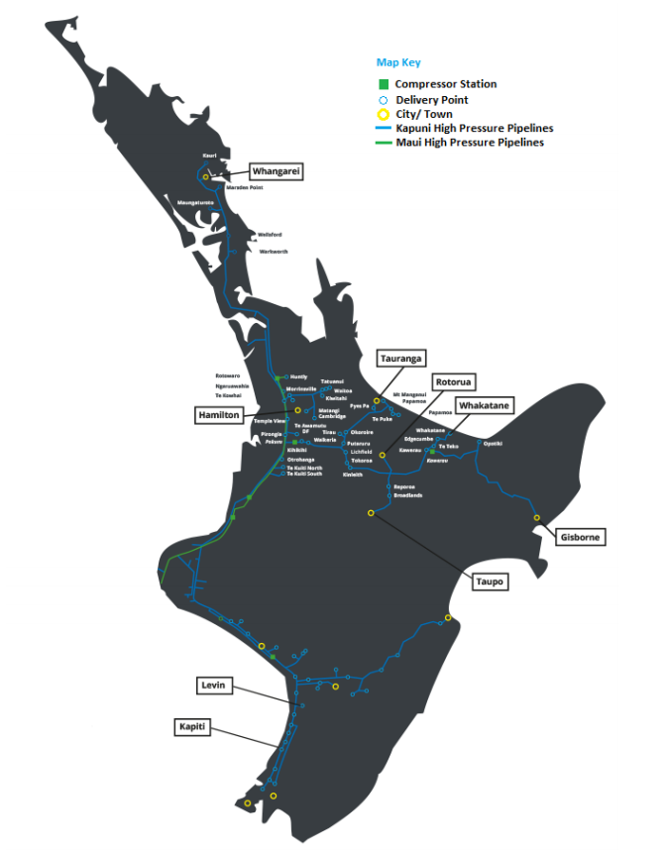
Illustration of Zones – North Island Map
DZ 1
DZ 5
DZ 4
DZ 6
DZ 14
DZ 3
DZ 16
DZ 13
DZ 17
DZ 15
DZ 2
DZ 1
DZ 7
DZ 8
DZ 10
DZ 11
DZ 9
DZ 12

Slide 19
List of Possible Zones by Region
Wellington
DZ 12
Otaki
Te Horo
Waikanae 2
Paraparaumu
Pauatahanui 2
Gtr Waitangirua
Belmont
Tawa A
Tawa B (Nova)
Manawatu-
Wanganui
DZ 8
Wanganui
Lake Alice
Kakariki
Marton
Flockhouse
DZ 9
Oroua Downs
Longburn
Kairanga
Palmerston North
Feilding
Ashhurst
Mangatainoka
Pahiatua
DZ 11
Foxton
Levin
Kuku
No Zone
Kaitoke
Pahiatua DF
Taranaki
DZ 1
Opunake
Pungarehu 1
Pungarehu 2
Okato
Oakura
DZ 2
Kapuni Lactose
Eltham
Kaponga
Stratford
Inglewood
Waitara
New Plymouth
DZ 7
Matapu
Manaia
Hawera
Hawera (Nova)
Patea
Waverley
Waitotara
No Zone
Kapuni
Kupe
Ballance AUP
Kaimiro
Bertrand Road
Faull Road
Ngatimaru Road
Tikorangi 3
Stratford 2
Stratford 3
TCC
Okaiawa
Mokoia
Waikato
DZ 3
Te Kuiti South
Te Kuiti North
Otorohanga
Ngaruawahia
Pirongia
Huntly Town
DZ 6
Horotiu
Matangi
Cambridge
Kiwitahi 2
Morrinsville
Waitoa
DZ 13
Gtr Kihikihi
Tokoroa
Kinleith
Putaruru
Tirau
Okoroire Springs
No Zone
Te Awamutu DF
Huntly Power Station
Gtr Hamilton
Kiwitahi 1
Morrinsville DF
Tatuanui DF
Te Rapa Cogen
Waikeria
Lichfield DF
Lichfield 2
Kinleith (Pulp & Paper)
Tirau DF
Bay of Plenty
DZ 14
Gtr Tauranga
Gtr Mt Maunganui
Te Puke
DZ 15
Reporoa
Taupo
Rotorua
DZ 16
Kawerau
Te Toko
Edgecumbe
Edgecumbe DF
Whakatane
No Zone
Rangiuru
Broadlands
Kawerau (Tissue)
Kawerau (Pulp & Paper)
Auckland
DZ 4
Tuakau 2
Harrisville 2
Ramarama
Drury 1
Pukekohe
Kingseat
Gtr Auckland
Hunua
Hunua (Nova)
Flat Bush
Alfriston
No Zone
Glenbrook
Hunua 3
* Note: individual nominations at Delivery Points not in a zone, with transmission service to those Delivery Points separately priced
Northland
DZ 5
Waitoki
Warkworth
Wellsford
Whangarei
Marsden 2
No Zone
Maungaturoto DF
Marsden 1
Kauri DF
East Coast
DZ 17
Opotiki
Gisborne
Hawkes Bay
DZ 10
Dannevirke
Takapau
Hastings
Hastings (Nova)
No Zone
Mangaroa

Slide 20
Section 3: Transmission Products and Zones
Priority Rights (PRs)
Provide ability for parties to “firm up” nominations for DNC in parts of network that face prospect of congestion (as determined by First Gas)
Tool to signal value of limited transmission capacity. Interruptible Load (if obtainable) provides another tool to achieve this outcome (s 10)
Will be auctioned off in month prior to PRs taking effect (we propose 1 auction in the first year of the GTAC, and not < 2 in later years)
Propose to start with a relatively simple design that may be modified over time if the product proves useful
Key initial design features:
6 month PR term (but scope for more frequent auctions, with shorter term)
Only shippers can participate in auctions
PRs may be “tagged” to particular end users if the IT system permits
Low (non-zero) reserve price
Price based on marginal clearing bid
Secondary trading permitted, on the IT system
“Take or pay” product, i.e. all PRs must be paid for but use is subject to nominations (s 3.18)

Slide 21
Link to First Gas investment decisions
Parties may be concerned about prospect of paying elevated prices (i.e. DNC + PRCs) for extended periods of time
This can be resolved if First Gas invests to expand capacity
The draft GTAC does not currently provide a direct link between PRs and investment because:
First Gas’ allowed capital expenditure is set by the Commerce Commission as part of price-quality resets (i.e. outside of code processes), so we may not get what we ask for
A formulaic approach to triggering investment is too inflexible
As a tool to value limited capacity, PRs aim to improve understanding of where and when capacity expansion will be valuable:
Creates need for TSO to regularly assess capacity v demand, and provides contractual process for communicating when particular locations face the prospect of congestion
Enables parties to express the value of transmission capacity on parts of the transmission system that face an identified prospect of congestion

Slide 22
Section 3: Transmission Products and Zones
Agreed Hourly Profiles
DNC comprises a specific relationship between MDQ and MHQ (1/16th of MDQ)
This may not suit all users at dedicated Delivery Points, particularly those at which the load can experience sudden changes
The GTAC provides for First Gas to agree an alternative “peaky” profile at either Receipt or Delivery Points.
The aim is to improve users’ operational flexibility and provide a way for them to avoid overrun charges, as well as provide Gas Control with better intelligence re users’ intentions.
Not an issue for network Delivery Points

Slide 23
Section 4: Nominations
Purpose: Set out a process for shippers and OBA parties to nominate separately for gas injections (receipt nominations) and for transmission capacity usage (delivery nominations)
Key design features:
Nominations required to delivery zones, dedicated Delivery Points and congested Delivery Points
Will permit week ahead and day ahead nominations, and provide functionality for 4+ ID cycles
Open to offering an emergency ID cycle to provide flexibility to respond to changing circumstances (particularly after last ID cycle) – IT system functionality and cost to be explored
Note: not compulsory to use all nomination cycles at all locations – shippers and end users can determine the balance of administrative resource vs managing transmission costs for themselves
Proposing separate receipt and delivery nominations (i.e. no daisy chaining). See worked example on following slides.
We have addressed shipper feedback around their perceived need for 2 sets of delivery nominations by providing balanced overrun/underrun incentives

Slide 24
Example of MPOC Nominations
Shipper has 2 gas suppliers (at Oaonui and Ngatimaru Rd), and serves load at 5 locations (Auckland 30 TJ, Hamilton 10 TJ, Morrinsville 10TJ, Tauranga 30 TJ, and Wellington 20 TJ)
Nominations required under the MPOC
Receipt Point | Delivery Point | Quantity (TJ)
Oaonui | Rotowaro | 20
Oaonui | Pirongia | 10
Oaonui | Pokuru | 10
Oaonui | Frankley Rd | 10
Ngatimaru Rd | Rotowaro | 20
Ngatimaru Rd | Pokuru | 10
Ngatimaru Rd | Frankley Rd | 20

Slide 25
Example of GTAC Nominations
Shipper has 2 gas suppliers (at Oaonui and Ngatimaru Rd), and serves load at 5 locations (Auckland 30 TJ, Hamilton 10 TJ, Morrinsville 10 TJ, Tauranga 30 TJ, and Wellington 20 TJ)
Nominations required under the GTAC:
Receipt Point | Quantity (TJ)
Oaonui | 50
Ngatimaru Rd | 50
Delivery Zone | Quantity (TJ)
Auckland | 30
Hamilton | 10
Morrinsville | 10
Tauranga | 30
Wellington | 20
Need to ensure balanced incentives on both receipt and delivery nominations for this to be cost-effective (and avoid different nominations). We have introduced symmetrical overrun/underrun provisions to seek to avoid consistently different nominations for receipts and deliveries

Slide 26
Sections 5 & 6: Energy Quantity Determination and Allocation
Purpose: Provides requirements for metering and processes for allocating gas quantities to shippers and OBA parties, and provides for gas trading within the transmission system
Metering
Metering is obligatory at all Receipt Points and Delivery Points (except where uneconomic) (s 5.1 & 5.2)
An updated “metering requirements” document will continue to ensure accurate metering (s 5.3 & 5.4)
Sets out information to be published by First Gas in the form of Daily Delivery Reports and Hourly Delivery Reports (s 5.5)
Receipt and Delivery Quantities
Sets out available processes for allocating quantities of gas
OBAs available (via ICAs) at Receipt and Delivery Points (s 6.1, 6.9)
GTAs at Receipt Points (s 6.2)
Allocation Agreements (DRR or other) at Delivery Points (s 6.10, 6.15)
Sets out processes for shippers to trade gas in the transmission system (GTAs and via the Market)
Requires no change in the current DRR

Slide 27
Section 7: Additional Agreements (non-standards)
Purpose: Sets out requirements for other agreements (aside from TSAs) relevant to transmission services, namely Supplementary Agreements, Interruptible Agreements, and Interconnection Agreements
Supplementary agreements
General support for proposed approach gained early in process (SCOP2)
Preserves flexibility (currently found in VTC but not MPOC) to enter into non-standard agreements
Seeks to limit availability of non-standard agreements to:
Situations of genuine bypass risk (with requirement on shippers and end-users to demonstrate)
Opportunities to expand use of transmission system where that would not otherwise occur
Required to be published in full once signed (s 7.6)
Interruptible agreements
Non-standard capacity option (to maximise use of transmission capacity)
Additional tool (as well as PRs) to help manage prospect of congestion

Slide 28
Section 7: Additional Agreements (interconnection)
Interconnected Agreements (ICAs) continue to be bilateral arrangements between First Gas and an interconnected party
Template Receipt Point and Delivery Point ICAs available
All new Receipt and Delivery Points will continue to be governed by ICA (s 7.12)
GTAC specifies the provisions that must be included in and principles that will apply to every new ICA (s 7.13), such as (for a Receipt Point):
Must only inject gas that meets the Gas Specification;
Technical information e.g. max/min flow rates, pressure, odorisation;
Any interconnection fees that apply;
Metering information and requirements;
Information flows;
Process for material modification to existing interconnection or development of new point;
Specifying the applicable allocation mechanism (with access to nominations mechanism where required)
ICA deems certain provisions of the GTAC to apply e.g. where “OBA Party” or “Interconnected Party” is specifically mentioned in the GTAC
First Gas has released template Receipt Point and Delivery Point ICAs (which we intend to be the basis for replacement ICAs required by existing Maui Interconnected Parties

Slide 29
Section 8: Balancing
Purpose: Provides obligations, incentives and tools to match gas injections with deliveries
Set out parties’ obligations to match receipts with deliveries across a Day (shippers, OBAs, First Gas)
Provides incentives for primary balancing through excess running mismatch (ERM) charges
Gives First Gas tools as system operator to manage line pack:
Park and loan facility to give greater visibility of intended use of storage
Buying and selling balancing gas where acceptable limits are likely to be breached (and allocating costs to parties with running mismatch at the end of the day before)
Reflect situations where line pack has greater value (see slide 31)
Negative Excess Running Mismatch (ERM)
Primary balancing range
Positive Excess Running Mismatch (ERM)
Tier Two ERM Charge
Tier One ERM Charge
Tolerance (“free RM”)
Tier One ERM Charge
Tier Two ERM Charge

Slide 30
Section 8: Balancing – Park and Loan
We have proposed the option (but not the obligation) for First Gas to offer park and loan services. In effect, an authorised running mismatch for a pre-determined period
Provides an additional tool for shippers to manage their gas positions (intra-week)
Provides greater visibility of intended system use
Provides a clearer view on the value of line pack to assess investments to increase linepack
Two concerns raised on park and loan through Emerging Views paper
Risk that First Gas dedicates too much pipeline flexibility to park and loan (reducing volume of line pack available for other parties (i.e. to provide Running Mismatch)
Risk that park and loan becomes a substitute for trading gas on wholesale market
Both are legitimate concerns that we think can be adequately managed
Obligations in section 2 (transmission capacity obligation s 2.3, RPO obligation s 2.13) should lead to a conservative approach to offering park and loan – accepting that parties can still incur ERM anyway
Pricing of park and loan relative to market prices will be transparent

Slide 31
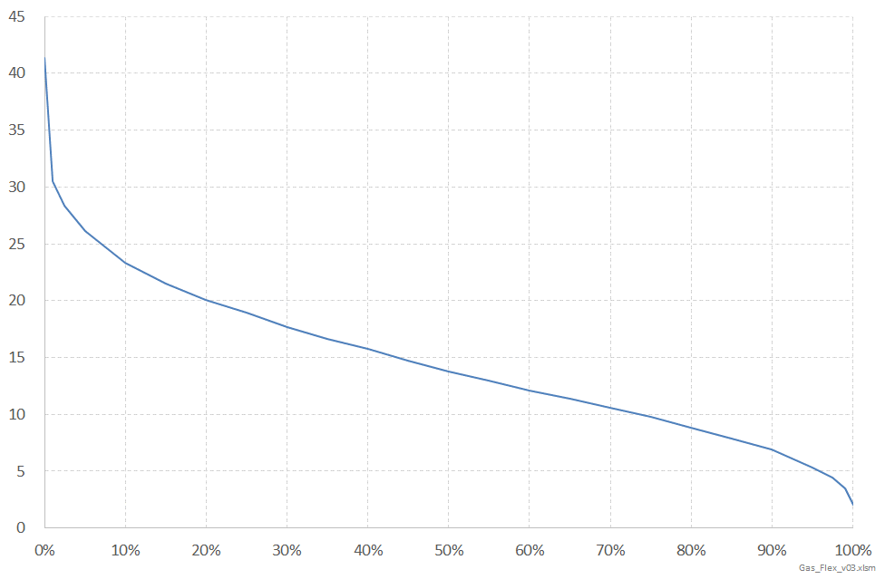
Section 8: Balancing – “Difficult Period”
Our general philosophy in the draft GTAC is to give shippers access to line pack for intra-day differences and fluctuations in injections/offtake
ERM charges should then reflect the value of parties’ cumulative use of line pack as opposed to alternatives (e.g. gas trading, flexible supply contracts, underground storage, etc)
However, the value of line pack can vary significantly – as suggested by the load duration curve shown below, when line pack is heavily relied on (>30PJ) to match supply and demand within a day
A single set of tolerances/ERM charges is unlikely to work across the range of line pack outcomes
TSO able to adjust ERM (and park and loan) charges in situations that warrant such a response (s 8.12 and s 8.13)
Having the ability for the TSO to declare a difficult period means:
Providing shippers and OBA parties with access to line pack on one set of terms when conditions are “normal”
Signalling when line pack has a higher value (e.g. during a sustained period of shipper mismatch, as observed in May 2017)
Small number of days when pipeline storage is highly valuable (and therefore extensively used)
Within-Day Change in line pack (TJ)
* Data from 1 Jan 2011 to 31 Mar 2017
Percent of Time

Slide 32
Sections 9 & 10: Curtailment and Congestion Management
Purpose: Set out circumstances where First Gas may curtail nominations and provides processes for managing such events, and prescribe processes for dealing with situations where demand exceeds ability to deliver gas on any part of the transmission system
General philosophy is to avoid curtailment wherever possible
There are circumstances where TSO action is needed to avoid emergencies / CC events (s 9.1)
Hierarchy of actions:
Operational Flow Orders (s 9.3)
Curtailment of injection / off-take (s 9.5) - note: failure to comply with OFOs has same effects on liability as incurring overruns
Congestion management provides contractual process for managing nominations so demand does not exceed transmission capacity
Enables First Gas to enter into contracts for Interruptible Load (with costs recovered from parties that benefit, s 10.14)
Gives effect to firm nature of PRs by scaling back DNC as required
Addresses risk of over-nomination to congested locations (s 10.18 and 10.19)
Provides for requirements about notifying new loads
Exclusion of TSO liability (s 10.24) reflects inherently uncertain nature of congestion

Slide 33
Section 11: Fees and Charges
Purpose: Set out the fees that First Gas can charge for access products and balancing services, and specify billing and payment requirements
Transmission Charges:
DNC charges (for each zone and Delivery Points not in a zone)
Throughput charge (initially propose to set at 0)
PR charges (determined via auction) and credited to DNC charges for same period
Overrun and underrun charges
Hourly overrun charge
Congestion management charges
Note: Overruns do not enable party to claim RPO defence against any resulting loss (but still subject to liability caps in s 14)
Balancing Charges:
ERM Charges
Park and Loan Charges
Balancing Gas Charges

Slide 34
Determining DNC Fees
First Gas proposes to set initial DNC fees (and other fees) so that the charge per GJ for transmission to any point approximately equals what it would have been in total under the MPOC and VTC
Basic methodology will involve the following process:
Start with allowable recoverable revenue
Subtract revenue from non-standard agreements
Determine delivered GJ to each zone or point
Determine the total $ for those GJ under the MPOC and VTC
Forecast the estimated quantity of DNC that will be booked and the estimated overruns
Divide the total $ for each zone or point by the forecast DNC (adjusted for overruns) to determine the DNC fee
In setting prices, First Gas aims to recover is maximum allowable revenue set by the Commerce Commission. If prices generate more revenue than allowed, this must be deducted from allowable revenue in the following year

Slide 35
Sections 12 & 13: Gas Quality and Odorisation
Purpose: Set out First Gas responsibilities for ensuring that only spec gas is injected and transported, and the actions taken in the event of non-spec gas entering the system, and First Gas responsibilities for odorising gas
Obligation on First Gas to require (via Receipt Point ICAs) that only specification gas is injected into the transmission system
ICA counterparties are required to have adequate facilities, systems, procedures and monitoring to ensure that only specification gas is injected into the transmission system
First Gas retains the right in its ICA’s with injecting parties to periodically seek a demonstration of compliance with the Gas Specification
Similar provisions from previous transmission codes requiring Shippers to be notified as soon as practicable after First Gas detects, suspects, or has been notified of a gas quality excursion
Obligation on First Gas to take reasonable steps to avoid causing non-specification gas as a result of gas transmission
Odorisation provisions carried over from VTC

Slide 36
Sections 14, 15 & 16: Prudentials, FM and Liabilities
Purpose: Prescribe requirements for shippers to post credit support for gas transmission services, define circumstances for FM, and limit liabilities
Prudential requirements carried across from existing codes
Force majeure
FM Event is a defined term
Requires an “event or circumstance beyond the reasonable control of a Party which results in or causes a failure or inability by such Party in the performance of any obligations”
Also seeks to clarify circumstances that do not constitute an FM event (s 15.4 & 15.5)
Liabilities
Proposing essentially the same exclusions and caps on liability as in existing codes

Slide 37
Sections 17 & 18: Code Governance
Purpose: Set out processes for changing the code and resolving disputes
Intention is to provide a process that allows GTAC to evolve and improve over time
Proposed change process:
Enable party requesting change to carry out initial consultative process for change requests (similar to VTC)
Give GIC decision-making role (similar to MPOC)
In line with recommendations from Concept Consulting in its report to GIC, except that ability to propose change limited to contract counterparties.
Have provided fast-track process for minor and urgent changes
Will require an MoU between First Gas and GIC.
Standard provisions to resolve disputes (negotiation, arbitration)

Slide 38
Next steps and proposed process

Slide 39
Revised engagement approach for draft GTAC
Complete GTAC draft released for consultation and negotiation (10 August)
Submission of GTAC to GIC for review (27 October)
2-day workshop (24-25 August)
Release of revised GTAC draft (8 September)
GIC complete review (by 22 December)
Initial run through session (17 August)
Mark-ups and submissions on revised draft GTAC due (6 October)
Telecon Q&A session (31 August)
* See GIC paper “Proposed approach to GTAC assessment” for further details on this stage
August 2017
September 2017
October 2017
November 2017
December 2017
Ensure provisions of GTAC are well-understood before inviting mark-ups
Enable further revisions to be made to better achieve intent and eliminate ambiguities
Allow stakeholders to propose improvements and highlight any remaining concerns on design
Time for First Gas to review proposed changes and submissions
Allow stakeholders further opportunity to address any unresolved issues (including issues raised by other parties prior to submission of final GTAC)

