Slide 1
Gas Transmission Access: Revised Draft GTAC Release
11 September 2017
First Gas / Presentation

Slide 2
Agenda
Purpose: highlight most significant changes from August draft – help to prepare stakeholders mark-ups and submissions
Agenda:
Update background information on zones and pricing
Most material areas of change to draft GTAC:
Further defining use of TSO discretion
Revising daily overruns/underruns
Reducing scope for hourly overruns and ensuring that agreed hourly flow profiles work as intended
Adding PR principles and application to congested parts of system
Note: worked examples will be added to this presentation for the workshop on 15 September 2017

Slide 3
Revised engagement approach for draft GTAC
Release of revised draft GTAC (11 September)
We are here
Submission of GTAC to GIC for review (3 November)
Complete GTAC draft released for consultation and negotiation (10 August)
2-day workshop (24-25 August)
Workshop on revised draft GTAC (15 September)
Cross-submissions on revised draft GTAC due (18 October)*
GIC complete review (by 22 December)
Initial run through session (17 August)
Mark-ups and submissions on revised draft GTAC due (9 October)
Telecon Q&A session (31 August)
* See GIC paper “Proposed approach to GTAC assessment” for further details on this stage
August 2017
September 2017
October 2017
November 2017
December 2017
Ensure provisions of GTAC are well-understood before inviting mark-ups
Enable further revisions to be made to better achieve intent and eliminate ambiguities
Allow stakeholders to propose improvements and highlight any remaining concerns on design
Time for First Gas to review proposed changes and submissions
Allow stakeholders further opportunity to address any unresolved issues (including issues raised by other parties prior to submission of final GTAC)
✓
✓
* To be reviewed at 15 September to ensure best possible use of available time

Slide 4
Background
The following documents have been released:
Revised draft GTAC (clean)
Revised draft GTAC (marked up against August release)
Revised draft GTAC (table format for mark-ups)
Actions items from draft GTAC workshops (annotated with actions taken)
This presentation setting out key changes from August to September drafts

Slide 5
Updated information on zones and pricing

Slide 6
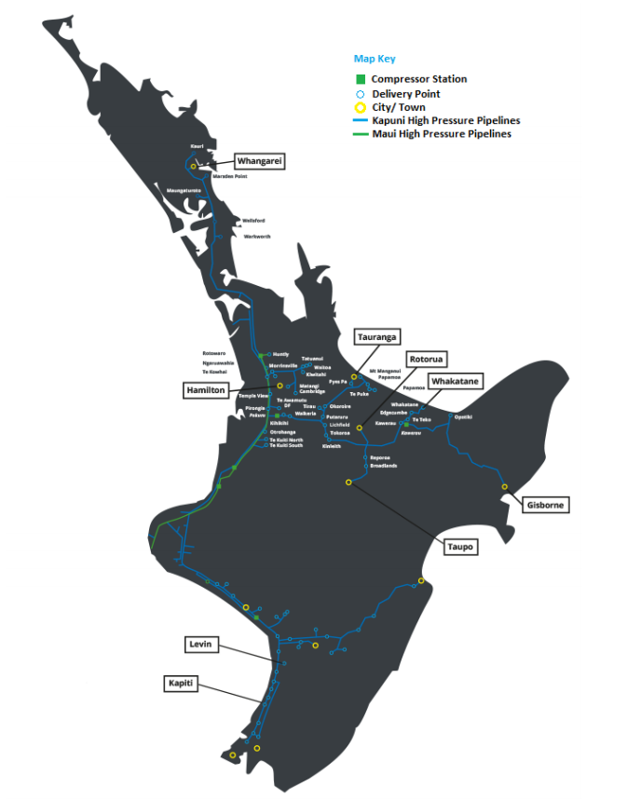
Updated information on zones
DZ 4
Number of delivery zones reduced from 17 to 12
Smaller dedicated delivery points integrated into zones
DZ 3
DZ 6
DZ 12
DZ 5
DZ 2
DZ 14
DZ 11
DZ 13
DZ 15
DZ 1
DZ 7
DZ 9
+ 15 Dedicated Delivery Points
DZ 8
+ Receipt Zone
DZ 11

Slide 7
Updated Illustration of Zonal Postage Stamp Prices
This shows approximately how much is paid per GJ for gas transmission
(Revenue / Volume)
Changes from earlier illustration reflect:
Reduction in number of delivery zones
Use of 2017/18 VTC prices
Some reallocation of intra-pipeline revenues
$2.30
$2.00
DZ 4
$2.30
$1.90
DZ 3
$2.40
* Hamilton (Zone 5) will, over time, be transitioned to a price equal to its zonal neighbours (Zones 2, 6 and 11)
DZ 6
DZ 12
$1.30
DZ 5
DZ 2
DZ 14
$2.00
DZ 11
$2.45
DZ 13
DZ 15
$0.50
DZ 1
$2.35
$1.75
DZ 7
DZ 9
DZ 8
$1.90
$2.10
DZ 11
$1.82

Slide 8
Is the change to GTAC likely to create price shock?
We aim to minimise price shock in moving to the GTAC
We must all acknowledge, however, that some degree of price change must accompany a single code (since the access product definitions will change):
Shippers with higher utilisation of reserved capacity can expect to pay more under GTAC (all else being equal)
Shippers with lower utilisation of reserved capacity can expect to pay less under the GTAC (all else being equal)
Parties that nominate accurately will pay less per GJ than other parties
From the information we have received from shippers, it seems likely that:
Some users may face significant changes in transmission charges – although as a proportion of their total gas charges, the changes are much less material (e.g. if transmission price to a user increases by 20% but transmission is only 10% of total gas charges, then the overall increase in gas charges is 2% (assuming direct pass-through))
The impact will be much less for each shipper, since shippers serve a diverse customer base. Hence, the ultimate price impact for users will depend on how shippers pass-through price changes

Slide 9
Material changes in revised draft GTAC

Slide 10
Further defining use of TSO discretion
If First Gas or a related party becomes involved in gas production or activities that require use of the gas transmission system for reasons other than in its role as TSO, we will apply to ourselves the same requirements for use of the gas transmission system as set out in the code
The TSO cannot offer preferential shipping treatment to related parties
First Gas does not need to be a Shipper to ship fuel to its compressors (which it does currently under the MPOC given the two code structure). This does not diminish our requirement to balance / liability for Mismatch
Note: Arms length transaction is defined in ISA (NZ) 550 as “a transaction conducted on such terms and conditions as between a willing buyer and a willing seller who are unrelated and are acting independently of each other and pursuing their own best interests”

Slide 11
Further defining use of TSO discretion
Allocation of costs/credits and GJ of Balancing Gas is now limited to shippers’ and OBA parties’ negative and positive running mismatches
Code now specifies initial ERM incentive fees in s8.14 (based on existing incentive fees charged under the MPOC since last critical contingency):
$0.60/GJ for negative ERM
$0.20/GJ for positive ERM
Reflects asymmetric consequences of low and high line pack events
Mechanism to change if:
Stated objectives are not being achieved (to provide incentives for shippers and OBA parties to meet their Primary Balancing Obligation)
5 days notice is required prior to any change
“Difficult day” provisions provide scope for increasing incentive fees (with notice) (s8.12(a)-(b) and s8.13(a)-(b))
Park and loan fees will be set no higher than balancing incentive fees – to reflect the benefits of TSO having notice of imbalances

Slide 12
Further defining use of TSO discretion
Limited use of First Gas veto of change requests to situations where change would:
Affect ability of First Gas to act as an RPO in its role as system operator
Lead to costs being incurred that cannot be recovered
Process for changing definition of receipt and delivery zones (sections 3.3 and 3.4), and requiring notice period

Slide 13
Daily overruns/underruns
Have adjusted overruns to 2x DNC and underruns to 1x DNC (s11.5(b))
Higher at Congested DPs
Have provided ability to change if (following consultation) FG concludes that the overruns/underruns as set are failing to achieve the objective of reasonably accurate nominations
Have not provided for a tolerance since:
Delivery Zones have been re-set (increasing diversification benefit for shippers)
Agree with concern that tolerances for overruns/underruns would allow parties with predictable daily requirements to “lean” on the tolerance (and therefore systematically underpay for transmission)
We see this as fundamentally different from balancing (where we have provided a tolerance), since balancing tolerances cannot be systematically abused given that mismatch is cumulative (RM / ERM) (i.e. “leaning” on the tolerance will not avoid ERM fees)

Slide 14
Daily overruns/underruns
We consider that these incentives help to address problems identified with the VTC, where new entrants face barriers to entry because incumbent retailers have an existing load profile that enables them to compete more effectively for new load that comes to market
Competitive advantage is instead aimed to generate flow of quality information from end users to shippers to FG in use of system capacity across zones

Slide 15
Hourly overruns and agreed hourly profiles
For Dedicated DPs, the MHQ will now be DP-specific, for determining Hourly Overrun Charges
To ensure peaky loads pay more for their “disproportionate” effects
Inserted a de minimus quantity of 200 GJ per hour
Subject to Agreed Hourly Profile (“AHP”)
Introduced an Over-Flow Charge, linked to the maximum physical capacity of a Dedicated Delivery Point
First Gas will charge the Interconnected Party for both Hourly Overruns and/or Over-Flow where we can, not Shippers
First Gas will not unreasonably withhold approval of an AHP
Made revoking an AHP conditional on avoiding breaching an Acceptable Line Pack Limit or having to curtail DNC or Supplementary Capacity

Slide 16
PRs
Simple change to code to enable multiple DP congestion (including dedicated delivery points)
“Congested Delivery Point” becomes “Congested Delivery Point(s)”
In situation of Congested Delivery Points competing for the same PRs (reflecting the physical reality that capacity scarcity applies across the aggregate load at more than one DP)
PR Auction drafting tidied up
If First Gas declares that Congestion is no longer an issue, a Shipper may cancel PRs if it chooses

Slide 17
PRs - Governance
We agree that some form of GIC oversight of PRs would be useful. Have not put anything formal in the Code. We think something like the GIC’s review of MBB 12 months on would be best way to provide this oversight. i.e.
Recap objectives: what are PRs supposed to achieve?
Review process: how did it work (auction mechanics, secondary trading, etc)?
Evaluate performance: did PRs actually serve to value scarce capacity in an effective, pro-competitive way?
Recommend improvements: What changes (if any) to code provisions or trading rules would help achieve objectives?

Slide 18
Allocations – Status of D+1 and meter data publication
GTAC balancing regime requires day-in-arrears allocations for all receipt and delivery points
D+1 allocations currently do this for delivery points allocated under the DRRs via Special Allocations
GTAC accepts all allocations for delivery points produced under the DRRs (including Special Allocations)
Until the DRRs have been updated for D+1 (or an equivalent replacement), First Gas will continue to use D+1’s day-in-arrears allocations
If necessary, First Gas will enter into a replacement document or amend the current agreement with the GIC so D+1 will be used under the GTAC
Under the GTAC First Gas will commit to providing the following data no later than what is done currently:
Gas Composition Data
Unvalidated meter data
Validated meter data

Slide 19
Curtailment
“Curtail” is used in different contexts in the GTAC e.g. First Gas may curtail nominations for DNC at a Delivery Point where it believes it will not be able to provide the capacity requested; we may also seek to curtail actual flow in the circumstances referred to in section 9.1 GTAC
Section 9 is not intended to provide the tools to curtail nominations. This section is mainly about events that have damaged or affected, or may damage or affect the physical ability of the Transmission System (or part of it) to receive and/or deliver gas
Shippers and Interconnected Parties encouraged to use the tools available to them e.g. ID Cycles (including proposed Emergency Cycle) and gas trading options to manage their respective positions and potential exposures
Section 15.1 and section 15.2 MPOC “curtailments” (exercisable outside of Nomination Cycles) are primarily designed to reduce Scheduled Quantities at both the Receipt and corresponding Delivery Points (given the linked nature of MPOC nominations) in the event of certain adverse circumstances. Curtailment in section 9 GTAC (and in ICA’s) is directed at the reduction of actual flow and may be supplemented with an OFO if the circumstances warrant it

Slide 20
Curtailment and Gas Quality
First Gas will direct any OFO to the Interconnected Party where possible
Where we become aware that Non-specification gas is in the system we will notify all Shippers and Interconnected Parties who might receive some
First Gas will notify any Maintenance that will reduce its ability to receive or deliver Gas on OATIS
Shippers must reasonably cooperate

