Slide 1
Gas Transmission Access: Revised Draft GTAC Release
15 September 2017
First Gas / Presentation

Slide 2
Agenda
Purpose: highlight most significant changes from August draft – help to prepare stakeholders mark-ups and submissions
Agenda:
Recap on where we are in process and next steps from here
Update background information on zones and pricing
Most material areas of change to draft GTAC (with worked examples):
Further defining use of TSO discretion
Revising daily overruns/underruns
Reducing scope for hourly overruns and ensuring that agreed hourly flow profiles work as intended
Adding PR principles and application to congested parts of system
Reflect on whether process and next steps will deliver on objectives

Slide 3
Background
The following documents have been released:
Revised draft GTAC (clean)
Revised draft GTAC (marked up against August release)
Revised draft GTAC (table format for mark-ups)
Actions items from draft GTAC workshops (annotated with actions taken)
This presentation setting out key changes from August to September drafts

Slide 4
Revised engagement approach for draft GTAC
Release of revised draft GTAC (11 September)
We are here
Submission of GTAC to GIC for review (3 November)
Complete GTAC draft released for consultation and negotiation (10 August)
2-day workshop (24-25 August)
Workshop on revised draft GTAC (15 September)
Cross-submissions on revised draft GTAC due (18 October)*
GIC complete review (by 22 December)
Initial run through session (17 August)
Mark-ups and submissions on revised draft GTAC due (9 October)
Telecon Q&A session (31 August)
* See GIC paper “Proposed approach to GTAC assessment” for further details on this stage
August 2017
September 2017
October 2017
November 2017
December 2017
Ensure provisions of GTAC are well-understood before inviting mark-ups
Enable further revisions to be made to better achieve intent and eliminate ambiguities
Allow stakeholders to propose improvements and highlight any remaining concerns on design
Time for First Gas to review proposed changes and submissions
Allow stakeholders further opportunity to address any unresolved issues (including issues raised by other parties prior to submission of final GTAC)
✓
✓
* To be reviewed at 15 September to ensure best possible use of available time

Slide 5
Decisions on GTAC adoption
If the MPOC change request is supported, we see the GIC review process proceeding as follows:
Submission of GTAC to GIC for review and industry consultation
Is GTAC materially better than MPOC / VTC?
YES
NO
Have any suggested improvements been made that are minor or non-controversial?
Can the reasons the GTAC is not materially better be remedied by First Gas?
YES
NO
YES
NO
Consider minor changes to final GTAC
Adopt version submitted to GIC as final GTAC
Revise and consult on GTAC to address reasons (3-6 months)
Regulated code

Slide 6
Updated information on zones and pricing

Slide 7
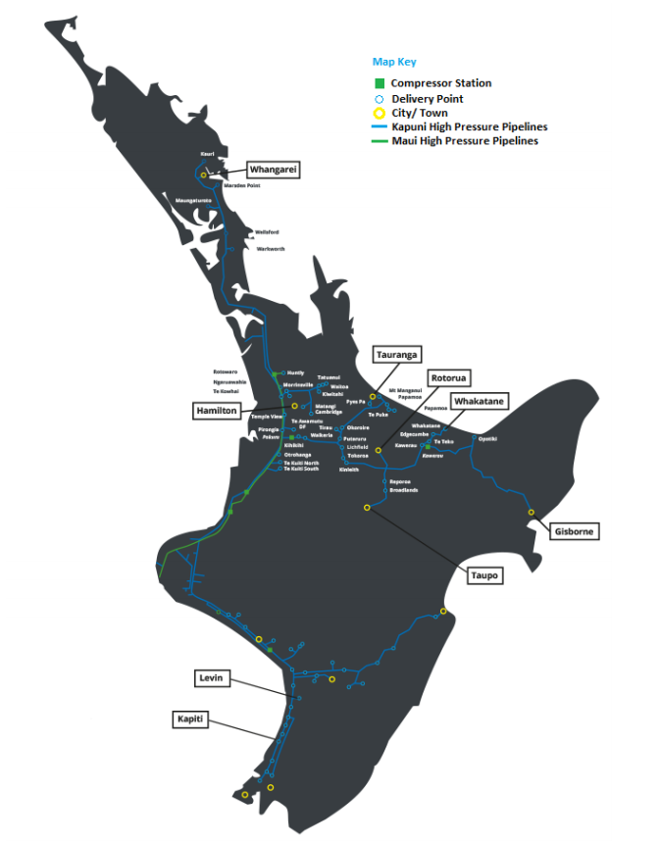
Updated information on zones
Number of delivery zones reduced from 17 to 15
Smaller dedicated delivery points integrated into zones (reducing DDPs from 37 to 15)
Spreadsheet on GIC website maps DPs to zones
DZ 4
DZ 3
DZ 6
DZ 12
DZ 5
DZ 2
DZ 14
DZ 11
DZ 13
DZ 15
DZ 1
DZ 7
DZ 9
+ 15 Dedicated Delivery Points
DZ 8
+ Receipt Zone
DZ 10
7

Slide 8
Updated Illustration of Zonal Postage Stamp Prices
This shows approximately how much is paid per GJ for gas transmission
(Revenue / Volume)
Changes from earlier illustration reflect:
Reduction in number of delivery zones
Use of 2017/18 VTC prices
Some reallocation of intra-pipeline revenues
$2.30
$2.00
DZ 4
$2.30
$1.90
DZ 3
$2.40
* Hamilton (Zone 5) will, over time, be transitioned to a price equal to its zonal neighbours (Zones 2, 6 and 11)
DZ 6
DZ 12
$1.30
DZ 5
DZ 2
DZ 14
$2.00
DZ 11
$2.45
DZ 13
DZ 15
$0.50
DZ 1
$2.35
$1.75
DZ 7
DZ 9
DZ 8
$1.90
$2.10
DZ 10
$1.82
8

Slide 9
Is the change to GTAC likely to create price shock?
We aim to minimise price shock in moving to the GTAC
We must all acknowledge, however, that some degree of price change must accompany a single code (since the access product definitions will change):
Shippers with higher utilisation of reserved capacity can expect to pay more under GTAC (all else being equal)
Shippers with lower utilisation of reserved capacity can expect to pay less under the GTAC (all else being equal)
From the information we have received from shippers, it seems likely that:
Some users may face significant changes in transmission charges – although as a proportion of their total gas charges, the changes are much less material (e.g. if transmission price to a user increases by 20% but transmission is 10% of total gas charges, then the overall increase in gas charges is 2% (assuming direct pass-through))
The impact will be much less for each shipper, since shippers serve a diverse customer base. Hence, the ultimate price impact for users will depend on how shippers pass-through price changes

Slide 10
Material changes in revised draft GTAC

Slide 11
Further defining use of TSO discretion
If First Gas or a related party becomes involved in gas production or activities that require use of the gas transmission system for reasons other than in its role as TSO, we will apply to ourselves the same requirements for use of the gas transmission system as set out in the code
The TSO cannot offer preferential shipping treatment to related parties
First Gas does not need to be a Shipper to ship fuel to its compressors (which it does currently under the MPOC given the two code structure). This does not diminish our requirement to balance / liability for Mismatch
Note: Arms length transaction is defined in ISA (NZ) 550 as “a transaction conducted on such terms and conditions as between a willing buyer and a willing seller who are unrelated and are acting independently of each other and pursuing their own best interests”

Slide 12
Further defining use of TSO discretion
Allocation of costs/credits and GJ of Balancing Gas is now limited to Shippers’ negative and positive running mismatches
Code now specifies initial ERM incentive fees in s8.14 (based on existing incentive fees charged under the MPOC since last critical contingency):
$0.60/GJ for negative ERM
$0.20/GJ for positive ERM
Reflects asymmetric consequences of low and high line pack events
Mechanism to change if:
Stated objectives are not being achieved (to provide incentives for shippers and OBA parties to meet their Primary Balancing Obligation)
5 days notice is required prior to any change
“Difficult day” provisions provide scope for increasing incentive fees (with notice) (s8.12(a)-(b) and s8.13(a)-(b))
Park and loan fees will be set no higher than balancing incentive fees – to reflect the benefits of TSO having notice of imbalances

Slide 13
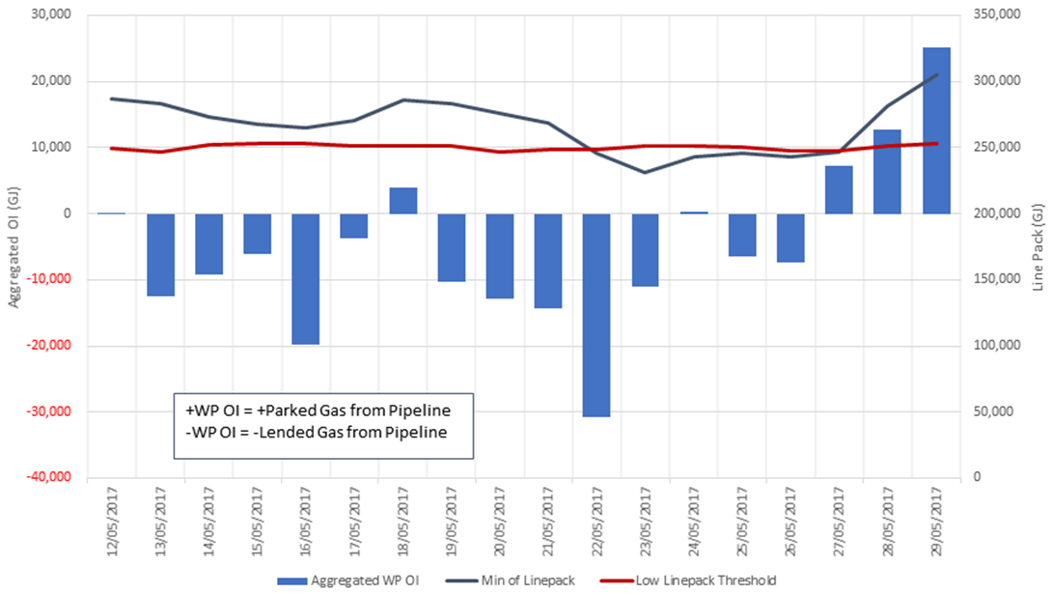
Difficult Day – Worked example: May 2017

Slide 14
Difficult Day – Worked example (MPOC)
Consistent negative mismatch suggests short term storage has value that exceeds cost of cash-outs
Critical contingency declared
Increasing negative mismatch suggests value of short term storage exceeding pipeline capacity to deliver

Slide 15
Difficult Day – Worked example (GTAC)
Negative ERM charge increased from $0.60/GJ to $3.00/GJ
Positive ERM reduced from $0.20/GJ to $0/GJ
Difficult day
declared
Charges for ERM better reflect short term storage value and pipeline ability to accommodate

Slide 16
Further defining use of TSO discretion
Limited use of First Gas veto of change requests to situations where change would:
Affect ability of First Gas to act as an RPO in its role as system operator
Lead to costs being incurred that cannot be recovered
Process for changing definition of receipt and delivery zones (sections 3.3 and 3.4), and requiring notice period

Slide 17
GTAC Nomination Examples
The following slides are basic examples of how nominations work under the draft GTAC
An Excel version is available on request

Slide 18
GTAC Nomination Examples – Basic Process, NATA
Shippers place nominations
Nominations are approved by OBA parties and/or First Gas
During the day there will be intraday nominations cycles
Shippers, OBA parties and First Gas can trade during the day
This includes balancing gas
Balancing gas transaction allocation occurs as soon as that transaction is uploaded into the IT system and the Running Mismatch for the previous day is calculated
The next day the actual GJ that have flowed are allocated and the Running Mismatches for the day calculated
Nominate
Approve
Trade
Allocate

Slide 19
GTAC Nomination Example
In this example the Shipper –
Sources gas from:
An OBA injecting party; and
A non-OBA injecting party
Trades gas via:
The gas market
Bilateral trades through GTAs
Has gas transported to:
An OBA delivery point; and
An Allocation Agreement direct connect delivery point; and
A Delivery Zone

Slide 20
GTAC Nomination Example – Nominate, Receipts
Shipper makes the receipt nominations
Receipt Point | Nomination
OBA Receipt | 50
Non-OBA Receipt | 70
Total Receipts | 120
OBA Receipt nomination is what is agreed with the OBA party
Non-OBA Receipt nomination will be:
What has been agreed with the connection party, if the connected party is using the IT system’s nomination functionality; or
The Shippers estimate of what they expect to receive from the connection party, if the connected party is not using the nomination functionality

Slide 21
GTAC Nomination Example – Nominate, Delivery
Shipper makes the delivery nominations
Delivery Point | Nomination
OBA Delivery | 40
AA Delivery | 25
DZ Delivery | 50
Total Deliveries | 115
Note that the Shipper has nominated for less than the receipt nominations
Delivery nominations may be different than receipt nominations because the Shipper is forecasting that their delivered gas will be different than their receipted gas
OBA Delivery nomination is what is agreed with the OBA party
Other nominations are what the connected party has agreed (AA Delivery) or what the Shipper has forecasted (DZ Delivery)

Slide 22
GTAC Nomination Example – Nominate, intraday
During the day the Shipper can renominate their receipt and delivery nominations during the ID cycles
For an OBA point, the renomination will reflect the changed agreed quantity with the relevant OBA party
For other points the nomination will be changed to equal the Shippers adjusted forecast of demand to the relevant point or delivery zone
To keep this example simple there are no renominations

Slide 23
GTAC Nomination Example – Approve
OBA nominations will need to be approved by the OBA party
Delivery point OBA party’s will incur overrun/underrun charges for the difference between the total nominations and the gas flow through the relevant point
Nominations to non-OBA points, where the connected party has chosen to use the nomination functionality, will need to be approved by the connected party
Nominations to all other points will be auto-checked by the IT system for approval as they are done currently
To avoid over/underrun incentive fees, it is the Shipper’s responsibility to ensure these nominations are accurate

Slide 24
GTAC Nomination Example – Trade, Balancing Gas
During the day First Gas may need to buy or sell balancing gas
Allocation of balancing gas GJ will be calculated by the IT system when the trade has occurred and the closing Running Mismatch for the previous day has been calculated
In this example a balancing gas trade has occurred, the allocation to the Shipper is -5

Slide 25
GTAC Nomination Example – Trade
Net of the receipt and delivery nominations is 120 – 115 = +5
The Shipper also has:
-5 of balancing gas transactions
Carryover Running Mismatch of +10
The net of this is +5 -5 +10 = +10
To reduce this, the Shipper engages in Market and GTA trades
Trade Regime | Trade
Balancing Gas | -5
Market | -10
GTA | +5
Net Trading | -10

Slide 26
GTAC Nomination Example – Trade
Trades occur in the Receipt Zone and are essentially an adjustment to the net receipts
Traded quantities are the GJ traded:
On the market
Uploaded into the IT system by the market owner
First Gas is talking with emsTradepoint on when the uploads happen
Ideal is that uploads occur when the trade has occurred
Via bilateral agreements:
Entered and performed via a functionality in the IT system; or
Uploaded into the IT system by the relevant party
It is up to the relevant parties to upload/enter the trade into the IT system
Shippers will not need to enter nominations for traded gas as is done currently
Traded gas will not be able to be ‘curtailed’ as can happen currently
Parties can trade more than their Running Mismatch

Slide 27
GTAC Nomination Example – Trade, OBA Parties
Running Mismatch ‘exists’ in the Receipt Zone
All trading occurs within the Receipt Zone
OBA parties can reduce Running Mismatch by:
Changing nominations relative to gas flow; or
Trade (gas market or bilateral)
However, delivery point OBA parties also have overrun/underrun incentives
Using nominations to reduce Running Mismatch will attract these incentives
Therefore, if a delivery point OBA party wishes to reduce their Running Mismatch without incurring overrun/underruns they will need to trade

Slide 28
GTAC Nomination Example – Allocate, GJ
After the end of each day, energy quantities (GJ) for each point and zone are calculated
For a Shipper their allocated GJ will be:
For OBA points – Approved nominated GJ
For an Allocation Agreement point – the GJ allocated via the Allocation Agreement
This will be uploaded into the IT system by the relevant party
For a DRR point – GJ allocated by the DRRs
This will be uploaded into the IT system by the Allocation Agent
Delivery Zone GJ are the sum of the GJ for the relevant delivery points

Slide 29
GTAC Nomination Example – Allocate, Mismatch
The table below shows the results from the allocations
Cells highlighted in yellow are allocated GJ that are different to the nominated GJ
The Shipper had nominated/traded for a net difference for the day of 110 – 115 = -5 but the allocated difference for the day, and actual Mismatch, is 115 – 105 = +10
Point/Zone | Rcpt Nom | Dlvy Nom | Rcpt GJ | Dlvy GJ
Rcpt OBA | 50 |  | 50
Rcpt Non-OBA | 70 |  | 75
Trades | -10 |  | -10
Dlvy OBA |  | 40 |  | 40
AA Dlvy |  | 25 |  | 20
DZ Dlvy |  | 50 |  | 45
Net | 110 | 115 | 115 | 105
Mismatch | 0 |  | +10

Slide 30
GTAC Nomination Example – Allocate, Running Mismatch
With the allocated quantities calculated, the Running Mismatch is now calculated
This is Running Mismatch from the previous day plus Mismatch on the day
In the previous slide the balancing gas allocation had been included as part of the trades
Item | RM d-1 | Mismatch d | RM d
Running Mismatch | +10 | +10 | +20

Slide 31
Allocations – Status of D+1 and meter data publication
GTAC balancing regime requires day-in-arrears allocations for all receipt and delivery points
D+1 allocations currently do this for delivery points allocated under the DRRs via Special Allocations
GTAC accepts all allocations for delivery points produced under the DRRs (including Special Allocations)
Until the DRRs have been updated for D+1 (or an equivalent replacement), First Gas will continue to use D+1’s day-in-arrears allocations
If necessary, First Gas will enter into a replacement document or amend the current agreement with the GIC so D+1 will be used under the GTAC
Under the GTAC First Gas will commit to providing the following data no later than what is done currently:
Gas Composition Data
Unvalidated meter data
Validated meter data

Slide 32
Daily overruns/underruns
Have adjusted overruns to 2 x DNC and underruns to 1 x DNC (s11.5(b))
Higher at Congested DPs
Able to change the multiple if (following consultation) FG concludes that the overruns/underruns are failing to achieve the objective of reasonably accurate nominations
Have not provided for a tolerance since:
Delivery Zones have been re-set (increasing diversification benefit for shippers)
Agree with concern that tolerances for overruns/underruns would allow parties with predictable daily requirements to “lean” on the tolerance (and therefore systematically underpay for transmission)
We see this as fundamentally different from balancing (where we have provided a tolerance), since balancing tolerances cannot be systematically abused given that mismatch is cumulative (RM / ERM) (i.e. “leaning” on the tolerance will not avoid ERM charges)

Slide 33
Daily overruns/underruns
We consider these incentives help to address problems identified with the VTC, where new entrants face barriers to entry because incumbent retailers have an existing load profile that enables them to compete more effectively for new load that comes to market
Competitive advantage is instead aimed to generate flow of quality information from end users to shippers to FG in use of system capacity across zones

Slide 34
Hourly overruns and agreed hourly profiles
For Dedicated DPs, the MHQ will now be DP-specific, for determining Hourly Overrun Charges
To ensure peaky loads pay for their “disproportionate” effects
There is a threshold HQ of 200 GJ
Subject to Agreed Hourly Profile (“AHP”)
First Gas will charge the Interconnected Party for Hourly Overruns where we can, not Shippers
AHP is a schedule of consecutive HQs for one or more consecutive days
Can be switched on or off
First Gas will not unreasonably withhold approval of an AHP
Will revoke only to avoid breach of an Acceptable Line Pack Limit or having to curtail DNC or Supplementary Capacity

Slide 35
Hourly Overrun Charges – why have them at all?
The day is accepted as the appropriate time base for gas sales and purchases, hence transmission capacity (as MDQ).
DQs are no use whatever in designing pipelines, compressors, metering or anything else to do with the Transmission System
For design, the accepted time base is the hour, hence hourly quantity (MHQ) or flow rate scm/hour
In reality it’s the “peak instantaneous flow” that causes blades to come off turbine meters and regulators to go haywire. But, in most cases, the downstream system into which gas flows buffers PIF
HQs are often more significant in determining capacity
MHQ has been defined since Moses. Our ancestors knew what they were doing: 1/16th of the MDQ is a terrifically good rule of thumb

Slide 36
Hourly Overrun Charges (2)
An Hourly Overrun Charge is a commercial thing. Why bother defining a contractual MHQ if there is no sanction for exceeding it? Think of HOCs as:
A peaking charge, to compensate for the disproportionate effect of peaky loads on line pack (i.e. taking us closer to a minimum pressure, limiting transmission capacity, etc)
A “fairness” charge. A peaky load that doesn’t have to worry about MHQ may book less DNC and contribute less revenue than a flatter load, even though it is peaky loads that ultimately determine how much capacity we can sell
An advertisement that “flow rates” matter too, not just DQs and AQs
With the hourly overrun threshold at 200 GJ, HOCs will generate negligible revenue, but that is beside the point
There are other ways to achieve the “fairness” aspect of HOCs: e.g. by including a peak flow or load factor component into DNC Fees

Slide 37
Over-Flow Charge
Have introduced an Over-Flow Charge, linked to the maximum physical capacity of a Dedicated Delivery Point (expressed as a “Physical MHQ”)
The Over-Flow Charge is intended as a deterrent to exceeding the Physical MHQ: unpredictable and very bad things can happen.
First Gas will charge the Interconnected Party for Over-Flow where we can, not Shippers

Slide 38
PRs
Simple change to code to enable multiple DP congestion (including dedicated delivery points)
“Congested Delivery Point” becomes “Congested Delivery Point(s)”
In situation of Congested Delivery Points competing for the same PRs (reflecting the physical reality that capacity scarcity applies across the aggregate load at more than one DP)
PR Auction drafting tidied up
If First Gas declares that Congestion is no longer an issue, a Shipper may cancel PRs if it chooses

Slide 39
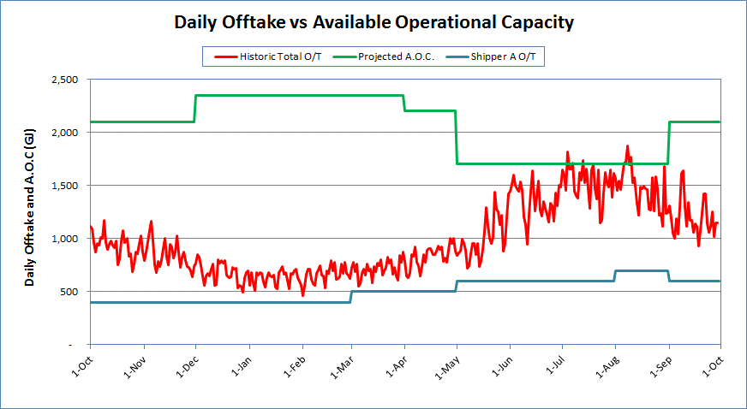
Worked Example – Congestion Management (1)
Available Operational Capacity normally varies during a Year, e.g.:

Slide 40
Congestion Management Example (2)
In this example, the “historical” offtake is expected to exceed the projected A.O.C. on some days
The GTAC proposes ≥ 2 Scheduled PR Auctions per year:
On 1 Sept. (for 1/10 – 31/03) and 1 March (for 1/04 – 30/09)
No Congestion is indicated in 1 October – 31 March
Congestion appears likely in July and August
The Scheduled PR Auction for 1 March (only) is confirmed
1,700 PRs offered (= minimum projected A.O.C. 1 April – 30 Sept.)
PR Allocation Day: 1 April
PR Term (6 months): 1 April – 30 September
Imagine Shippers A & B account for all offtake
Both bid for PRs equal to 100% of historic peak offtake

Slide 41
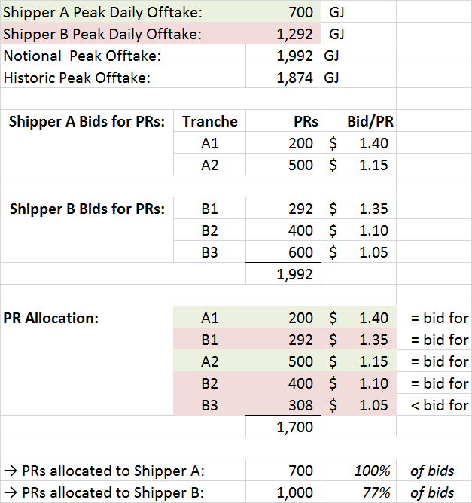
Congestion Management Example (3)

Slide 42
Congestion Management Example (4)
Shipper A’s peak offtake (700 GJ) is fully covered by PRs (700)
Shipper B has insufficient PRs (1,000) to cover its peak offtake (1,292 GJ): it could have NQs curtailed
But, PRs are only useful if the Shipper nominates to them
Precedence: Changed Provisional NQs > Intra-Day NQs
Various scenarios are possible:
Future load might be less, equal or greater than historic
Shippers obtain DNC/PRs for their individual peaks: if they don’t overlap Congestion might not occur
Shipper B might be curtailed if its NQ < 700 GJ and its customers peak unexpectedly (→ maybe Shipper A not so much)
A.O.C. on a Day might be > projected prior to the Year

Slide 43
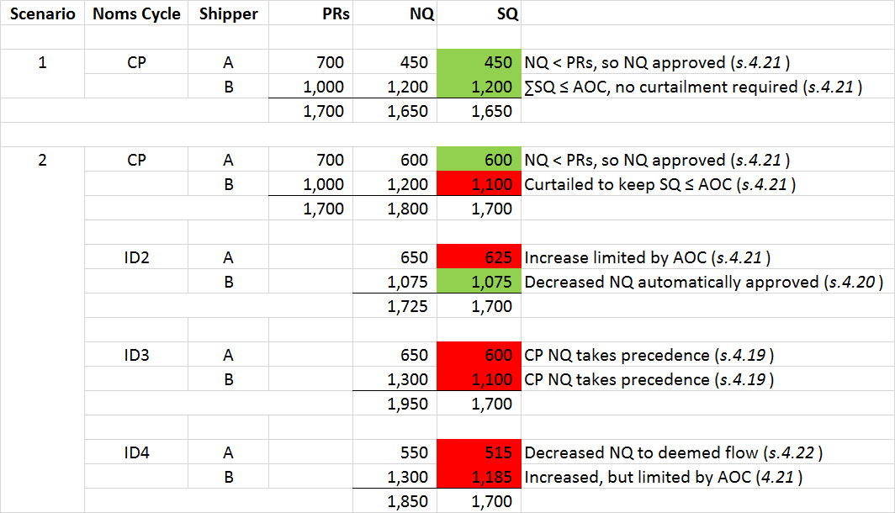
Congestion Management Example (5)

Slide 44
Congestion Management Example (6)

Slide 45
Congestion Management Example - Conclusion
PRs are intended to provide priority access to transmission capacity
PRs themselves do not:
Provide or create capacity
Protect the holder against the physical effects of others’ overruns
A Shipper whose NQs are curtailed bears the responsibility for ensuring its customers’ demand does not exceed its contractual capacity entitlements
No different from current Codes

Slide 46
PRs - Governance
We agree that some form of GIC oversight of PRs would be useful. Have not put anything formal in the Code. We think something like the GIC’s review of MBB 12 months on would be best way to provide this oversight, e.g.:
Recap objectives: what are PRs supposed to achieve?
Review process: how did it work (auction mechanics, secondary trading, etc)?
Evaluate performance: did PRs actually serve to value scarce capacity in an effective, pro-competitive way?
Recommend improvements: What changes (if any) to code provisions or trading rules would help achieve objectives?

Slide 47
Curtailment
“Curtail” is used in different contexts in the GTAC, e.g. First Gas may curtail:
NQs at a Delivery Point > Available Operational Capacity (as discussed above)
Actual flow in the circumstances referred to in section 9.1
Section 9 is not intended to provide the tools to curtail nominations. It’s focus is responding to events that have damaged or affected, or may damage or affect the physical ability of the Transmission System (or part of it) to receive and/or deliver gas.
Shippers and Interconnected Parties should use the tools available e.g. ID Cycles (including proposed Emergency Cycle) and gas trading to manage their Mismatches.
First Gas will only use an OFO if the circumstances warrant
Section 15.1 and section 15.2 MPOC “curtailments” (exercisable outside of Nomination Cycles) are primarily designed to reduce Scheduled Quantities at both the Receipt and corresponding Delivery Points (given the linked nature of MPOC nominations) in the event of certain adverse circumstances.

Slide 48
Curtailment and Gas Quality
First Gas will direct any OFO to the Interconnected Party where possible
Where we become aware that Non-specification gas is in the system we will notify all Shippers and Interconnected Parties who might receive some
First Gas will notify any Maintenance that will reduce its ability to receive or deliver Gas on OATIS
Shippers must reasonably cooperate

Slide 49
“Additional Agreements” – ICA’s & Supplementary Agreements
The August draft Receipt Point and Delivery Point ICAs are being updated in line with GTAC changes
This process will continue until the GTAC is finalised. Revised ICAs will accompany the “final” GTAC that goes to the GIC in early November
The template ICAs will be the foundation for discussions with existing MPOC ICA holders. A degree of customisation is expected
Existing Supplementary Agreements will be reviewed case by case with the Shippers concerned. For example:
Receipt and Delivery Point definitions may need to change
Transmission fees will need to reflect the MPOC’s demise
First Gas will discuss Existing Supplementary Agreements with Shippers once the GTAC goes to the GIC

Slide 50
Revisit Process and Next Steps

Slide 51
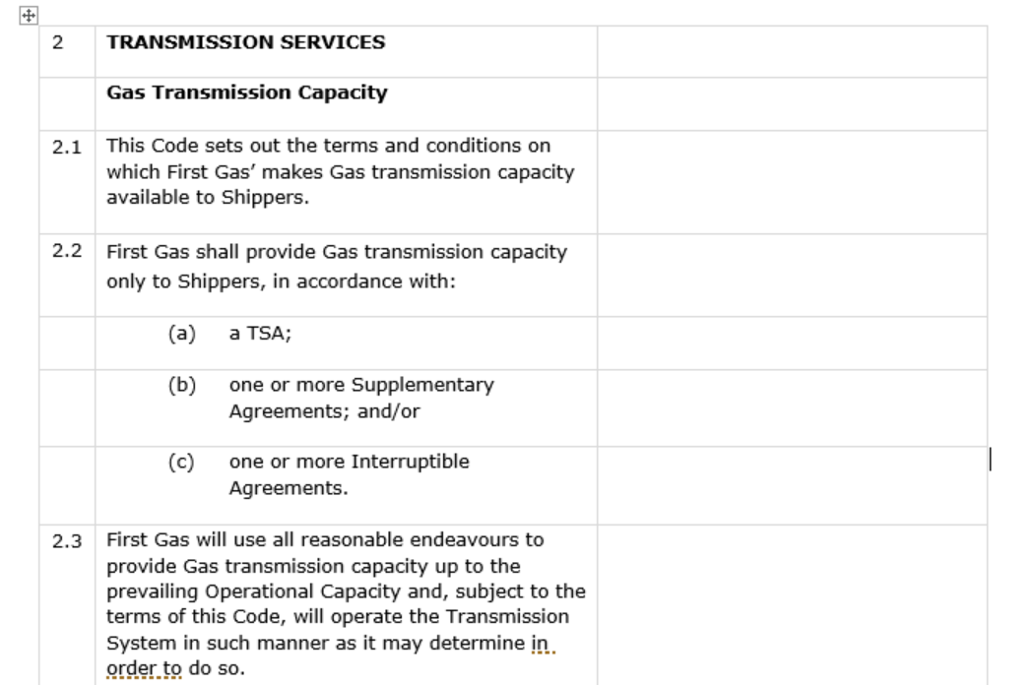
Proposed format of revised draft GTAC – 11 September
On 11 September, we released:
A complete clean version of the GTAC
A mark-up comparing to version released on 11 August
A clean version in table format (shown on left) for parties to mark-up

Slide 52
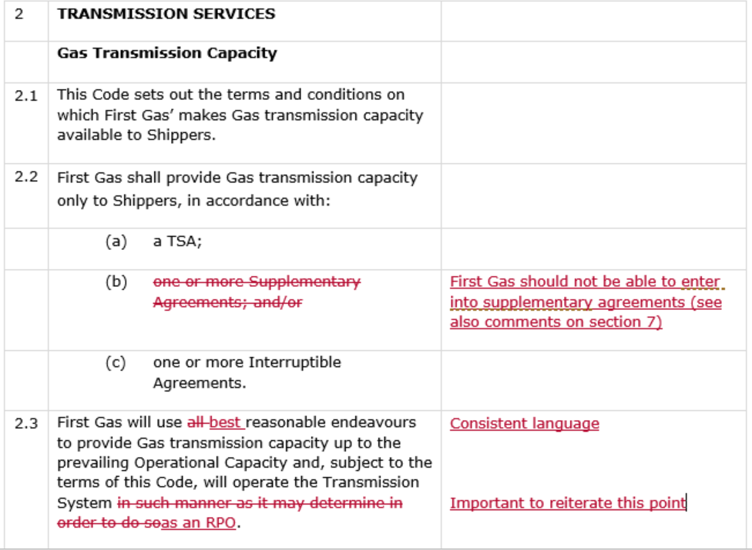
Release of revised draft GTAC – 11 September

Slide 53
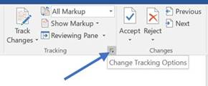
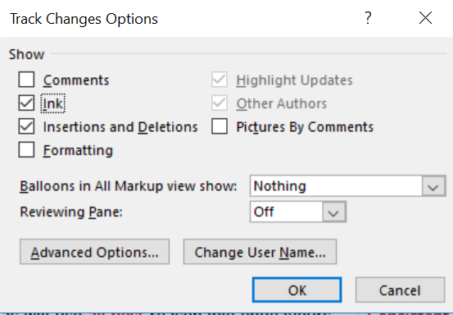
Important Rules for mark-ups
One set of mark ups per organisation in Word (will not be accepting hand-written pdfs)
Retain consistent numbering – to add a provision insert a row and mark with *, if a provision is deleted leave the number
No formatting changes or Word comments (use the table for comments)
Adjust track change settings as shown

Slide 54
Once mark-ups are received
First Gas will work through all marked-up versions clause by clause – deciding which to accept, reject or consider further
We may seek clarification from parties about particular mark-ups, but will not be workshopping the mark-ups
The GTAC sent to the GIC for review will be accompanied by an explanation of changes made from 11 September version – also in table format
Unlikely to respond to each proposed mark-up
Will be able to respond to themes/material issues for each section/clause
We will provide an assessment of costs and benefits of the GTAC that is sent to the GIC for review

Slide 55
Will process deliver on objectives?
Release of revised draft GTAC (11 September)
We are here
Submission of GTAC to GIC for review (3 November)
Complete GTAC draft released for consultation and negotiation (10 August)
2-day workshop (24-25 August)
Workshop on revised draft GTAC (15 September)
Cross-submissions on revised draft GTAC due (18 October)*
GIC complete review (by 22 December)
Initial run through session (17 August)
Mark-ups and submissions on revised draft GTAC due (9 October)
Telecon Q&A session (31 August)
* See GIC paper “Proposed approach to GTAC assessment” for further details on this stage
August 2017
September 2017
October 2017
November 2017
December 2017
Ensure provisions of GTAC are well-understood before inviting mark-ups
Enable further revisions to be made to better achieve intent and eliminate ambiguities
Allow stakeholders to propose improvements and highlight any remaining concerns on design
Time for First Gas to review proposed changes and submissions
Allow stakeholders further opportunity to address any unresolved issues (including issues raised by other parties prior to submission of final GTAC)
✓
✓
* To be reviewed at 15 September to ensure best possible use of available time

