Slide 1
Gas Transmission Access: Second Revised Draft GTAC Release
9 November 2017
First Gas / Presentation

Slide 2
Agenda
Purpose: highlight significant issues considered and changes made from September draft GTAC
Help stakeholders consider whether priority issues have been addressed, and what further mark-ups and submissions (by 23 November)
Agenda:
Recap on where we are in process and next steps from here
Review main points made in first round of mark-ups and submissions, and how these have been reflected in changes made by First Gas
Note: a more comprehensive list of issues made in submissions and First Gas’ response is available on the GIC website

Slide 3
Materials released
The following documents have been released:
Second revised draft GTAC (clean)
Second revised draft GTAC (marked up against September release)
Summary of points made in submissions and First Gas’ response
Second revised draft GTAC (marked up in table format explaining changes)
Second revised draft GTAC (clean in table format for further mark-ups)
This presentation

Slide 4
Approach for final round of GTAC negotiation
We are here
Complete GTAC draft released for consultation and negotiation (10 August)
Release of revised draft GTAC (11 September)
Focused sessions on selected topics (21 & 28 September)
Submission of GTAC to GIC for review (8 December)
GIC complete review (by 23 March)
Workshop on revised draft GTAC (15 September)
Release of second revised draft GTAC (3 November)
GIC releases Preliminary Assessment (22 December)
2-day workshop (24-25 August)
Submissions on GIC Preliminary Assessment due (23 February)
Stakeholder mark-ups and submissions on revised draft GTAC due (9 October)
Final mark-ups on second revised draft GTAC due (24 November)
Initial run through session (17 August)
Telecon Q&A session (31 August)
Aug 2017
Sept 2017
Oct 2017
Nov 2017
Dec 2017
Jan 2018
Feb 2018
Mar 2018
Ensure provisions of GTAC are well-understood before inviting mark-ups
Enable further revisions to be made to better achieve intent and eliminate ambiguities
✓
Allow stakeholders further opportunity to address any unresolved issues (including issues raised by other parties prior to submission of final GTAC)
✓
Allow stakeholders to propose improvements and highlight any remaining concerns
Allow time for First Gas to review proposed changes and submissions
Allow stakeholders to review changes made following first round of mark-ups and obtain legal review/mark-ups
Allow time for First Gas to finalise the GTAC before submitting to GIC
✓
✓
* See GIC paper “Proposed approach to GTAC assessment” for further details on this stage
✓

Slide 5
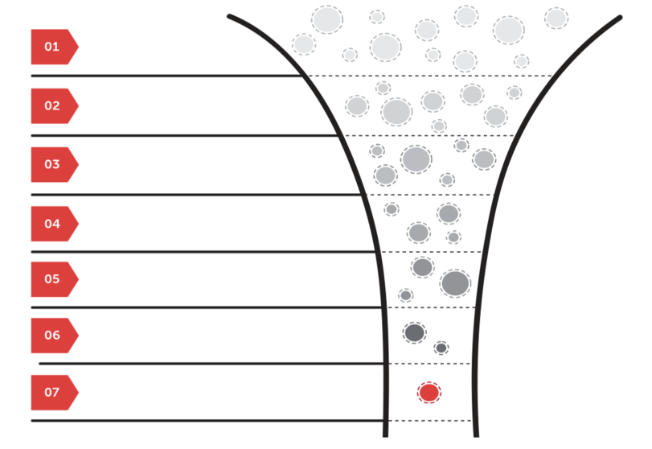
GTAC Development Funnel
SCOP1 (September 2016)
Role of GIC and First Gas
Scope: what sits inside v outside
Regulatory objective
GTAC objectives
Access product options
Use of OBAs
SCOP2 (November 2016)
Relationship between GTAC, TSAs, ICAs
Use of zones
Structure and process of nominations
Intended pricing approach
Non-standard agreements
Emerging Views (May 2017)
Rebate of PR charges
Offer P&L
Balancing incentive fees (no auto cash-outs)
Incentive charges (overrun only)
Nominations to points
PRs via auctions
Code change
Complete Draft GTAC & Trello (August 2017)
Definition of zones
Interruptible load contracts
Agreed Hourly Profiles
TSO discretion
Indicative pricing
Incentive charges (overruns/underruns)
Allocation method (D+1, pro-rata on nominations)
Difficult Day balancing
Revised Draft GTAC (September 2017)
RPO definition
Extra nominations cycle
FG veto of code changes
Force majeure definition
Second Revised Draft GTAC (November 2017)
OFOs (Shippers v interconnected parties)
Intra-day status of PRs
Hierarchy of responses to congestion
Final GTAC Sent to GIC
(December 2017)
Common ICA terms (TTP, OFOs outage notices)
Overrun / underrun incentive rebates
Running mismatch tolerance and rebates

Slide 6
Some comments on process to finalise GTAC
First Gas and industry have put considerable time and effort into developing the GTAC
GIC will evaluate whether the GTAC is materially better than the existing codes (VTC and MPOC) in achieving the objectives of the Gas Act and GPS
We are not taking the outcome of that evaluation for granted:
We have carefully considered workshop actions, Trello questions, and mark-ups and submissions on the revised draft GTAC
We have evaluated concerns and proposed changes on their merits
We believe that the GTAC has improved as a result of this process of engagement and we look forward to further suggestions on the second revised draft GTAC
We are giving this our best shot and intend to submit the GTAC to GIC by 8 December – if the GIC is unable to conclude that it is materially better then we will accept that outcome and look to move forward constructively in 2018

Slide 7
Update on parallel IT procurement process
First Gas has received proposals from 6 parties looking to provide the IT system required to administer GTAC transactions and information exchange
We are working through the proposals, but the quoted prices are consistent with our expectations and budgets and the software aligns with our service expectations
Shippers and interconnected parties are assisting in our evaluation of the different products through a User Reference Group, by:
Attending half-day product demo sessions from 5 of the 6 bidders
Reviewing products and services offered in proposals
We remain on track to select a preferred provider before the end of 2017
Proposals confirm that “go live” of 1 October 2018 is achievable, with functional specifications and fit for purpose confirmation as per approved MPOC change

Slide 8
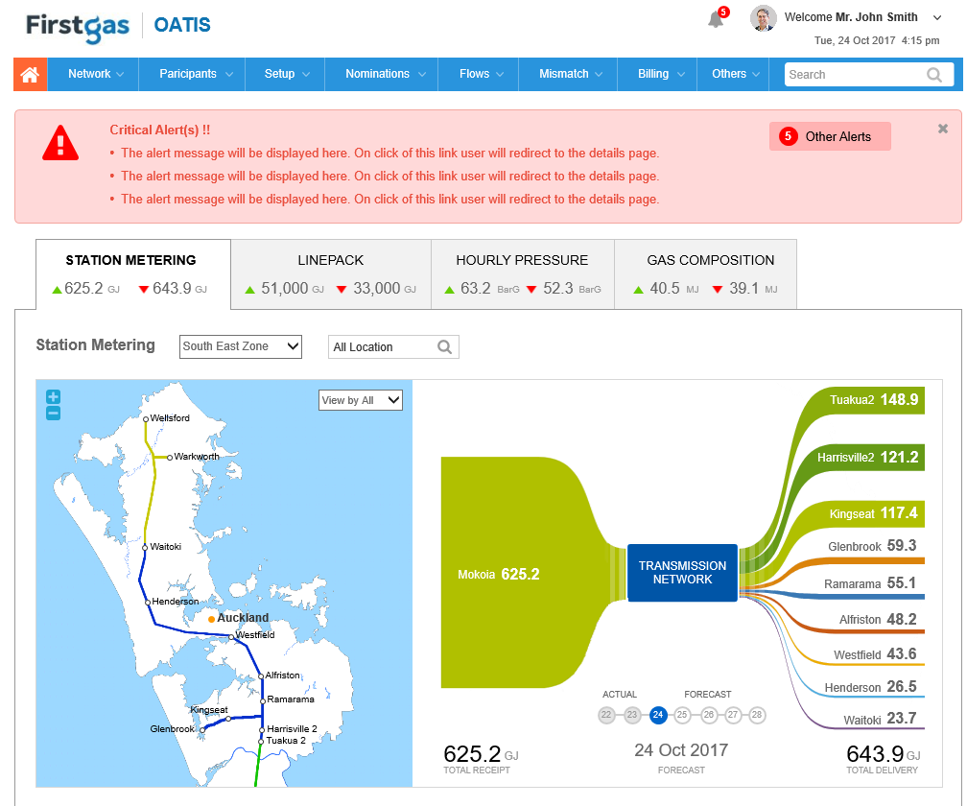
Teaser
Note: This display is for illustrative purposes only and does not indicate final vendor selection. The way these elements are displayed will differ in the final product.
Custom profiles with pre-set permissions and dashboards
Standard drop-down menus for full range of GTAC functions
Full text search
Alerts notifying user of specific actions required or relevant events
Real time system information
Full colour-coded zonal system map, with click-through to delivery points and receipts points
Visual representation of gas injections and withdrawal (linked to map)
Drill down to key statistics at zones and points (quantities, pressures, events, etc)
Summary of action gas flows and upcoming forecasts (based on nominations)

Slide 10
Themes / comments from submissions and mark-ups
Overall objectives
Workability
Certainty v flexibility
During transition to GTAC
Once GTAC is in force
Status of interconnected parties, especially at receipt points
Need to change design of Priority Rights product
Consistent approach to pricing products and incentives

Slide 11
Objectives should be inserted into GTAC
MGUG suggested objectives/purpose statements for each section
Nova suggested an overall reference to Gas Act and GPS for:
Interpreting GTAC provisions in the event of ambiguity
Code changes
We have adopted Nova’s suggestion:
Fits best in section 1.2 on code interpretation
Doesn’t just apply in event of ambiguity (i.e. is a tool to help guide GTAC interpretation more generally)
Should also alleviate other concerns raised:
That existing regulatory controls are inadequate (Shell)
That further documents issued might deviate from industry objectives (e.g. PR auction rules, interconnection policies)

Slide 12
Workability
Concerns raised about “workability” of GTAC provisions
Unclear whether this means:
GTAC as drafted will not work (i.e. will break on day one)
GTAC as drafted may not work (i.e. we will need to wait to find out and may need fix up change requests)
GTAC as drafted may not achieve desired objectives (i.e. further thought will be required to calibrate incentives to achieve right behaviours, provide additional tools)
Have provided greater clarity on some issues relevant to workability:
Definition of DNC, MDQ, MHQ
Relationship between DNC and Supplementary Capacity
Confirmed continued ability to use D+1 allocations under GTAC
Refined approach to OFOs

Slide 13
Certainty v flexibility – during transition to GTAC
Area where greater certainty is wanted | First Gas response
Pricing | Indicative prices and approach disclosed in August. General approach to allocating costs known, remaining uncertainty on the impact of incentive fees (<10% revenue). The approach will be tested and refined in development and consultation on GTPM in 2018
Specific DQ/HQ | Allows impacts of hourly flows to be tailored to specific sites. May need to be developed in conjunction with determining linepack limits carried out for Balancing SOP in 2018
Transition of Supplementary Agreements | We intend to maintain existing supplementary agreements. Each agreement is specific to particular customer needs, with some requiring more change than others. Our expectation is that the economic balance of these contracts will not change

Slide 14
Certainty v flexibility – once GTAC is in force
Area where greater certainty is wanted | First Gas response
Park and loan | Better left for development alongside Balancing SOP
Running Mismatch tolerance | Better left for development alongside Balancing SOP (linepack limits)
PR auction rules | To be developed in 2018. We will not run an auction without having acceptable rules that aim to safeguard expected outcomes. See: www.gasindustry.co.nz/dmsdocument/4885
Timeframes for notifying PR auction | Agree with Genesis that these should be longer than proposed
PR term | Agree with Contact that these should be specified in the auction rules (rather than the GTAC)
Overrun/underrun fees | Flexibility to change (with notice) is valuable to ensure that stated objectives are being achieved
Notification of prices | Agree with several parties that price changes should be notified earlier with no provisional pricing

Slide 15
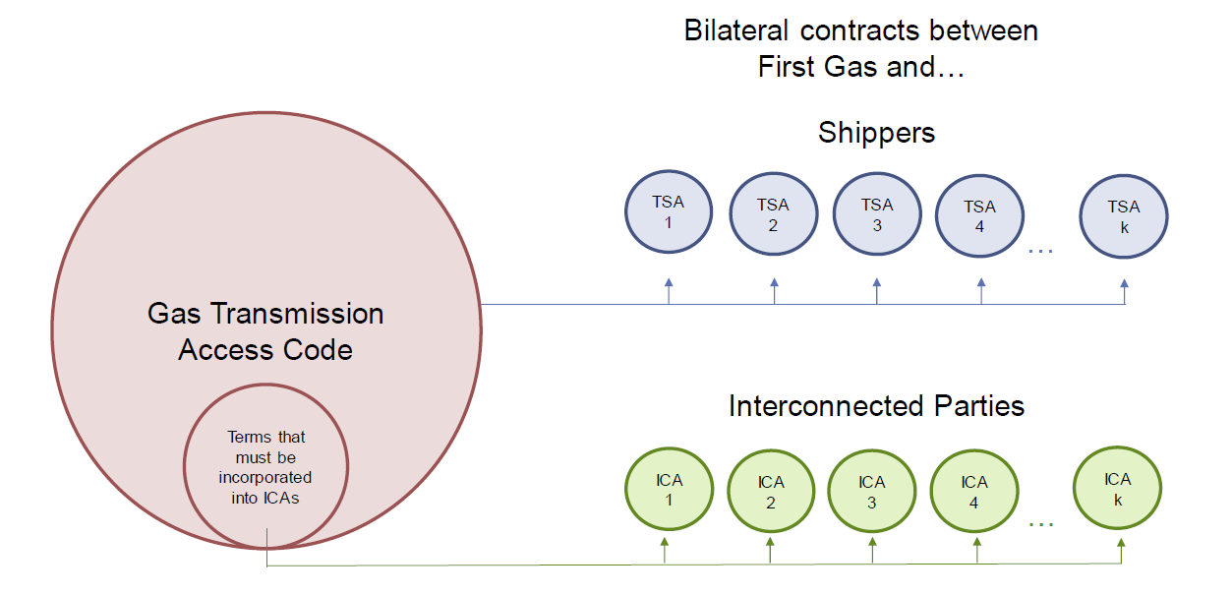
Status of interconnected parties, especially at receipt points
Concern that GTAC has adopted a contractual framework that does not specify all of the terms of interconnection (Shell and Methanex)
Specific concern that this could lead to divergent approaches and lack of privity on important issues such as:
TTP
OFOs
Contractual framework reflects decision made following SCOP2 paper
Provisions added to section 7 for:
TTP
OFO
Information on outages

Slide 16
Need to change design of Priority Rights product
Concerns raised (predominantly by Trustpower) that PRs:
Reclassify firm access as non-firm access
Are without comparators internationally and are therefore untested
Should not try to be an operational management tool
Expose households to unmanageable risk and deviate from the priority order that applies during critical contingencies
Create market power issues that need to be mitigated

Slide 17
Need to change design of Priority Rights product
GTAC three-step process for dealing with Congestion:
Step One: Identify (capacity modelling for AMP ahead of 30 Sept release)
Prior to any Year First Gas will, using the best information available to it at the time (including capacity information from its most recent Asset Management Plan), use reasonable endeavours to identify any Delivery Point likely to experience Congestion during that Year and in what periods of that Year (section 3.4).
Step Two: Manage
Invest
New investment in the Transmission System is both technically and economically feasible (section 3.4(a))
Interruptible Load
Interruptible Load in accordance with this section 3 is available (section 3.4(b))
Priority Rights (PRs) will need to be utilised (including where the new investment referred to in this section 3.4(a) cannot reasonably be implemented in time) (section 3.4(c))
Priority Rights

Slide 18
Need to change design of Priority Rights product
GTAC three-step process for dealing with Congestion:
Step Three: Operationalise rights
Call on interruptible capacity (section 10.3(a)(ii))
Approve nominations backed by PRs, with pro-rata curtailment of remaining nominations (section 10.3(a)(v))

Slide 19
Consistent approach to pricing products and incentives
Concerns raised about:
Throughput fee
Rebate of incentive charges
Rebate of balancing charges
Agreed to remove throughput fee
Agreed to rebate incentive charges (daily overruns, daily underruns, hourly overrun, overflow charges) in the same way as PR revenue
This does not fundamentally change who benefits from the rebates, but recycles the funds sooner and avoids the need for First Gas to forecast overrun/underruns
Agreed to rebate balancing charges to all parties that pay them (Shippers and OBA parties)

Slide 20
Conclusion
GTAC continues to improve
Significant majority of substantive design choices have now been resolved
Still work to do before final GTAC is submitted to GIC on 8 December
Parties can submit second (and final) round of contract mark-ups on 24 November
First Gas will consider these before finalising the GTAC and submitting to GIC for review on 8 December

