Slide 1
Worked Example
Situation 1
Producer A (has an Operational Balancing Arrangement, OBA) supplies gas to Shipper A at Kapuni
Shipper A sells that gas to Shipper B at Kupe
Shipper B is then on-sells the gas to Shipper C at Kupe
Shipper C delivers the gas to Direct Connect A (has an OBA) and also to end users on the Greater Auckland network
Shipper A and Shipper B do not supply end-users
Situation 2
Same supply, trading and demand as Situation 1 but…
Producer A has a production issue and Shipper A is not going to be allocated as much gas as it originally thought
Shipper A buys gas on emsTradepoint (from Party X) to meet its own customers demand and to meet its commitment to Shipper B

Slide 2
Situation 1 – In Pictures!
Trade/transfer at Kapuni
Trade/transfer within Receipt Zone
Producer A
Shipper A
Shipper B
Shipper C
Auckland
Direct Connect A

Slide 3
Situation 2 – In Pictures!
Trade/transfer at Kapuni
Trades/transfers within Receipt Zone
Producer A
Shipper A
Shipper B
Shipper C
Party X
Auckland
Direct Connect A
Anonymous trade via gas market
Also within Receipt Zone

Slide 4
Some questions
Why isn’t Kupe mentioned in the pictures?
No gas is delivered to or received from Kupe
All the trades ‘at Kupe’ are treated as though they have happened within the Receipt Zone
Who is Party X?
Unknown but as a party who can trade gas under the GTAC, Party X can only be a Shipper or an OBA party
For this example, Party X has been kept anonymous

Slide 5
What contracts are needed?
As Producer A has an OBA then a Gas Transfer Agreement (GTA) with Shipper A is not needed
As Direct Connect A has an OBA then an Allocation Agreement (AA) is not needed
To trade on the gas market, a Market Participation Agreement (MPA) is needed
Who? | ICA | OBA | GTA | AA | TSA | MPA
Producer A | ✓ | ✓ | *
Shipper A |  |  | * |  | ✓ | ✓
Shipper B |  |  |  |  | ✓
Shipper C |  |  |  | ** | ✓
Direct Connect A | ✓ | ✓ |  | **
Party X | Unknown |  |  |  |  | ✓

Slide 6
A note on – OBAs
OBAs are an option for receipt points and direct connect delivery points
Shippers are allocated gas equal to the approved nomination at the point
The OBA party is responsible for the difference between the nominations and actual gas flow through the point (Running Mismatch)
An OBA party for a delivery point is also responsible for any overrun/underrun charges for that connection
But…OBA parties can trade on the gas market and bilaterally with other OBA parties and Shippers

Slide 7
A note on – GTAs
GTAs are an allocation arrangement for receipt points without an OBA
GTA allocates injected gas at a receipt point from a defined producer to defined Shippers
Between the connected party, the relevant Shipper(s) and a defined Gas Transfer Agent
The Gas Transfer Agent performs the allocation
The producer is not responsible for any difference between the approved nominations and the gas flow
A GTA can ape an OBA by defining a ‘swing shipper’ to take ownership of the difference between the approved nominations and gas flow
Is a GTA required at a receipt point where the connected party and the receiving Shipper are the same party?
Yes, the allocation needs to be performed via a GTA so there is a contractual link for gas title transfer to the Shipper

Slide 8
A note on – AAs
AAs are an allocation arrangement for delivery points without an OBA and which are not covered by the Downstream Reconciliation Rules (DRRs)
AA allocates gas taken at a delivery point to defined Shippers
Between the connected party, the relevant Shipper(s) and a defined Allocation Agent
The Allocation Agent performs the allocation
The connected party is not responsible for any difference between the approved nominations and the gas flow
An AA can ape an OBA by defining a ‘swing shipper’ to take ownership of the difference between the approved nominations and gas flow
Is an AA required for a direct connect delivery point (no OBA) which is only supplied by one Shipper?
Yes, without it First Gas does not know who the supplying Shipper is for any day

Slide 9
Onto the Allocations
Allocations occur at Receipt and Delivery points
Who? | Where? | How?
Producer A | Kapuni | OBA
Shipper A | Kapuni | GTA or OBA
Shipper B | N/A | N/A
Shipper C | Auckland | DRRs
 | Direct Connect A | AA or OBA
Direct Connect A | Direct Connect A | OBA
Party X | ?????
Producer A and Direct Connect A can only be allocated gas if they are on an OBA
DRRs for this example mean any day in arrears allocations for allocated gas gates

Slide 10
Transmission Fees $$
Transmission Fees occur at Delivery points/zones
Shipper A and Shipper B do not supply any end users
Direct Connect A can have overrun/underruns as it has an OBA, if it didn’t then Shipper C would be liable for any overrun/underruns at the point
Who? | Where? | DNC | Overrun/Underrun
Producer A | N/A
Shipper A | N/A
Shipper B | N/A
Shipper C | Auckland | ✓ | ✓
 | Direct Connect A | ✓ | *
Direct Connect A | Direct Connect A |  | ✓
Party X | ??????

Slide 11
Balancing
Each Shipper and OBA party can hold a balancing position i.e. Running Mismatch
Calculations on the next few slides show the Running Mismatch for each party
For the calculations it is assumed that:
Producer A and Direct Connect A have OBAs
Shipper A and Shipper B do not supply any end users

Slide 12
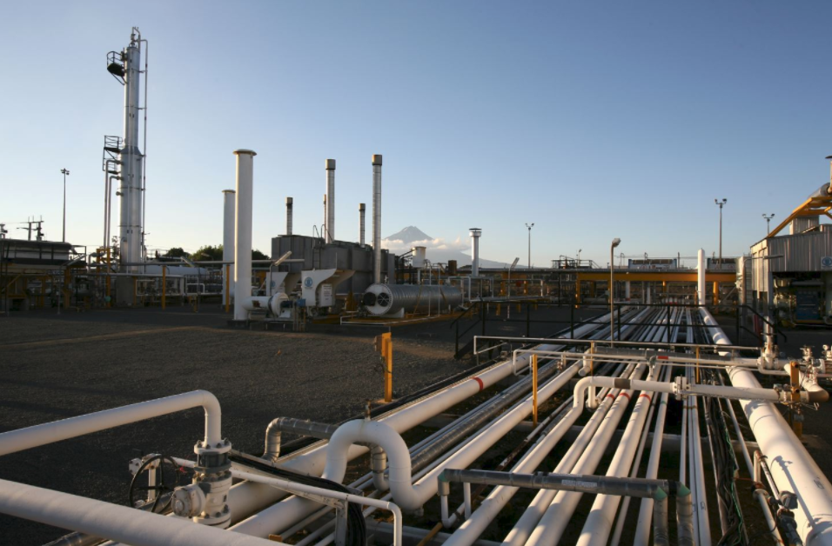
Running Mismatch – Situation 1, Producer A
Producer A | +/- | Item
Running Mismatch = | + | Opening Running Mismatch
 | + | Kapuni gas flow
 | - | Approved Kapuni Nominations
 | +/- | Applied wash-ups
 | +/- | Balancing gas allocated (if any)

Slide 13
Running Mismatch – Situation 1, Shipper A
Shipper A | +/- | Item
Running Mismatch = | + | Opening Running Mismatch
 | + | Approved Kapuni Nominations
 | - | Gas sold to Shipper B
 | +/- | Applied wash-ups
 | +/- | Balancing gas allocated (if any)

Slide 14
Running Mismatch – Situation 1, Shipper B
Shipper B | +/- | Item
Running Mismatch = | + | Opening Running Mismatch
 | + | Gas purchased from Shipper A
 | - | Gas sold to Shipper C
 | +/- | Applied wash-ups
 | +/- | Balancing gas allocated (if any)

Slide 15
Running Mismatch – Situation 1, Shipper C
Shipper C | +/- | Item
Running Mismatch = | + | Opening Running Mismatch
 | + | Gas purchased from Shipper B
 | - | DNC to Direct Connect A
 | - | Gas allocated to Shipper A (Auckland)
 | +/- | Applied wash-ups
 | +/- | Balancing gas allocated (if any)

Slide 16
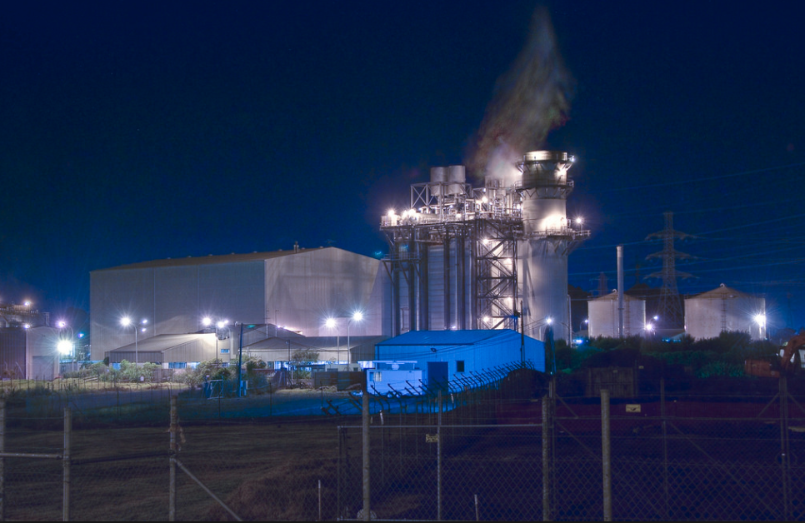
Running Mismatch – Situation 1, Direct Connect A
Direct Connect A | +/- | Item
Running Mismatch = | + | Opening Running Mismatch
 | + | DNC to Direct Connect A
 | - | Direct Connect A gas flow
 | +/- | Applied wash-ups
 | +/- | Balancing gas allocated (if any)

Slide 17
Balancing – Situation 2
Only three parties are affected by Situation 2
Producer A has dropped/curtailed supply at Kapuni
Shipper A has had to purchase gas from the gas market (Party X)
Party X has sold gas on the gas market (to Shipper A)

Slide 18
Running Mismatch – Situation 2, Producer A
Producer A | +/- | Item
Running Mismatch = | + | Opening Running Mismatch
 | + | Kapuni gas flow (reduced)
 | - | Approved Kapuni Nominations (reduced)
 | +/- | Applied wash-ups
 | +/- | Balancing gas allocated (if any)

Slide 19
Running Mismatch – Situation 2, Shipper A
Shipper A | +/- | Item
Running Mismatch = | + | Opening Running Mismatch
 | + | Approved Kapuni Nominations (reduced)
 | - | Gas sold to Shipper B
 | + | Gas purchased on gas market (Shipper X)
 | +/- | Applied wash-ups
 | +/- | Balancing gas allocated (if any)

Slide 20
Running Mismatch – Situation 2, Party X
Party X | +/- | Item
Running Mismatch = | + | Opening Running Mismatch
 | + | Unknown Receipts
 | - | Unknown Deliveries
 | - | Gas sold on gas market (Shipper A)
 | +/- | Applied wash-ups
 | +/- | Balancing gas allocated (if any)

Slide 21
Information Needs
The tables below show the various information requirements that will be needed

Slide 22
Information Needs – Nominations
When | Method | Action | From ➔ To
As required | OATIS | Enter Nomination | Shipper A | ➔ | Producer A*
 |  |  | Shipper C | ➔ | Direct Connect A
 |  |  | Shipper C | ➔ | First Gas
 |  | Approve Nomination | Producer A | ➔ | Shipper A
 |  |  | Direct Connect A | ➔ | Shipper C
 |  |  | First Gas | ➔ | Shipper C

Slide 23
Information Needs – Trades
When | Method | Action | From ➔ To
Before end of day gas changes hands | OATIS | Bilateral Trade | Shipper A | ➔ | Shipper B
 |  |  | Shipper B | ➔ | Shipper C
 | OATIS Upload | Gas Market trade | Party X | ➔ | Shipper A

Slide 24
Information Needs – Allocations & Transfers (GTAs)
When | Method | Action | From ➔ To
Final Intra Day | OATIS | OBA Allocation | Producer A* | ➔ | Shipper A
 |  |  | Direct Connect A | ➔ | Shipper C
After Meter Validation |  |  | First Gas | ➔ | Producer A
 |  |  |  |  | Direct Connect A
 | OATIS Upload | DRR Allocation | Allocation Agent/GIC | ➔ | First Gas
 |  |  |  |  | Shipper C
 | OATIS/ OATIS Upload | GTA Transfer | Producer A* | ➔ | Shipper A

Slide 25
Information Needs – Balancing
When | Method | Action | From ➔ To
Before Month | OATIS | Wash-up allocation | First Gas | ➔ | Shippers and OBA Parties
After Allocations |  | Running Mismatch

Slide 26
General – Contracts (1)
Where are these contracts needed? (Allocation Agreement, Gas Transfer Agreement, Interconnection Agreement)
Allocation Agreement
Needed at direct connect delivery points that are not on an OBA
Between the connected party and the relevant Shipper(s)
Gas Transfer Agreement
Needed at receipt points that are not on an OBA
Between the connected party and the relevant Shipper(s)
Interconnection Agreements
Needed for all connection points to the combined First Gas transmission system
Between the connected party and First Gas

Slide 27
General – Contracts (2)
What happens with Existing Supplementary Agreements?
Changes needed to align with the GTAC
SAs under the VTC reference receipt and/or delivery points that will not be recognised by the GTAC
At the very least, the receipt and/or delivery points in each SA will need to be amended
Consideration is being given to other changes (e.g. should these SAs require nominations?)

Slide 28
General – Information needed before the day
What information do parties need to provide First Gas before the day?
Via OATIS
Provisional and Changed Provisional Nominations (Shippers)
Approval of Provisional & Changed Nominations (OBA Parties)
Bilateral trades (if confirmed on a prior day)
Uploaded to OATIS
Wash-up allocations (Allocation Agent/GIC)
Gas market trades (market owner, if confirmed on a prior day)
Other
New/changed Allocation Agreements, Gas Transfer Agreements etc.
Upcoming maintenance that will affect gas flows (if OATIS does not allow those parties to post notices themselves)

Slide 29
General – Information needed during the day
What information do parties need to provide First Gas during the day?
Via OATIS
Intra Day Nominations (Shippers)
Approval of Intra Day Nominations (OBA Parties)
Bilateral trades (trading parties)
Uploaded to OATIS
Gas market trades for the day (market owner)
Other
Hourly metered flow data (if First Gas does not own the meter)
Information on outages that affect gas flows and/or scheduled gas flows (if any)

Slide 30
General – Information needed for the previous day
What information do parties need to provide each day for the previous day?
Via OATIS
GTA transfers (if can be automated by OATIS)
Uploaded to OATIS
Distribution delivery point allocations (Allocation Agent/GIC)
GTA transfers (designated party)
Other
Connected parties to First Gas –
Metered flow data (if First Gas does not own the meter)
Shippers to Allocation Agent/GIC –
Any TOU data for downstream end-users (i.e. “D+1”)

Slide 31
General – Information provided during the day
What information do we receive during the day?
Allocations for the previous day
Balancing information for the previous day, including
Balancing gas transaction allocations
Closing Running Mismatch positions
ERM (if any)
Balancing tolerances for the day (at the start of the day)
Rolling estimates of your balancing position during the day
Depends on IT system procured
Notifications
Maintenance
Outages
Pipeline condition (if there are issues)

Slide 32
General – Allocations
How is gas allocated at both Receipt Points and Delivery Points?
Gas is allocated at receipt points via OBAs or GTAs
Gas is allocated at delivery points via the DRRs (includes “D+1”), OBAs and Allocation Agreements

Slide 33
General – “D+1” and the GTAC
How will the D+1 mechanism work with the GTAC?
Current wording is reliant on D+1 being incorporated into the DRRs
First Gas is considering a variation of wording used in the MBB D+1 Pilot Agreement, the wording in that agreement is:
Delivery Quantity has the meaning given to it in the Code, other than section 6.5(b) of the Code which is replaced with:
“a Delivery Point on a Pipeline that is used by (or available to be used by) more than one Shipper, will be the quantity supplied by the GIC for each Shipper for that Delivery Point or the Allocation Result, whichever is more recent;”

Slide 34
General – Wash-ups (1)
How will the wash-up mechanism work for transmission and balancing?
Current wording requires the application of wash-ups to be “…in the manner agreed by First Gas and Shippers…”
i.e. An agreement separate from the GTAC will be required
Unless the agreed application of wash-ups is different, First Gas’ intent is to use wash-ups in the same manner as they are done currently

Slide 35
General – Wash-ups (2) Transmission Invoicing
Amounts for prior periods will be reassessed based on any delivery quantity changes resulting from a wash-up
Any differences from what was previously invoiced will be applied as debits and/or credits with the next invoices

Slide 36
General – Wash-ups (3) Balancing
Current intent is that Wash-up application will be the same as what is currently done via the MBB D+1 Pilot Agreement, that is:
Initially published Running Mismatch opening positions for a day are unaffected by wash-ups
Each day is reassessed and any difference between previously published amounts and quantities determined
Any difference in amount credited/debited with the next balancing invoice
Any difference in quantity is returned in the next month after the month in which calculation has been performed (spread over each day)

Slide 37
General – Wash-ups (4) Balancing
Alternatives to the hybrid wash-up method include:
Financial only – Quantity wash-up differences are monetised and credited/debited, previously billed amounts are reassessed
Quantity Only – Quantity wash-up differences are returned, no recalculation of previously billed amounts

