Slide 1
GIC Preliminary GTAC Assessment
27th March 2018
Duncan Jared – Fuel Portfolio Manager

Slide 2
Today
3 Submission Points
Merits of HQ/DQ – First Gas Huntly Analysis
Question the merits of 2 * DNC for underrun/overrun charges
Contractual uncertainty remains

Slide 3
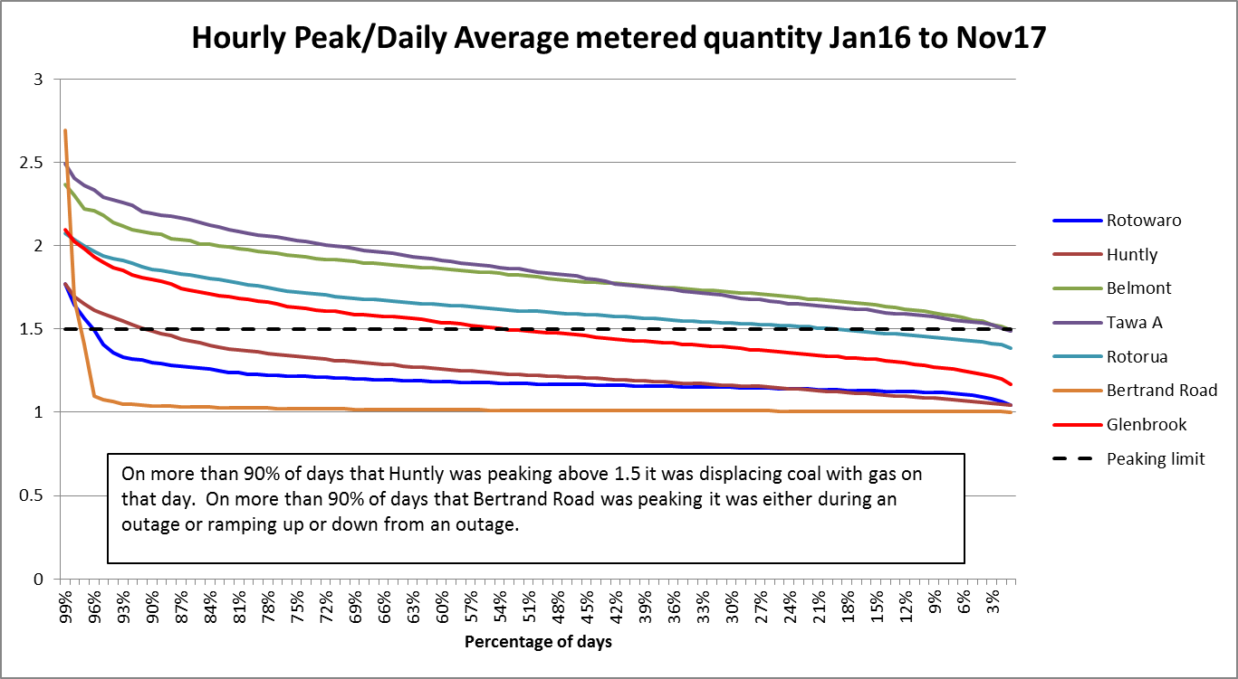
Huntly HQ/DQ Background
Genesis presented to this group on 17 November 2017 on Huntly HQ/DQ
Summary was that a Huntly HQ/DQ ratio of 1.8 will meet 99% of gas use scenarios
First Gas investigated whether this was possible.

Slide 4
Huntly HQ/DQ: First Gas Analysis
First Gas conducted analysis on Huntly’s maximum gas use without causing pipeline issues.
Assumed a system “peak week”. Lowest pipeline pressure as starting point.
The transmission system can supply Huntly with the following volume:
Timeframe | Maximum Huntly Gas (scm/s) | Maximum Huntly Gas (TJ/hour) | Constraint
<= 4 Hours | 70 | 9.8TJ per hour | Huntly Lateral
12 Hours | 70 | 9.8 TJ | Huntly Lateral
24 Hours | 55 | 7.7 TJ | Mokau Compressor
5-7 Days | 37.5 | 5.3 TJ | Maui Pipeline
Unit 5 and 2 Rankines running at 100% uses 7.9 TJ/hour

Slide 5
Huntly HQ/DQ: First Gas Analysis
So Huntly cannot possibly cause pipeline issues until 24 hours of peak use (i.e. Huntly HQ/DQ is a red herring).
In fact a lower HQ/DQ is more likely to be problematic with high gas use
The real issue is Huntly consuming high rates for 5-7 days
Genesis’ view is that 5-7 day view is conservative because Huntly has had 4 Rankine units running on gas + Otahuhu B + Southdown running on gas.

Slide 6
Daily Overrun/Underrun Charge
Genesis agrees that there is some benefit in having accurate gas nominations
E.g forecasting demand on congested delivery points
But there has been no analysis provided by First Gas to show why DNC * 2 is required to incentivise accurate nominations
In particular why $0.20 /GJ or $0.60 /GJ (Running mismatch charges) are sufficient to incentivise good running mismatch practice but >$4 /GJ is required to incentivise accurate daily nominations?
Saying that it is “lower than before” is not a sufficient answer
The “penalty” only needs to be high enough to incentivise shippers to nominate accurately and not be punitive.
Surely 10-20% would be sufficient?

Slide 7
Contractual Uncertainty
We still have no certainty regarding contracts that will replace the arrangements put in place to transport gas from the Kupe field.

