Slide 1
GTAC Workshop Block 1
11 July 2018

Slide 2
Agenda
Agenda Items |  | Indicative Timing
 | Workstream 2 – Linepack Management and Intraday Flexibility
2.1 | Taranaki Target Pressure | 9-10am
2.2 | Balancing | 10am-12pm
 | Lunch
2.3 | Peaking | 1-5pm

Slide 3
2.1 Taranaki Target Pressure
Discussion Objective
GTAC Reference
Revise treatment of Taranaki Target Pressure in GTAC to address concerns highlighted in FAP
s. 7.13 (e)
FAP Findings
Supporting Material
Efficient and prudent to at least maintain level of control under MPOC (187)
Reasonable endeavours to keep between 42-48
Reasonable endeavours to keep towards low end
Reference to aggregate ERM
RPICA not mirror of section 7.13(e) (187)
Inclusion in the GTAC as well as in the ICAs (per 7.13)
NA

Slide 4
Target Taranaki Pressure Treatment under GTAC
The commitments in the GTAC and MPOC relating to TTP are:
GTAC s. 7.13(e)
for any Receipt Point on First Gas’ “400 line” between Oaonui and the Turangi Mixing Station as at the date of this Code, that First Gas will use reasonable endeavours to maintain the pressure in that line at or near the Bertrand Road Offtake between 42 and 48 bar gauge (Target Taranaki Pressure), subject to a Critical Contingency, Force Majeure Event, Emergency, Maintenance or the aggregate ERM of Shippers and/or OBA Parties, and that any change to the Target Taranaki Pressure shall be subject to a Change Request not to be effective earlier than 12 Months following its approval;
MPOC s. 2.5(c)
Subject to the provisions of this Operating Code, TSP shall, acting as a Reasonable and Prudent Operator: (c) subject to complying with section 2.19, use reasonable endeavours to manage the Target Taranaki Pressure to be as low as practicable while maintaining sufficient Line Pack to meet its obligations under this Operating Code
First Gas Position:
As a Reasonable and Prudent Operator First Gas needs to take into account the aggregate ERM of shippers in managing pipeline pressure
The insertion of ‘as low as reasonably practicable’ would be appropriate
GTAC provisions can be amended to better mirror the MPOC

Slide 5
2.2 Balancing
Discussion Objective
GTAC Reference
Clarify the process First Gas intends to use in setting an allocating balancing tolerances
s. 8
FAP Findings
Supporting Material
FG has not defined the amount of linepack to be set aside for shipper tolerances and no constraint on setting tolerances. As this is outside GTAC, there is no constraint on FG to act neutrally (19, 75)
Principles for setting running mismatch tolerances or the tolerances themselves to be included in GTAC (19, 75)
First Gas role as balancing agent
Approach to setting Balancing Tolerances

Slide 6
First Gas role as balancing agent
The GTAC sets out the following considerations in setting tolerance:
GTAC Balancing Incentives
s. 8.6 - TSO issues a Low or High Line Pack Notices if a breach an Acceptable Line Pack Limit is likely
s. 8.6 – TSO may buy or sell balancing after issuing the Line Pack Notice unless there is no time to do so
s. 8.7 – TSO will use reasonable endeavours to buy or sell gas in the most cost effective, efficient and transparent manner, including via a Gas Market.
s. 8.8 and 8.9 – Balancing gas and gas costs are allocated to users according to their Running Mismatch position in the direction of the transaction
ss. 8.12 and 8,13 – Excess Running Mismatch charges are increased by a factor of 5 if a Line Pack Notice is issued in the direction of the mismatch
First Gas Position:
The ERM regime incentivises users to balance their own positions
First Gas takes balancing actions if required to maintain pipeline stability for all users

Slide 7
Principles for setting tolerance
The GTAC sets out the following considerations in setting tolerance:
GTAC s. 8.5
First Gas will use reasonable endeavours to maintain the Line Pack between the lower and upper limits it determines (respectively, the lower and upper Acceptable Line Pack Limits) will enable it to:
(a) meet its current obligations to provide all DNC and Supplementary Capacity;
(b) provide Running Mismatch Tolerance for Shippers and OBA Parties, subject to:
(i) not affecting its ability to provide additional transmission capacity;
(ii) not unduly increasing the risk of breaching an Acceptable Line Pack Limit;
(iii) providing a reasonable allowance for Specific HDQ/DDQ and AHPs; and
(iv) providing for park and loan service (where First Gas elects to offer such service); and
(c) meet any other obligations it has under this Code, including any obligations it has to Interconnected Parties set out in section 7.
Key questions:
Does the clause above set out the correct considerations for First Gas?
What other considerations must be included?
First Gas Position:
We believe that the terms of s. 8.5 are aligned with our proposed management of the pipeline
However we want to hear where improvements can be made

Slide 8
Allocating Tolerance between users
Gas Receipts
Shipping
Gas Deliveries
Interconnected Party
GTA Points
(IP has no balancing risk)
Shipper
Shipper Tolerance
Interconnected Party
Tolerance is allocated to shipper
Tolerance is allocated to shipper
Allocation Agreement Points
(IP has no balancing risk)
Tolerance is allocated to OBA Party
Tolerance is allocated to OBA Party
OBA Points
(IP has balancing risk)
OBA Points
(IP has balancing risk)
OBA Party Tolerance
Key Principles:
Shared and dedicated delivery points have different requirements for tolerance
Parties taking the balancing risk need tolerance
This is a change to the GTAC which allocates tolerance between OBA parties and shippers

Slide 9
Tolerance as a receipt and delivery allocation
X/2 TJ Receipts
X/2 TJ Deliveries
+/- X TJ System Wide
OBA, GTA
OBA, DNC, SA
GTAC Changes:
Remove references to OBA Party Tolerance and Shipper Party Tolerance
Add terms for Receipt Tolerance and Delivery Tolerance

Slide 10
Allocation to individual users
Minimum tolerance of 400 GJ per user system wide
For OBA Parties at receipt and/or delivery points:
Receipt Tolerance: Their pro-rata share of Receipt Tolerance based on their Approved Quantity (AQ) at all receipt points divided by the sum of all OBA receipt point AQs and shipper receipt nominations via GTAs; plus
Delivery Tolerance: Their pro-rata share of Delivery Tolerance based on their AQ at all delivery points divided by the sum of all OBA delivery point AQs and all shipper quantities under Transmission Services Agreements (TSAs) and Supplementary Agreements (SAs)).
For Shippers:
Receipt Tolerance: Their pro-rata share of Receipt Tolerance based on their receipt nominations at all receipt points via their GTAs divided by the sum of all OBA receipt point AQs and shipper receipt nominations via GTAs; plus
Delivery Tolerance: Their pro-rata share of Delivery Tolerance based on their quantities shipped under their TSA and SAs divided by the sum of all OBA delivery point AQs and shipper delivery nominations via TSAs and SAs)
Key principles:
Need to separate Receipt Tolerance and Delivery Tolerance as receipt and delivery quantities may not match
The Delivery and Receipt Tolerance is additive for Shippers and OBA Parties if they are taking risk on both receipt and delivery balancing
The minimum tolerance of 400 GJ is based on the current number of parties and rates of flow
This principle gives all parties the certainty of having at least +/- 400 GJ of tolerance

Slide 11
Operational objectives of line pack management
Ensure availability of DNC and supplementary capacity is maximised
Ensure reasonable underruns and overruns in flow can be accommodated (provide tolerance)
Allow for peaking where this is notified and approved
Provide for park and loan (on an as-available basis)
Ensure that the proposed use of the system by one user doesn’t impact another user (e.g. the tolerance allocated to one user doesn’t restrict another user from nominating DNC)
To ensure the system has adequate ‘spare’ line pack in order to absorb short-term producer trips without needing to immediately curtail delivery quantities
To avoid flow fluctuations leading to a breach of the Critical Contingency Time-to-Pressure thresholds

Slide 12
Understanding the line pack limits
Upper Line Pack Limits
Lower Line Pack Limits
Provide flexibility for pipeline users
Maintain the Taranaki Target Pressure (i.e. avoid breaching the upper TTP limit)
Operate within the approved operating envelope of the pipeline and its associated equipment.
There is a greater risk of pressure in the southern section of the Maui pipeline rising rapidly in the event of a Mokau Compressor trip (and breaching the upper TTP limit) when close to upper line pack limit
Provide flexibility for pipeline users
Maintain the Taranaki Target Pressure (i.e. avoid breaching the lower TTP limit)
Operate within the approved operating envelope of the pipeline and its associated equipment
Ensure that parties have the ability to respond within appropriate timeframes in the event of an unplanned loss of receipt flows
Avoid flow fluctuations leading to a breach of a Critical Contingency Time-To-Pressure Threshold (or minimum pressure threshold)
Ensure there is a reasonable line pack buffer in the pipeline in the event of an unplanned pipeline emergency or major supply outage
Avoid the TSO having to take swift OFO/curtailment action due to low limits being breached

Slide 13
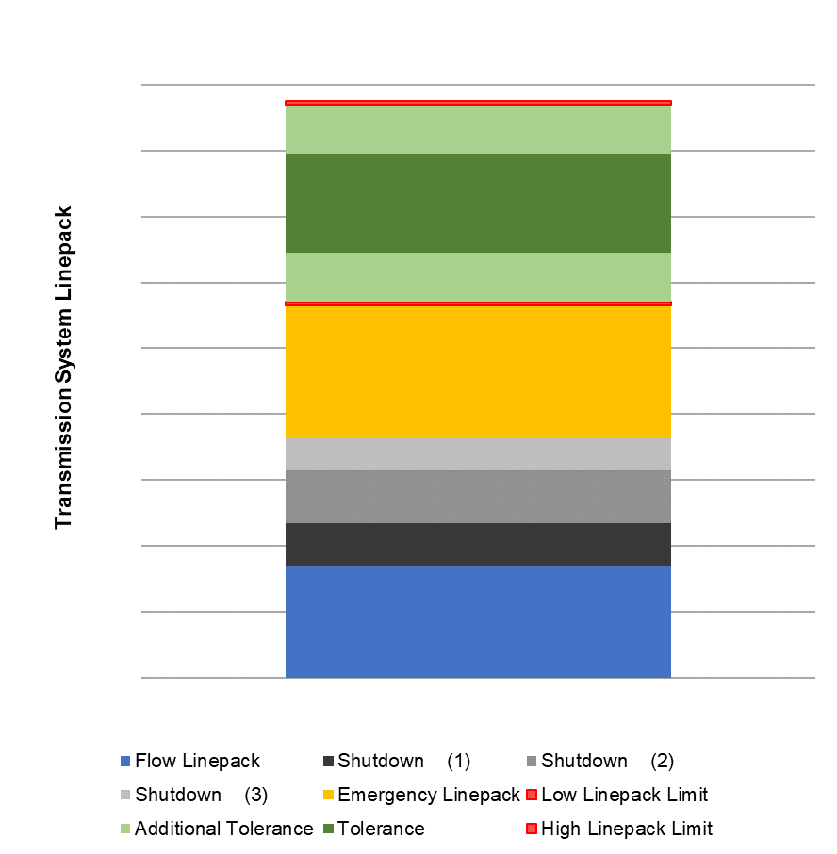
How we describe line pack
Flow line pack – Gas required to fill the pipeline to minimum pressure, and to create a pressure gradient to flow the nominated quantities
Shutdown Quantities – As per GTAC section 9.6
Emergency line pack – An amount of gas that is available for use in a major pipeline emergency, or major producer outage
Low line pack limit – the point at which there is no further line pack remaining in the pipeline for use; the point at which a low line pack notice will be issued (GTAC section 8.6)
Additional Tolerance – A tolerance above and below the standard tolerance, which may be available depending on prevailing pipeline conditions and uptake of park and loan (should this service be offered)
Tolerance – Available overall system wide tolerance for use by Shippers and OBA parties
High line pack limit – the point at which there is no further line pack capacity remaining in the pipeline for use; the point at which a high line pack notice will be issued (GTAC section 8.6)

Slide 14
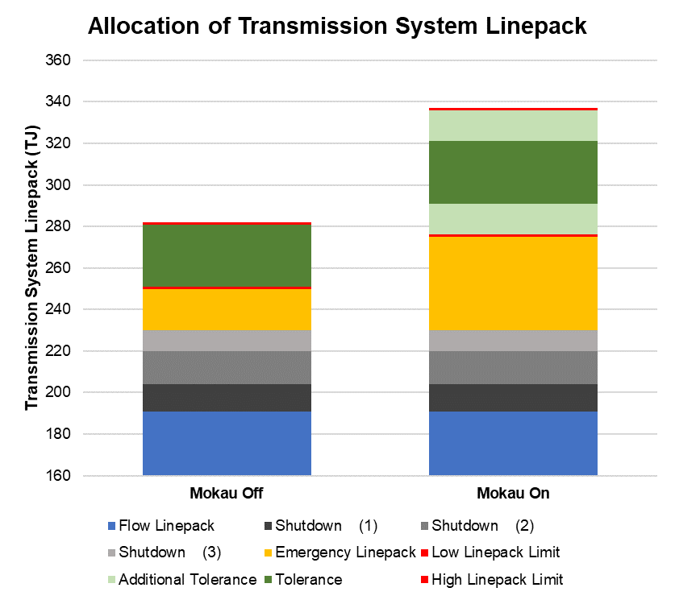
Defining the total system tolerance
Proposed operating regimes are as follows:
Mokau Off Total Tolerance:
30 TJ with a lower line pack limit of 250 TJ and an upper line pack limit of 280TJ
Mokau On Total Tolerance:
30 TJ with a lower line pack limit of 290TJ and an upper line pack limit of 320TJ
When Mokau is on, a further 30TJ could be accommodated to allow for extra tolerance (e.g. for park and loan).
With the extra tolerance option included, a lower line pack limit of 275 TJ and an upper line pack limit of 335 TJ become practical.
Key Finding:
Tolerance available for users is 30 TJ around the midpoint of this range – i.e. +/- 15 TJ

Slide 15
Split of System Tolerance between receipt and delivery
7.5 TJ Receipts
7.5 TJ Deliveries
+/- 15 TJ System Wide
OBA, GTA
OBA, DNC, SA

Slide 16
Comparison with existing system tolerance
Party | Nominations / SQ (GJ) | Under MPOC |  |  |  | Under GTAC
 |  | Tolerance (GJ) | Tolerance as % of SQ | Applied Tolerance (GJ) | Applied Tolerance as % of SQ | OBA Party AQ (GJ) | Shipper NQ (GJ) | GTAC Tolerance (GJ) | Tolerance as % of Flow
Receipt Tolerance
OBA-C | 41,620 | 3,000 | 1.0% | 3,000 | 7.2% | 41,620 |  | 604 | 1.5%
OBA-D | 157,607 | 1,500 | 1.0% | 1,576 | 1.0% | 157,607 |  | 2,287 | 1.5%
OBA-E | 134,799 | 1,500 | 1.0% | 1,500 | 1.1% | 134,799 |  | 1,956 | 1.5%
OBA-F | 149,577 | 6,000 | 1.0% | 6,000 | 4.0% | 149,577 |  | 2,170 | 1.5%
Shipper-A | 36,591 | 1,500 | 1.0% | 500 | 1.4% |  | 36,591 | 473 | 1.3%
Shipper-J | 6,687 |  |  | 500 | 7.5% |  | 6,687 | 10 | 0.1%
Shipper-K | 1,000 |  |  | 500 | 50.0% |  | 1,000 | 0 | 0.0%
Total Receipts | 527,881 | 13,500 |  | 13,576 |  | 483,603 | 44,278 | 7,500 | 1.4%
Delivery Tolerance
OBA-A | 66,011 | 1,500 | 1.0% | 1,500 | 2.3% | 66,011 |  | 958 | 1.5%
OBA-B | 103,200 | 3,000 | 1.0% | 3,000 | 2.9% | 103,200 |  | 1,497 | 1.5%
OBA-C | 1,000 | 0 | 0 | 0 | 0.0% | 1,000 |  | 15 | 1.5%
OBA-D | 133,643 | 1,500 | 1.0% | 1,500 | 1.1% | 133,643 |  | 1,939 | 1.5%
Shipper-A | 24,879 | 6,000 | 1.0% | 600 | 2.4% |  | 24,879 | 361 | 1.5%
Shipper-B | 46,715 |  |  | 600 | 1.3% |  | 46,715 | 678 | 1.5%
Shipper-C | 40,620 |  |  | 600 | 1.5% |  | 40,620 | 589 | 1.5%
Shipper-D | 0 |  |  | 600 | 0.0% |  | 0 | 400 | 0.0%
Shipper-E | 5,431 |  |  | 600 | 11.0% |  | 5,431 | 400 | 7.4%
Shipper-F | 59,646 |  |  | 600 | 1.0% |  | 59,646 | 793 | 1.3%
Shipper-G | 2,000 |  |  | 600 | 30.0% |  | 2,000 | 400 | 20.0%
Shipper-H | 4,000 |  |  | 600 | 15.0% |  | 4,000 | 400 | 10.0%
Shipper-J | 37,736 |  |  | 600 | 1.6% |  | 37,736 | 548 | 1.5%
Shipper-K | 3,000 |  |  | 600 | 20.0% |  | 3,000 | 400 | 13.3%
Total Deliveries | 527,881 | 15,000 |  | 12,000 |  | 303,854 | 224,027 | 9,378 | 1.8%

Slide 17
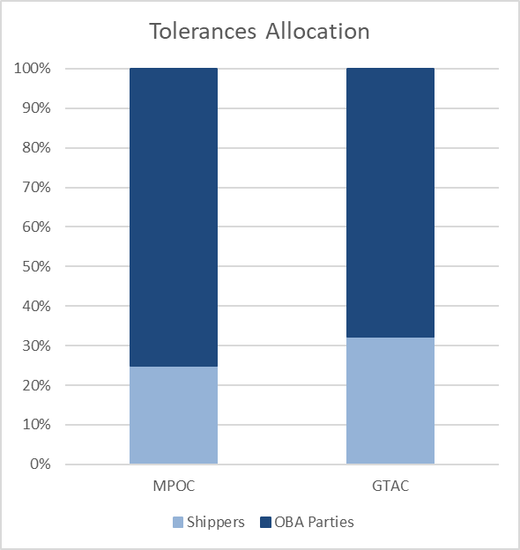
Comparison with existing system tolerance
Party | Nominations / SQ (GJ) | GTAC Tolerance Apportion (%) | GTAC Tolerance Apportion (GJ) | GTAC Applied Tolerance (GJ) | MPOC Tolerance (GJ)
OBA-A | 66,011 | 13% | 958 | 958 | 1,500
OBA-B | 103,200 | 20% | 1,497 | 1,497 | 3,000
OBA-C | 42,620 | 8% | 618 | 618 | 3,000
OBA-D | 291,250 | 56% | 4,226 | 4,226 | 3,076
OBA-E | 134,799 | 26% | 1,956 | 1,956 | 1,500
OBA-F | 149,577 | 29% | 2,170 | 2,170 | 6,000
Shipper-A | 61,470 | 11% | 834 | 834 | 600
Shipper-B | 0 | 0% | 0 | 400 | 600
Shipper-C | 40,620 | 8% | 589 | 589 | 600
Shipper-D | 46,715 | 9% | 678 | 678 | 600
Shipper-E | 5,431 | 1% | 79 | 400 | 600
Shipper-F | 59,646 | 11% | 793 | 793 | 600
Shipper-G | 2,000 | 0% | 0 | 400 | 600
Shipper-H | 4,000 | 0% | 0 | 400 | 600
Shipper-J | 44,423 | 7% | 558 | 558 | 600
Shipper-K | 4,000 | 1% | 44 | 400 | 600
TOTAL | 1,055,762 | 200% | 15,000 | 16,878 | 24,076

Slide 18
Summary
First Gas believes:
The total amount of tolerance allows the pipeline operator to manage pipeline flows safely while giving users flexibility on how they use the pipeline
Small and large users are allocated tolerance
Tolerances are allocated to those taking a risk in balancing of the pipeline
Tolerances are allocated based on use and exposure
Next Steps:
Get feedback from stakeholders on proposed balancing regime
Make required drafting changes following feedback
Update Balancing SOP to reflect proposed systems and issue for consultation prior to workshop in September

Slide 19
2.3 Peaking Regime
Discussion Objective
GTAC Reference
Discuss possible designs for peaking regime that address concerns raised in FAP
s. 3.26 -3.33
11.5
FAP Findings
Supporting Material
Hourly overruns only apply at DDPs (13, 50, 61)
HORs may be avoided through Specific HQ/DQ and AHPS but no guidance on how these will be applied. Potential for inefficient usage of the pipeline (55)
AHPs are uncertain and require further design work (13, 50, 55). Case for applying AHPs not well justified (55)
AHPs only available at DDPs – this is unfair (50)
OBA parties don’t have access to AHPs (18, 68)
Operational flexibility important but should not be provided without discrimination (182)
Peaking design
Purpose of peaking regime
Design options to manage peaking

Slide 20
Why do we need a peaking regime?
Ensure other pipeline users are not impacted by the peaking load
Ensure the transmission system is not impacted by the peaking flows (where there is a significant difference between receipt and delivery quantities at various times during the day). This could refer to variation in delivery quantities or receipt quantities.
Minimise the potential for the breach of Critical Contingency Thresholds on the system, caused by rapid changes in receipt and/or delivery quantities by managing gas flows
Avoid the need for balancing actions that are taken because the TSO is not informed that peaking is occurring (e.g. the TSO may see high line pack and sell gas when that line pack is about to be used)

Slide 21
What kind of system use is of concern for peaking?
System use that we are concerned about relates to delivery of gas to or receipt of gas from users that:
can take or inject their daily flows in less than 16 hours of the day
can rapidly ramp up and down their flow – within an hour
have the capacity to take or inject the majority of flow in their particular part of the network - 50% or more of flow within their part of the network
have an unpredictable flow profile.
Small number of users affected:
Large receipt points
Large, peaky users – e.g. peaking power stations

Slide 22
What tools does the TSO need to manage peaking?
To manage the impacts of these peaking loads, the TSO requires the following:
Information on the load/injection parameters (hourly profile) that will allow an assessment to be made that the peaking, short-term usage of the pipeline is acceptable. These profiles can be overlaid with the DNC nominations to understand if there will be an issue
The ability to decline an hourly profile request, or to propose a modified hourly profile request
Incentive fees to ensure compliance with the profile
These would replace the following current GTAC concepts:
Agreed Hourly Profiles
Specific HDQ/DDQ
Hourly Overrun Charges

Slide 23
Peaking Regime options - mechanics
Option 1
TSO identifies points for the Peaking Regime
Define characteristics of the flows in the Peaking Regime:
inject or take their daily flow in less than 16 hours; and
ramp up and down load within an hour; and
more than 50% of the capacity of the network at their location; and
loads that vary by time of day.
Detail on criteria in Balancing SOP
Receipt subject to the Peaking Regime during start up and shutdown through ICAs
Points in the scheme submit an hourly usage profile each day for approval by the TSO in relation to other flows on the network
DNC for points in scheme will be the sum of the hourly quantities
Option 2
Large RPs and DDPs (capacity greater than 200 GJ/h) included
Assign hard coded values in the GTAC:
Hourly Peaking Limit (in GJ)
Hourly Peaking Tolerance (%)
Points in the scheme submit an hourly usage profile each day for approval by the TSO based on compliance with the peaking limit at the point
DNC for points in the scheme point will be the sum of the hourly quantities
Key Questions:
Which option is more easily understood?
What does First Gas need to clarify?

Slide 24
Peaking Regime options - Fees
Option 1
Charge triggered based on maximum flowed hourly quantity (HQ)
If the max. flowed HQ > 1.25 x max. HQ of the approved profile incentive charges are imposed
Charge linked to additional use of capacity on an hourly basis in relation to the average of the total daily capacity booked (NQ)
∑(HQ-NQ/24)_{i} for each HQ-NQ/24 >0
Fee based on DNC for that point pro-rated for hourly usage
Fees for receipt points based on average DNC of network
Option 2
Charge triggered based on maximum flowed hourly quantity (HQ)
If the max. flowed HQ > Peaking Tolerance x Peaking Limit for the point
Charge linked to additional use of capacity on an hourly basis in relation to the average of the total daily capacity booked (NQ)
∑(HQ-NQ/24)_{i} for each HQ-NQ/24 >0
Fee based on DNC for that point pro-rated for hourly usage
Fees for receipt points based on average DNC of network
Key Questions:
Is the charging mechanism equitable?
Are the fees at the right level?
What is the right fees at receipt points?

Slide 25
Key characteristics – First Gas assessment
Item | Option 1 | Option 2
Targeted to those with the potential to affect other users | Yes. TSO has the ability to assess the load characteristics and include in the Peaking Regime. | Yes. Points that flow greater than 200 GJ/h are included in the scheme.
Targeted to those who can control their flow | Yes. Only dedicated delivery points and receipt points included. | Yes. Only dedicated delivery points and receipt points included.
Provides Information to TSO on pipeline usage | Yes. Hourly profile provided and injection profile to be included in ICA provisions. | Yes. Hourly profile provided and injection profile to be included in ICA provisions.
TSO approval | TSO approves profile based on system conditions. | TSO approves that profile is within tolerance for the point.
Incentivises usage in line with profile | Yes. Flows greater than 1.25 x max. hourly flow are subject to hourly charges. | Yes. Flows greater than a prescribed tolerance at that point are subject to hourly charges.

Slide 26
Objectives – First Gas assessment
Item | Option 1 | Option 2
Transparency | TSO determines those points to be included in the scheme based on assessment criteria. | Points to be included in the scheme are defined by fixed criteria. However eventual tolerance limits would be agreed with users.
Simplicity | Tolerance is calculated based on the profile submitted. | Tolerance is fixed for the point.
Scale of charge | Charging is linked to DNC and therefore proportionate to the additional usage of the system. | Charging is linked to DNC and therefore proportionate to the additional usage of the system.
Impacts contained to those peaking | Yes. Other points are not charged if one point exceeds peaking. | Yes. Other points are not charged if one point exceeds peaking.
In relation to MPOC | Less prescriptive than MPOC regime and greater TSO input. | Very similar to MPOC regime but more targeted to large loads.
In relation to VTC | NA – no hourly peaking in VTC | NA – no hourly peaking in VTC

