Slide 1
Financial Transmission Rights in NZ Market Considerations and Development 19th September 2018
Notes:
Intro
I’ve been involved with the FTR project team since 2013 and have helped consult, test and implement the various FTR market changes until today
Today, I’m going to go through the structure of the FTR market, and the FTR market design and hopefully the WHY to help your understanding of what you need to think about.

Slide 2
Financial Transmission Rights (FTRs)
FTRs are financial hedges:
protect energy traders from price uncertainty between nodes caused by transmission losses and constraints
Settlement of FTRs is based on:
half hourly wholesale electricity prices
the pool of loss and constraint rentals
prices paid for FTRs
FTRs are a standard component of most nodal markets

Slide 3
The CODE, RULES and
POLICIES

Slide 4
2004 JUNE 2013
Code & FMSPA
Fundamental requirements
FTR Allocation Plan
What FM must do
FTR Policies
How FM will do it
FTR Participation Agreement
The legal glue
The Code
RFP issued by the Authority
System Delivery Agreement
Service Provider Agreement
‘FTR Manager’ is a new service
provider under the Code

Slide 5
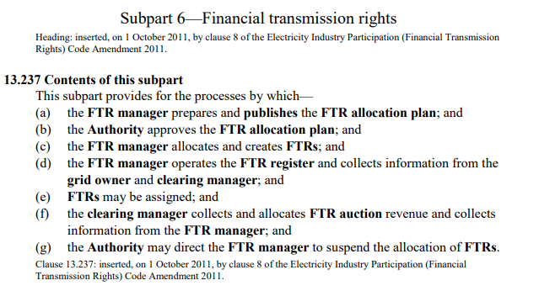
The CODE & SPA
Code & FMSPA
Fundamental requirements
Preparation of Allocation Plan
Creation, Allocation and Reconfiguration of FTRs
Auction Revenue
FTR Register
Assignment of FTRs
Auction Suspension Process
FTR SPA

Slide 6
Allocation Plan
FTR Allocation Plan
What FM must do
FTR Manager plan for operating the market
Auction Rules
FTR Products
FTR hub addition and removal process
Issued by the FTR Manager after EA approval
FTR Policies

Slide 7
FTR Policies
FTR Policies
How FM will do it
Registration
Use of the FTR Information System (a user guide)
FTR Calendar
FTR Grid and Auction Data
Prudential Requirements

Slide 8
Role of FTR Manager
Detailed in Subpart 6 of Part 13 of the Code
Prepare and publish the FTR allocation plan
Create and allocate FTRs
Operate the FTR register
Assign FTRs
Exchange information from other service providers:
Grid Owner
Clearing Manager
Pricing Manager

Slide 9
MARKET DESIGN

Slide 10
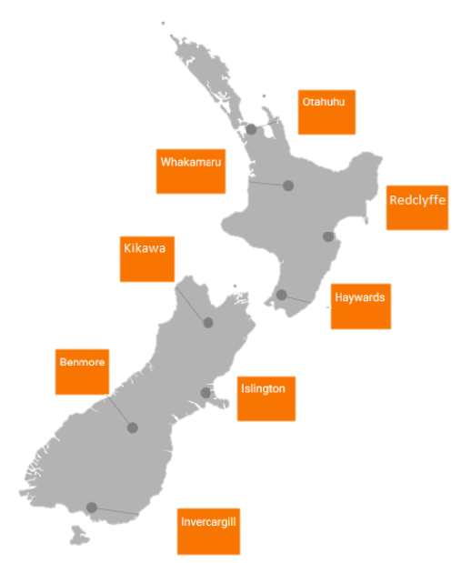
FTR Market Design Features
112 FTR Products
available
up to
2 years in the future

Slide 11
FTR Information System
Public FTR website
Portal for information and access to FTR Register
FTR Register
Open to public
Participant User FTR Information System (FIS)
Includes publicly available information (FTR Register)
Secure access for FTR Participants
Bid submission
File upload/download

Slide 13
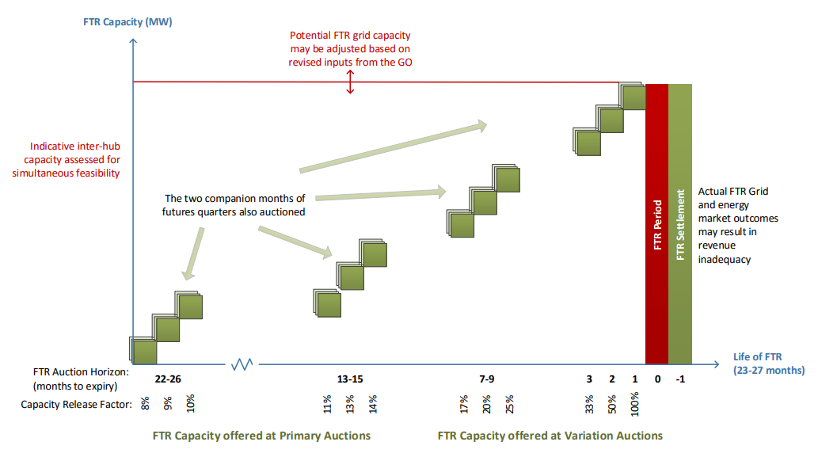
Progressive Release of FTR Capacity

Slide 14
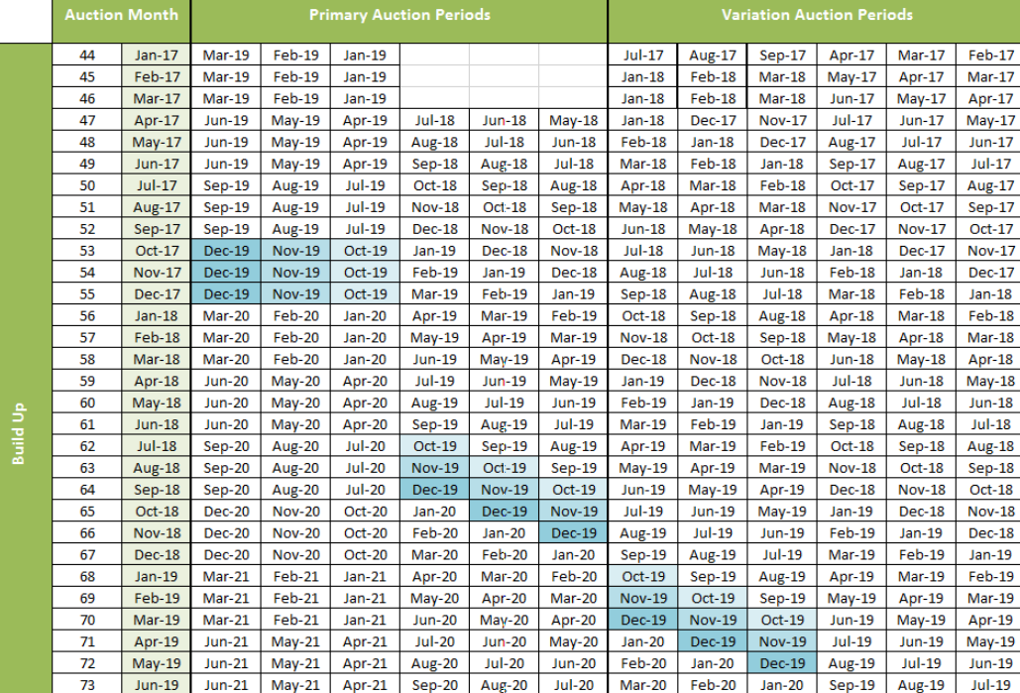
FTR Auction Schedule

Slide 15
Market Participants

Slide 16
FTR Participants – The FUG
SWET
Notes:
These are the current market participants.

Slide 17
Common issues
“This product was awarded at $XX! I would have paid that” – early on participants did not pay what it was worth to them
Anonymous market – every FTR and $$$$ is publically available
Consultations – investors vs Gentailers
Prorating tied bids
Indicative capacity
Indicative clearing prices by NZX
Conceptual understanding on FTR path vs a physical path

