Slide 1
GTAC Workshop
19 September

Slide 2
Agenda
emsTradepoint information flows to First Gas through TACOS (OATIS)
Information transfer between the two systems
Running mis-match position
Title and transfer of title
Force Majeure
Notes:
Introductions of QT + team
Explain that emsTradepoint’s success is due to having a clear vision and supporting it with innovation and agility
Explain that presentation will be broken down into two part: History/Present and Future that’s shows our vision for the gas market that is supported by innovation and agility

Slide 3
Nominations vs Trades in TACOS
Trades and nominations in TACOS will be quite separate under the new regime
Nominations:
deal with real physical requests for capacity to either:
Inject gas into the transmission system at a receipt point (the receipt quantity)
Take gas away from the transmission system at a delivery point or zone (the delivery quantity)
are subject to curtailments
Trades:
Can be:
Formed on emsTradepoint (or any other gas market)
Traded bilaterally and entered directly into TACOS
Quantities associated with gas transfers can also be entered directly into TACOS

Slide 4
Proposed eTP information flow
Three proposed options consider the regularity of information flow
Compulsory immediate flow of individual trade information when a trade has been formed on eTP
Information flow on a trade-by-trade basis (participant, volume and delivery period)
This could include day-ahead trades
emsTradepoint would be responsible for ensuring the information provided to First Gas is accurate
Compulsory frequent flow of net trade information
Timely flow of net delivery positions throughout the delivery day (participant net positions, net volume for delivery day) at regular intervals (similar to current OATIS nomination cycles)
emsTradepoint would be responsible for ensuring the information provided to First Gas is accurate
Optional flow of individual net delivery position information
Participants (via the exchange) would have the option to “opt” in their net delivery position at the end of the trading period
eTP would only be responsible for the traded volumes that have been opted in
Participants would be responsible for ensuring all other trade information provided to First Gas is accurate
Or a combination of option a and b, i.e. immediate flow of OTD trade information and frequent flow of net trade information for DA trades.
Notes:
Re b regular intervals: A new position to the market would be negative and a net delivery would be positive

Slide 5
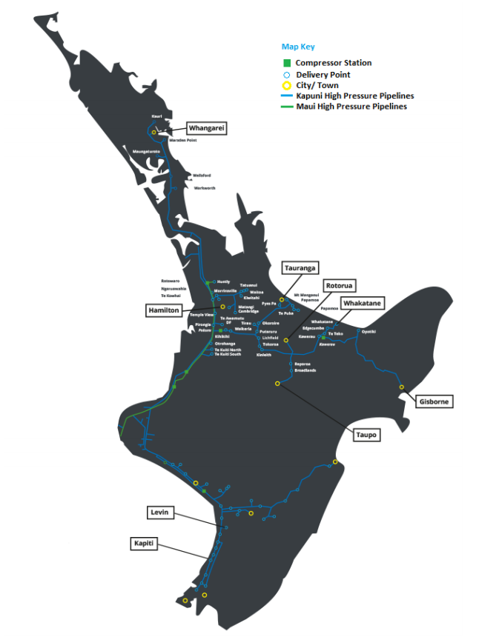
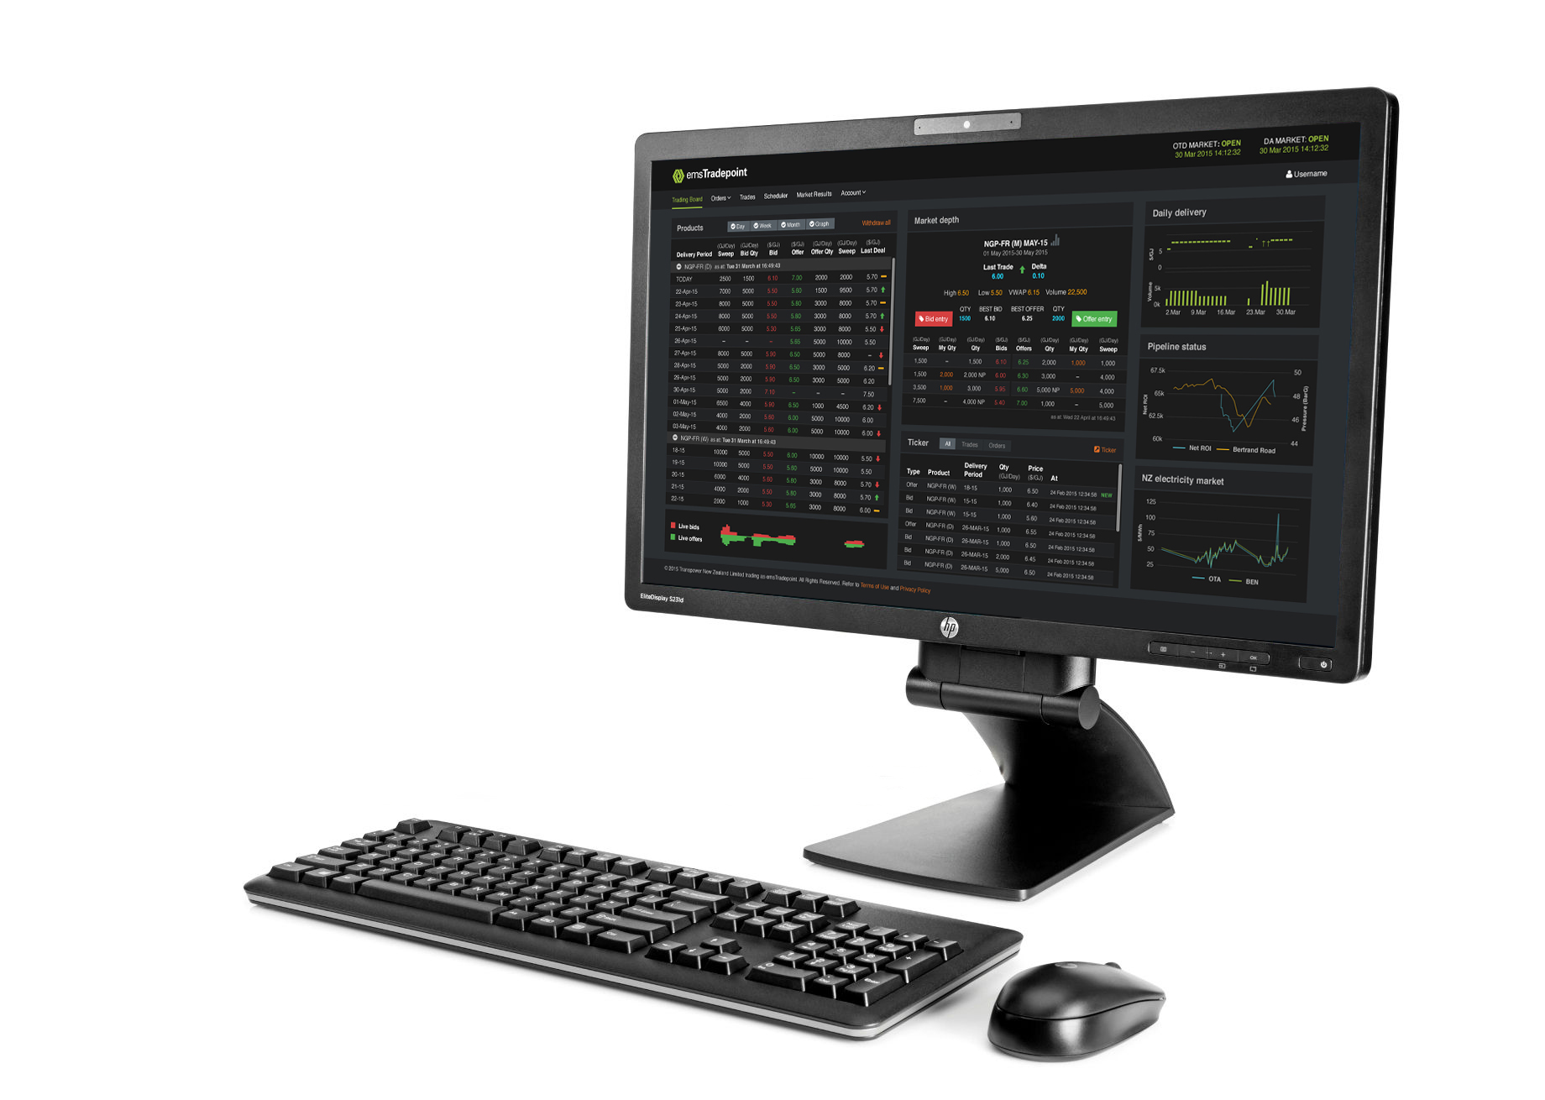
Trade and mis-match position
Receipt Points
5 TJ
3 TJ
2 TJ
10 TJ
DELIVERY ZONES
Shippers:
A
B
C
D
RECEIPT ZONE
Trades are executed here
Running mismatch exists here
20
2 TJ
5 TJ
3 TJ
5 TJ
5 TJ
Shippers:
C
A
D
D
A
2 TJ Traded
D
A
B
Delivery Points or Zones

Slide 6
Trade and mis-match position
Participants can manage their running mismatch in the receipt zone by trading on the emsTradepoint platform
The flow of information will update a participant’s mismatch position
Option a gives the most transparency to the system operator and the participant to effectively manage mis-match throughout the delivery day
Options b and c allow trades to effectively “pool” nominations in the trade zone

Slide 7
Visibility of trade information to market participants
Option a
Is more transparent than the status quo. First Gas would be privy to trade information on a trade-by-trade basis (the current nomination regime allows trading participants to net their receipt and delivery quantities at NGP-TRS)
Confidentiality would be maintained by First Gas
This information flow would not be visible to other market participants
Option b and c
The level of transparency, given the trade values are net values, does not differ from the status quo. There is also no obligation to disclose day-ahead trading before D+1.

Slide 8
Title transfer & legal arrangements
(currently under MPOC covered by nominations, needs to be covered by GTA transfer)
Sellers deliver to the Receipt Zone and buyers take away from the Receipt Zone
Title to gas passes from the seller, via emsTradepoint to the Buyer through TACOS at the Receipt Zone
A GTA seems like the appropriate legal arrangement to cover transfer of title from seller > eTP > buyer
We currently have an ICA (post MBB). We do not see a need for an ICA under the new regime
RZ

Slide 9
emsTradepoint Force Majeure
The current emsTradepoint FM rules do not affect the GTAC regime.
Only available on net volumes traded through weekly and monthly contracts.
Can apply to one or more individual delivery days.
Not available to be called for effect intraday (OTD).
Note: Changes were proposed at the most recent eTP OWG to include daily day-ahead contracts in eTP FM. There is no intention to include daily intra-day products.
eTP FM events will be considered in information flow arrangements as follows:
Option a and b
emsTradepoint will be responsible for ensuring FM has been accounted for in the information flow to TACOS
Option c
If participants “opt-in”, the exchange will account for FM and update net delivery volumes accordingly
If participants do not opt in, they will be responsible for providing the accurate trade/FM information to TACOS

Slide 10
Summary
Decision required regarding the granularity and regularity of information flows
This will determine whether information is more transparent than the status quo
Confidentiality would be maintained by First Gas
A participants position (including running mismatch) can be managed in the receipt trade zone
A GTA seems like the appropriate legal arrangement to cover transfer of title from seller > eTP > buyer
eTP FM (under the Market Rules) will not pose a challenge for trading participants because it does not apply to the OTD market. However, FM adjustments will be included in the information flow.

